Slide 1
PEOPLE WITH intellectual disabilities
Name of Lecturer
  Institution of Lecturer
00
00
0000

Slide 2
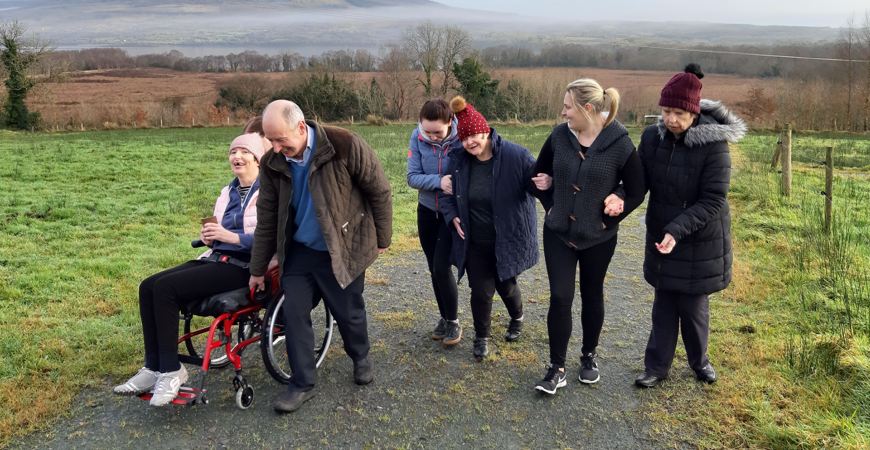
Notes:
This photo is taken at a social farm in the Northwest of Ireland. The participants are all people with intellectual and in some cases physical disabilities who came to this social farm at a time when they were transitioning from living in a centralised residential home to living in smaller homes in the local community. Social farming was a way to support these ladies with this transition. The photo highlights a number of other themes – the simple joy and happiness which social farming brings and the extent to which people of all sorts of abilities (sometimes even those with profound disabilities) can gain benefits from social farming

Slide 3
overview
Chapter 1: General Characteristics
  Chapter 2: Benefits for People with Intellectual Disabilities
  Chapter 3: Social Farming in Practice with People with Intellectual Disabilities
  Existing Services Supporting this Target Group
  Activity of Particular Relevance and Value to this Target Group
  Approach needed when working with this Target Group
  Chapter 4: Possible Behavioural References and Challenges

Slide 4
Chapter 1:
general characteristics of people with an intellectual disability

Slide 5
Intellectual disability: definition & description
No single definition but criteria* include a significant impairment in:
  General cognitive functioning
  Social skills
  Adaptive behaviour
Identified during the developmental years (i.e. childhood to adolescence)
….and has life-long implications for an individual’s capacity, functioning and development across multiple domains.

Slide 6
Intellectual disability: further description
Some mental health, neurodevelopmental, medical and physical conditions frequently co-occur in individuals with intellectual disability:
including cerebral palsy, epilepsy, ADHD, autism spectrum disorder, depression and anxiety disorders.
Dual diagnosis (DD): co-existence of intellectual disability (ID) and psychiatric disorder (double incidence in general pop.)
Life expectancy has increased substantially but on the whole poorer health, greater health needs, and shorter lives than general pop.
Notes:
Examples of health issues which are particularly prevalent include: vision and hearing impairment; a greater likelihood of being either underweight or obese; poor levels of physical activity, fitness and agility; greater incidence of diabetes and cardio-vascular disease, high incidences of gastro-intestinal problems.

Slide 7
Levels of severity and impacts
SEVERITY | COMMUNICATION | BASIC SKILLS | SUPPORTS NEEDED
Mild | Difficulty in complex language concepts. Able to do simple multiplications/division, to write simple letters, lists, etc. | Basic self-care & home activities. Able to complete basic job app, have some independent job skills; use public transportation | Supported as needed basis Can achieve relatively independent living and employment with appropriate supports
Moderate | Limited to basic language skills. For e.g. could copy address from card to job application, match written number to number of items | Some may master basic self-care, home activities and use of public transport with repetition and with appropriate supports/supervision | Most require consistent support in order to achieve independent living and employment as adults
Severe | V. limited language and capacity for acquisition of academic skills | May also have motor impairments. Require daily supports | Regular, consistent lifetime support in school, work and home
Profound | V. limited communication abilities. | May also have motor & sensory impairments. Require daily supports and supervision | High intensity supports needed across all environments

Slide 8
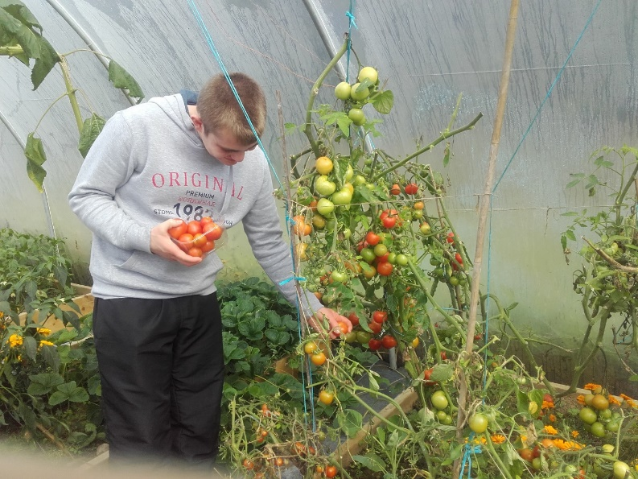
In the social farming context, level of severity will have an impact on factors such as:
……will all impact on their behaviour, their experience on the farm and the benefits they experience
  ability to understand instructions or processes
  level of fine/gross motor skills
  social skills, capacity to communicate needs and preferences
  physical capacity of people to engage in different activities
  Most of all, supports needed to enable people to participate in and maximise the benefits from social farming
© Social Farming Ireland
Notes:
Overall, most people, regardless of the severity of their disability, can derive benefit from social farming. This may be purely sensory – to be out in the fresh air, smelling new smells, getting to rub the animals, handling unfamiliar things, hearing new sounds like the animal noises, birdsong etc. Or it might be the pleasure and novelty of being in a home rather than institutional environment with, for example, an open fire, or meals eaten in an ordinary kitchen using ingredients grown on the farm. With the correct supports and with creativity and imagination, the level of severity of disability should not be a barrier to spending time on a social farm.

Slide 9
Chapter 2:
Benefits of social farming for people with intellectual disabilities

Slide 10
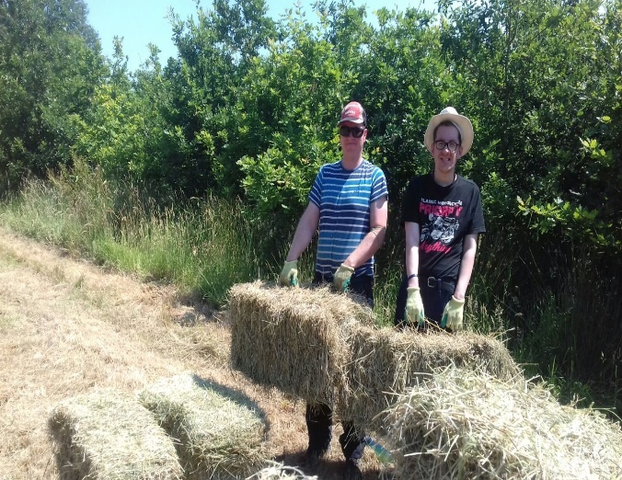
PERSONAL AND SKILLS DEVELOPMENT
  The farm as a ‘space of capability’
  Skills acquired inherently practical and valuable
  ‘Learning through movement’ , through doing, through repetition
  Huge variety of activities
  Allows participants of varying interests and capacities to exercise:
    Choice
    Independence
    Mastery and refinement
    Autonomy
© Social Farming Ireland
“The work gives the clients self-confidence, they know they can achieve something, they know something depends on them entirely, they are responsible and that they have been entrusted with this responsible work. We are talking about care of the forest, care of the garden, and care of the animals.”

Slide 11
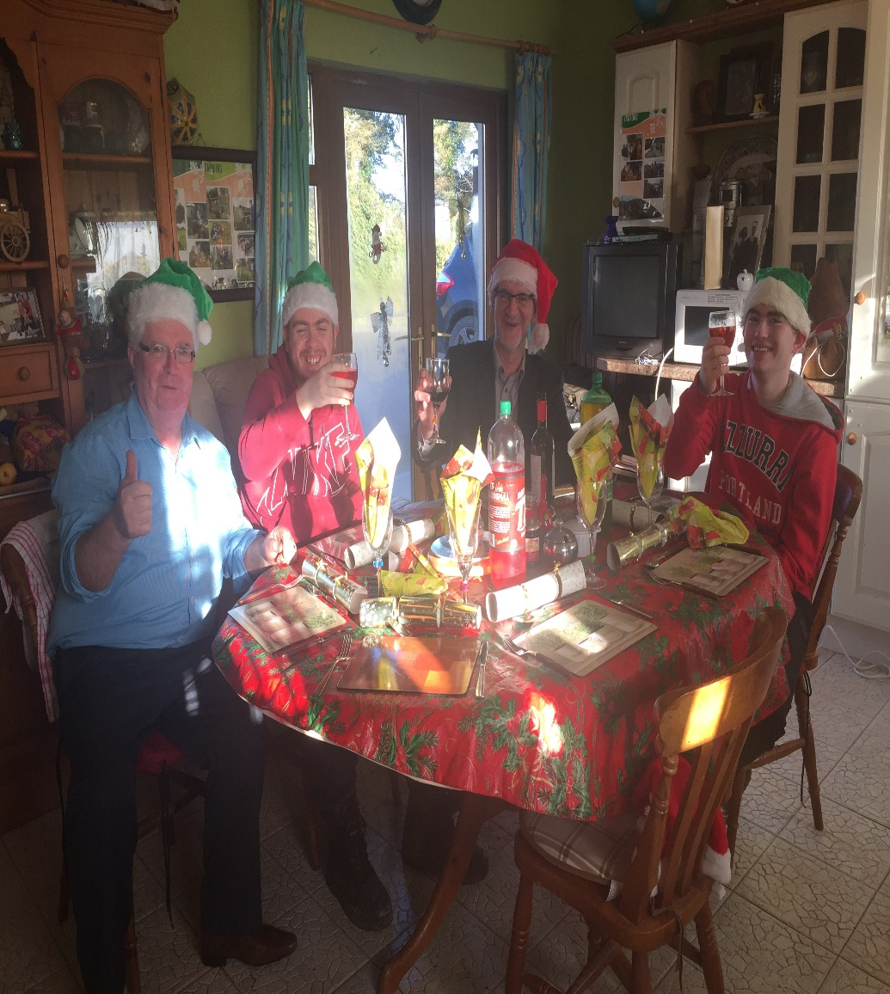
SOCIAL CONNECTION AND FRIENDSHIP
  Social networks of people with ID can be limited: social, spatial, cultural exclusion
  Expands the network in a very natural, organic way – inside and outside farm gate
  Group nature of activities
  Meaningful relationships outside of professional settings
  FUN
“A big part of the day is to have the meal together, if possible outside. We had a music session every time people came here with some singing and I play the guitar.”
© Social Farming Ireland
Notes:
Note participants having a Christmas party at the end of the social farming day in this photo. Many people will never have gotten to have a ‘work’ Christmas party, so this is something special for them.

Slide 12
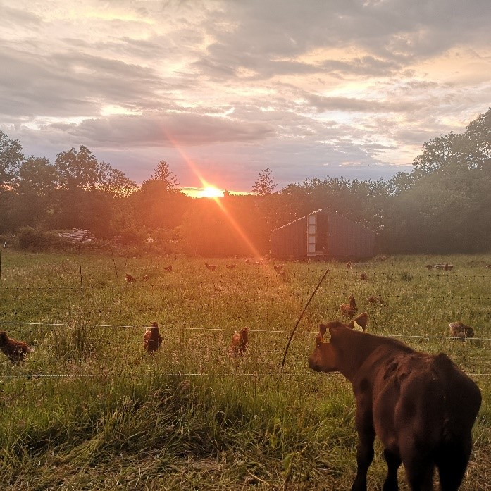
CONNECTION TO NATURE
© Social Farming Ireland
  Positive effects of caring for (plants, animals, each other) rather than being cared for
  Time with animals: calming, reassuring, non-judgemental
“There are times when I look at A [participant] and I think, what is he seeing? I think he is seeing things I’m not seeing. Nature is around him, nature is chatting and he responds to it. I think the people who come to me are more connected to the elements than we are.”

Slide 13
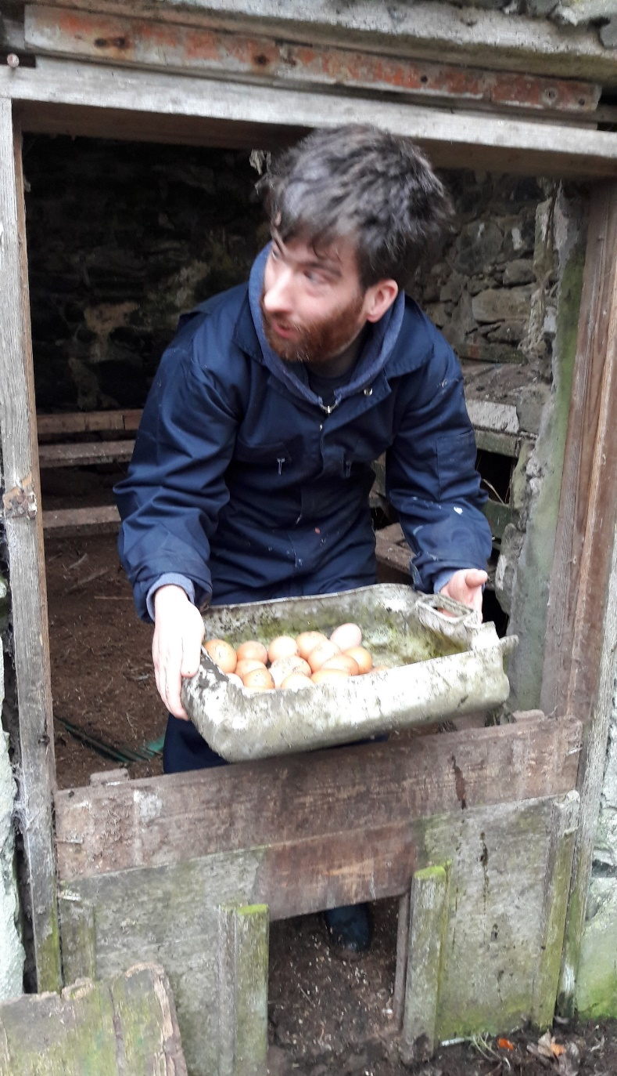
MEANINGFUL ACTIVITY
  Real, socially valuable work (the ‘fundamentals of life’)
  Clear results attached to what people do
  Part of a farm team, not feeling ‘less than’
  Can be especially valuable for men with intellectual disabilities
“The meaningful work bit is very important. That’s the thing that it really brings and where the gap is for lots of people. People may have really active lives outside of their service but the real, meaningful work, there is so much to be gained from it. People can see the reason for what they’re doing, can see the end result. Something like feeding the animals, they need to eat and the participants help with that.”
© Social Farming Ireland

Slide 14
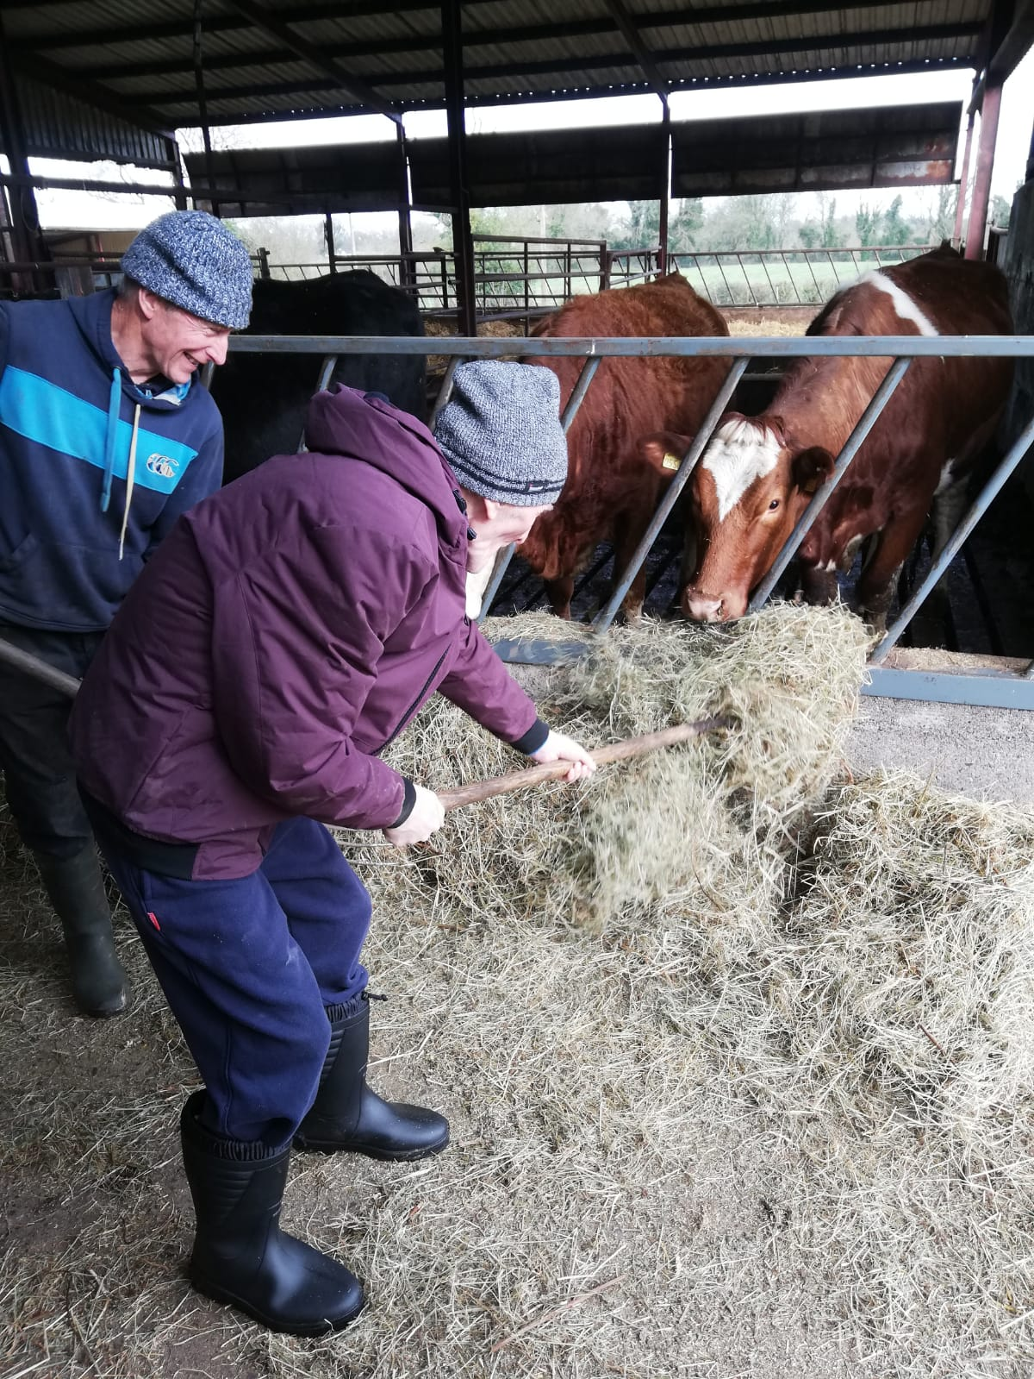
IMPROVED HEALTH &
WELL-BEING
Wide range of activities with potential to improve health and well-being and develop physical capacity – walking, lifting, sweeping, digging, carrying, bending…….
…. but in a very easy, natural way, culturally relevant way: “I’m going out farming”
© Social Farming Ireland
Notes:
For men in particular who may not wish to take part in some of the ‘activities’ typically on offer in a service context, it is really valuable to have this option which enables them to be doing something which makes sense to them, which is closely allied to what their peers might be doing, which is of cultural value

Slide 15
Chapter 3:
Social Farming in practice with people with intellectual disabilities
  Existing Services Supporting this Target Group
  Activity of Particular Relevance and Value to this Target Group
  Approach needed when working with this Target Group

Slide 16
EXISTING SERVICES SUPPORTING THIS TG
Gradual shift from the medical model of provision to a social model
Social and cultural movements for change, increased expectations for quality of life, demands from people with disabilities themselves and their families/advocates for greater autonomy, independence and choice.
Significant variation in the progress in making this a reality and in changing how services are delivered.
Key actors: the state, non-governmental organisations, charities working with people with intellectual disabilities, advocacy groups, families, etc.,
The relative importance of each varying from one country/culture to the next.
Notes:
Bullet point 1….which aims to be more person-centred, inclusive and community based (Wolfensberger, UN Convention, etc.)

Slide 17
EXISTING SERVICES SUPPORTING THIS TG
Type of Support | Relevance to Social Farming
Informal care and support, largely within family structures | Minimal formally, but people may work on own family farm or that of neighbours, friends
Institutional/congregated residential settings | High: Such settings may have own farms and gardens or support people to go ‘out’ to farms
Residential supports but in community setting | High: May be an excellent way to develop links with local community, provide supported employment (e.g. in Ireland)
Sheltered Workshops | High if they are farm/garden based sheltered workshops (e.g. in Germany)
Supported Employment | Could be availed of in a farm setting
Non-residential day services | High: SF an opportunity for people to participate in local community, develop skills, make friends, etc.
Individualised budgets | If person is interested, can use budget to avail of SF and/or personal supports necessary to access SF (e.g. as in Netherlands)

Slide 18
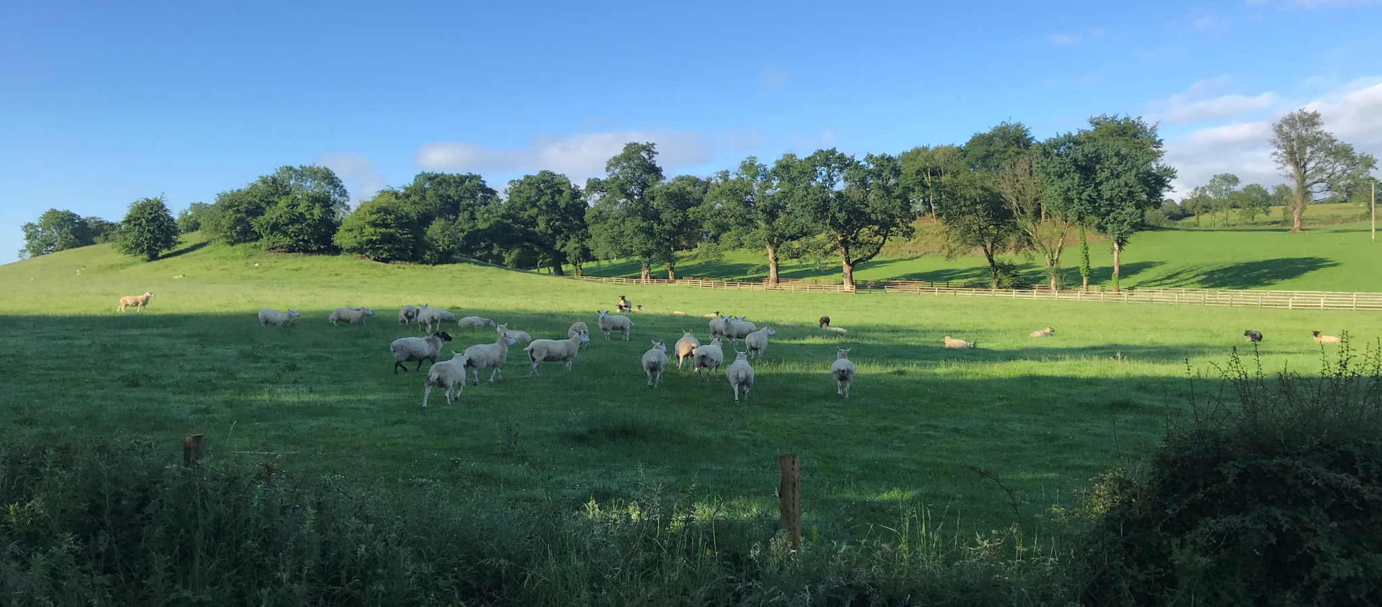
Group exercise
Discuss how the social farm environment could be more beneficial for some people with intellectual disabilities than the more usual options such as attending a day centre, remaining in an institutional setting, etc.

Slide 19
ACTIVITY OF PARTICULAR RELEVANCE & VALUE
  All individuals, with their own set of skills, interests, strengths, challenges and weaknesses.
  Process of discovery - what are participant’s capacities, preferences, skills, interests and challenges?
  An evolving mix of activities which balances the needs of the participants and the needs of the farm - needs of the participants predominate.
© Social Farming Ireland

Slide 20
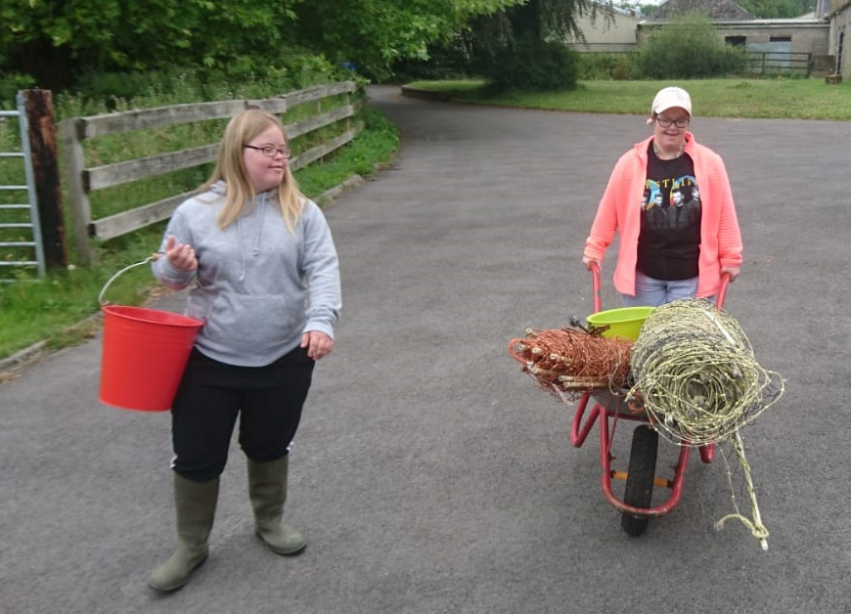
ACTIVITY OF PARTICULAR RELEVANCE & VALUE
Ordinary Farm Tasks
Things that need to be done should form core of time on the farm
Don’t need to invent things
‘Real’/commercial farm an advantage over institutionalised farm
© Social Farming Ireland

Slide 21
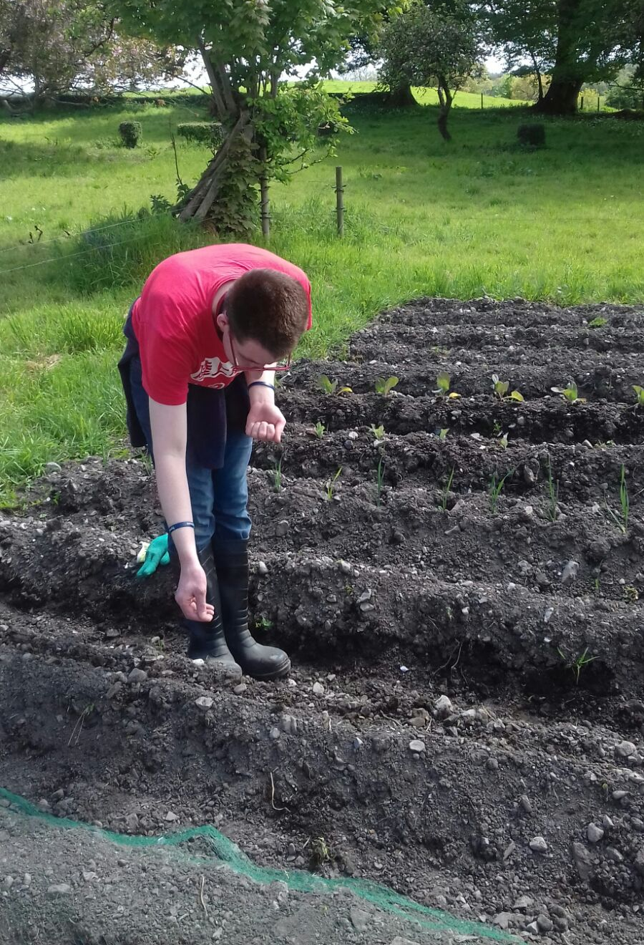
ACTIVITY OF PARTICULAR RELEVANCE & VALUE
Activities with clear outputs/results
  Clear, even visual output very important
  “Everything that concerns harvesting usually works very well. I always find that very nice. Because the work you put in beforehand can be seen in the finished product, which is harvested, lying in a box and weighed. Sorting, weighing, harvesting, transporting, these are things that are really very easy to motivate to. That's fun for everyone. You can see what you've done. These are things that work very well.“
© Social Farming Ireland

Slide 22
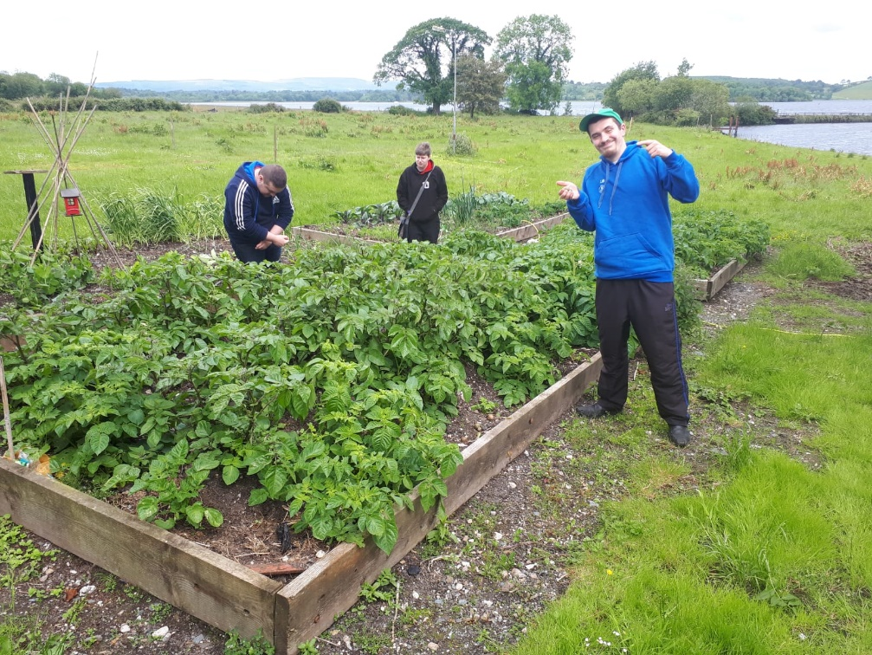
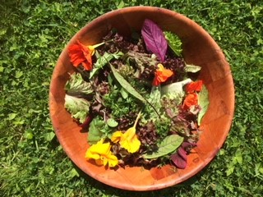

ACTIVITY OF PARTICULAR RELEVANCE & VALUE
Activities which are connected to one another
  A chain of connected activities which are noted (e.g. food production)
  Involvement in full cycle difficult to replicate elsewhere
© Social Farming Ireland
© Social Farming Ireland

Slide 23
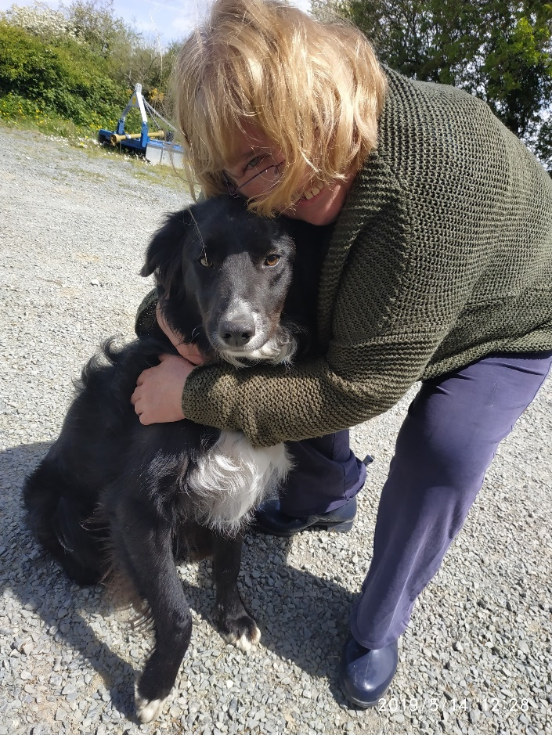
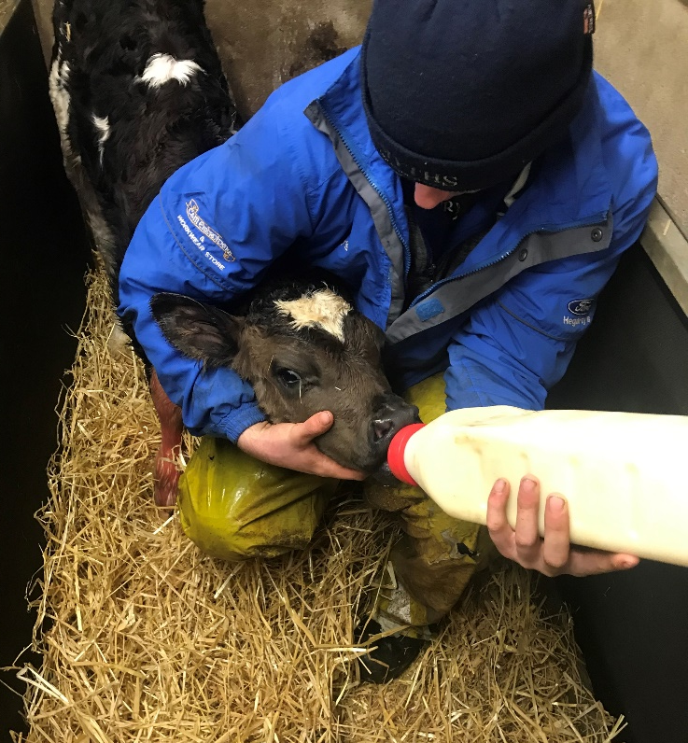
ACTIVITY OF PARTICULAR RELEVANCE & VALUE
Real access to animals and nature
  Up-close and tactile, real connection
  Supported to overcome fears if they are there
© Social Farming Ireland
“Well the horse was really popular among our clients. It truly was a kind of therapy. We had a client who used to warm herself up while leaning to the horse. Their temperature is really high.”
“You have to give time and space in the day to just ‘be’ with nature.”
© Social Farming Ireland

Slide 24
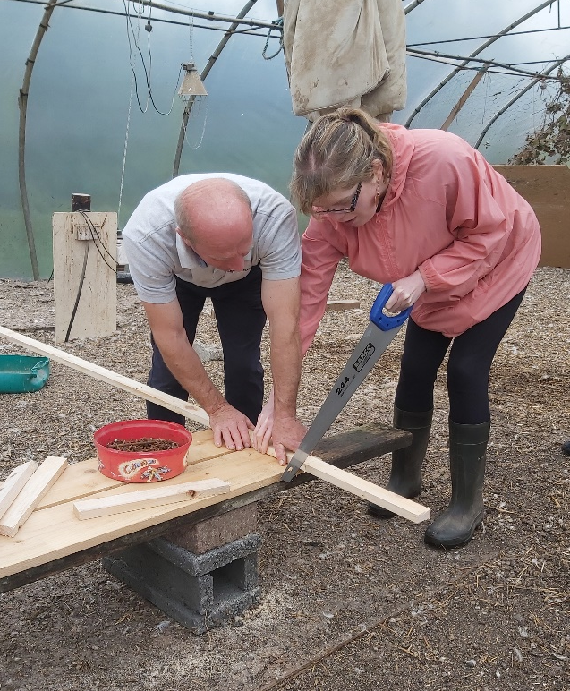
ACTIVITY OF PARTICULAR RELEVANCE & VALUE
Activities which allow for positive risk-taking
  Normal life can be characterised by risk minimisation and paternalism
  The farm a live environment where people can be supported to take risks, extend themselves
  Sense of freedom and space
  Access to machinery Creative approaches to doing so….
“In the forest they also like it because it is full of action, we often burn branches there and that is what they like. Well, especially our male clients. They do not really enjoy planting trees, but other forest works they do enjoy.”
“The machines are important because everyone likes to use as much technology as possible.... Most clients like to work with machines They also want to be a little bit in the centre through this. ‘I can handle technology’. This is very important. ‘I can already do more than others. I'm the one who can handle a lawn mower, the power saw, the chain saw, or even the tractor or our lawn tractor.”
© Social Farming Ireland
Notes:
Re. bullet point 4 and creative approaches to doing so….it can be as simple as allowing people to sit on the machinery, or maybe adapting and using the smaller tractor or piece of machinery so that the person can feel important and valuable.

Slide 25
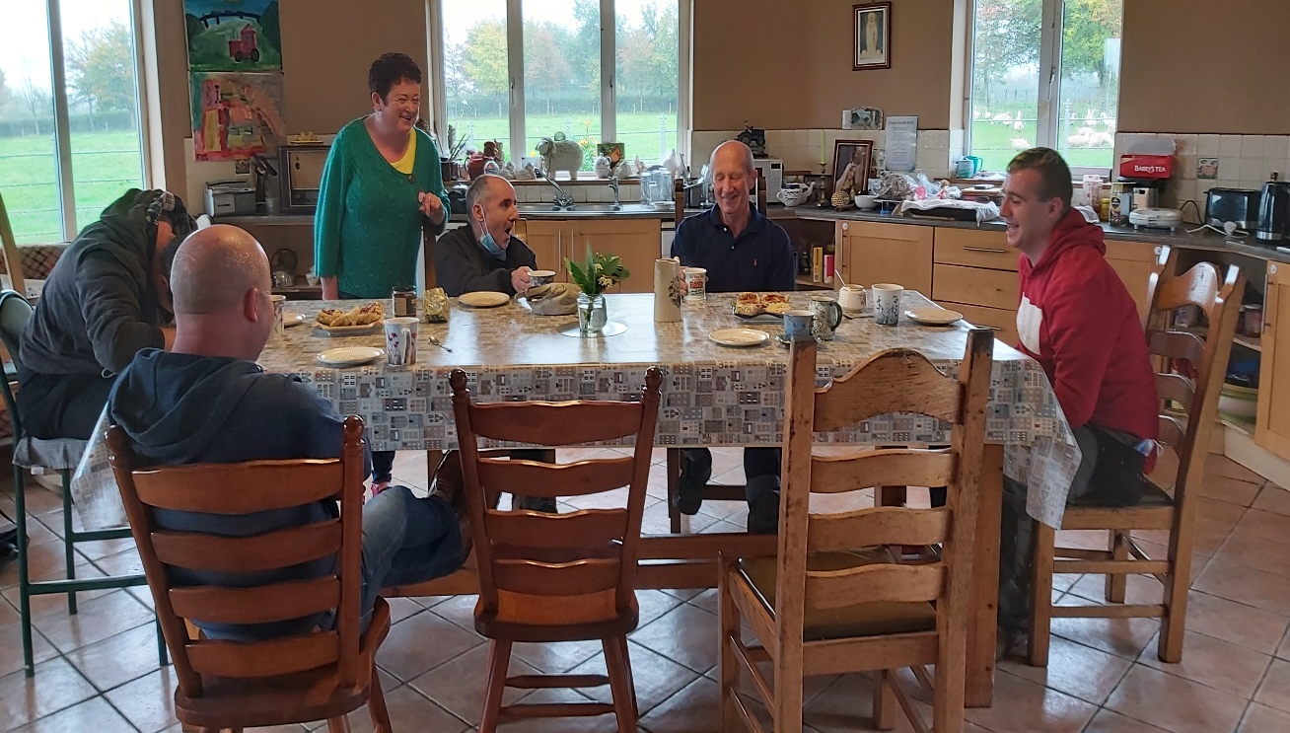
ACTIVITY OF PARTICULAR RELEVANCE & VALUE
Activities with a strong social dimension
“Fun activities around the holidays, just having fun together. I think for participants it adds value to their lives. Their world is generally small, they interact with the public here and get to know more people.”
© Social Farming Ireland
“And they have an environment here where they feel as comfortable as possible and where work is not only in the foreground, where leisure activities also take place…..Certain excursions are also made from time to time. Or we just play cards or today is a rainy day, ‘okay, let's take it easy. And that's also part of it.“
Notes:
Photo shows participants and farmers sitting at the table having tea and scones (buns) in the farm kitchen at the beginning of the day. This is where they exchange news and talk about what they are going to do for the day. We say in social farming that the kitchen table is the most important piece of farm equipment!

Slide 26
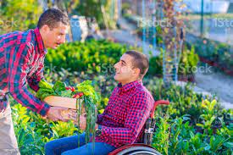
ACTIVITY OF PARTICULAR RELEVANCE & VALUE
Activities which engage with the ‘outside’ world
  Esp. relevant for those in residential services
  To be out there in the world, observing,
  being part of commercial activities
“The employees can also stand out or prove and show themselves, because we also have contacts with the outside world. We deliver the goods. And they like that. That you drive to the shop, show yourself. And when customers come to our garden, they enjoy serving the customers.”

Slide 27
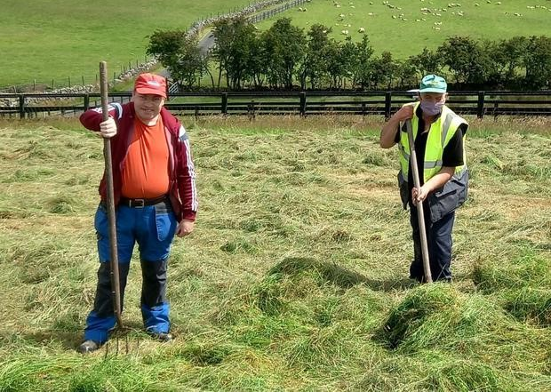
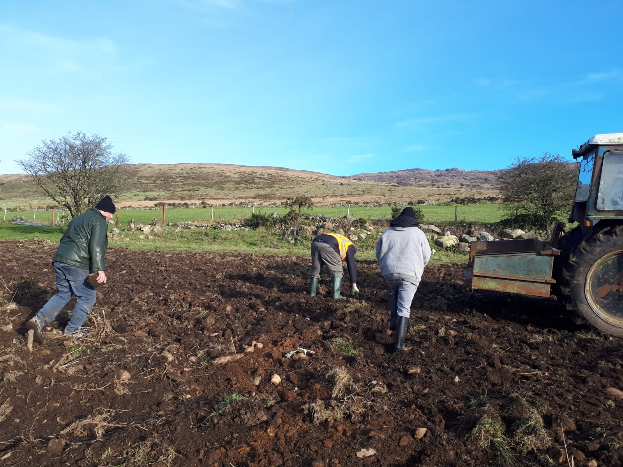
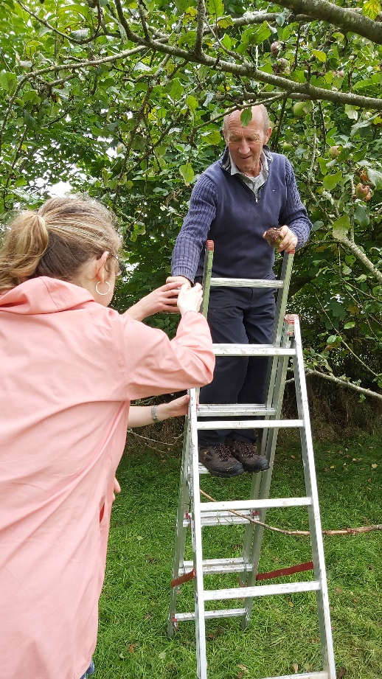
ACTIVITY OF PARTICULAR RELEVANCE & VALUE
Activities which encourage natural physical activity
“One of the great things about social farming is that everything is happening in the background, like exercise without having to be named and labelled as such. That is the beauty of it.”
“Here it starts with a walk uphill to the vineyard, then you’ve already had quite a physical effort. That’s just the start of the day.”
“The physical work was all new to them but noticed at the end of the 10 weeks their concentration and ability to work had really improved.”
© Social Farming Ireland (3x)
Notes:
There is a huge amount of natural activity on a farm, including walking (sometimes on uneven surfaces and up hills) , running after animals, digging, lifting, sweeping, chopping, carrying, stretching to do things. It all develops fitness, strength, agility, brings about positive tiredness, etc.

Slide 28
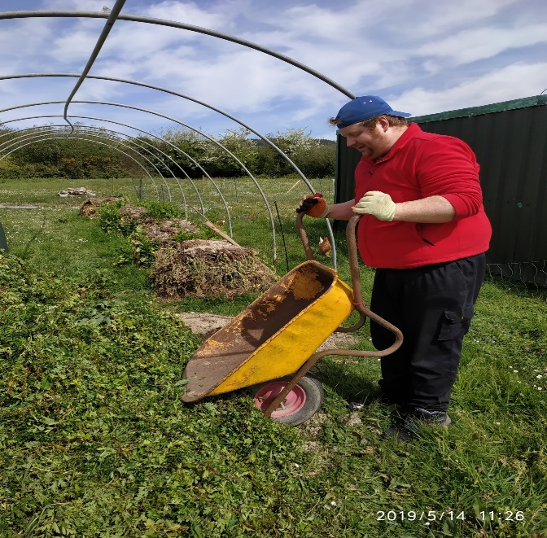
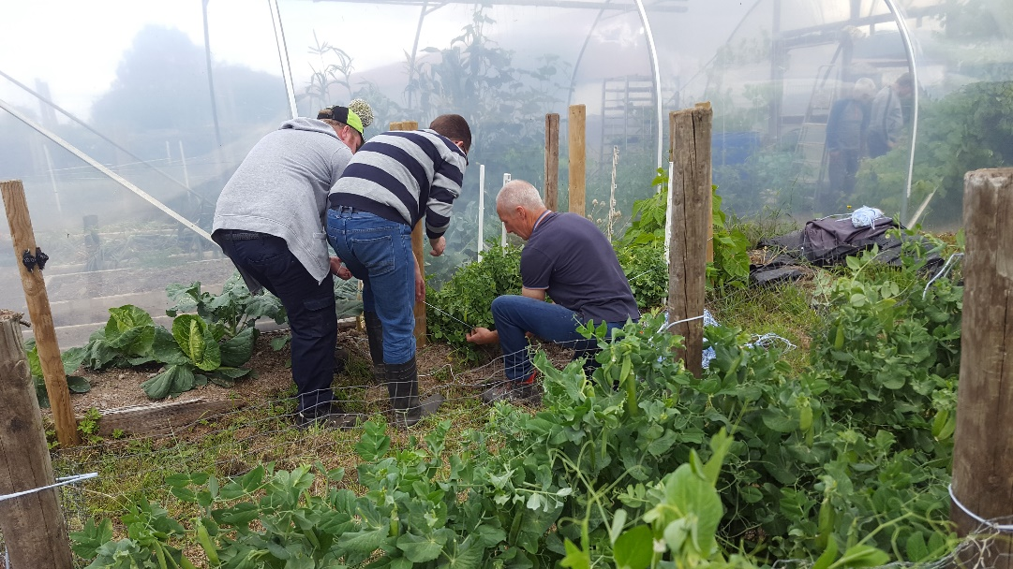
APPROACH NEEDED WORKING WITH THIS GROUP
Treat People as Individuals
  Encompasses a very wide range of abilities, needs, challenges, potential
  Need to actively manage and mediate between different needs and capacities
  Encourage people to find their niche, encourage ownership of it.
© Social Farming Ireland (2x)
“The work in the fields or in our stables is very individual and very different, depending on how much the respective employee needs to be supported. We sometimes have people who, after brief instruction, take on a task completely independently: mucking out the barn, planting a vegetable patch, feeding ducks or geese.”
Of course, there is also the completely different case where employees have to or want to join the farmer in all the time. And then we are almost always with this person.”

Slide 29
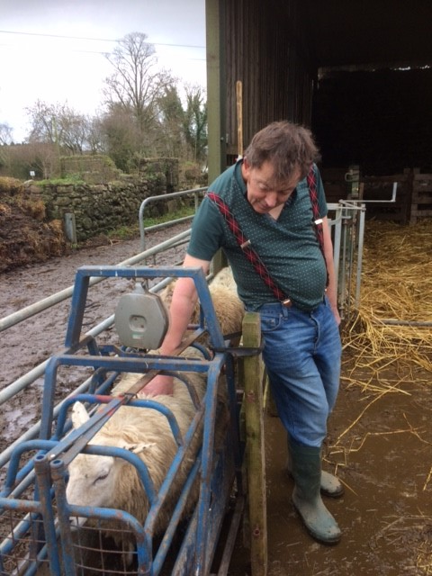
APPROACH NEEDED WORKING WITH THIS GROUP
Allow Opportunity for People to Grow and Develop
  Sharing of any previous knowledge and ideas should be encouraged.
  Involvement should be as wide and as deep as possible
  Level of responsibility & meaning can and should increase
  May (should?) include things which people find boring or even difficult – normal life
© Social Farming Ireland
“Some really enjoyed the projects we did or even suggested projects. ….Another lad suggested raised bed for the garlic to grow better and it did. A few of the lads had spent a lot of their time working on the farm in the service and it came back to them and we did learn stuff from them.”
“Our clients are involved in virtually everything within both horticultural operations. They also participate in the management and running of the business (e.g. growing programmes). The work is always distributed with regard to the individual abilities of each client.”
Notes:
Re bullet point 2: you should try and stretch people outside of their comfort zone, ensure that they get to try new things and also get to improve and master some things.
Re bullet point 4: A person centred approach does not mean people getting to do everything they want or like. Part of living a full and normal life comparable to ones peers involves doing some things which are tedious, boring, repetitive or just not so enjoyable. It is all part of the mix!

Slide 30
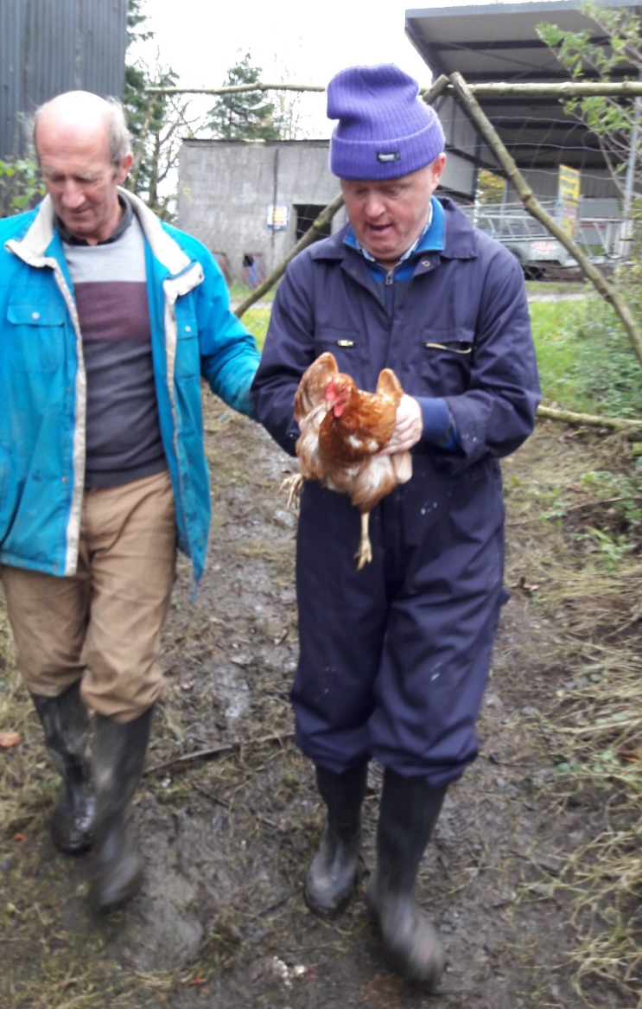
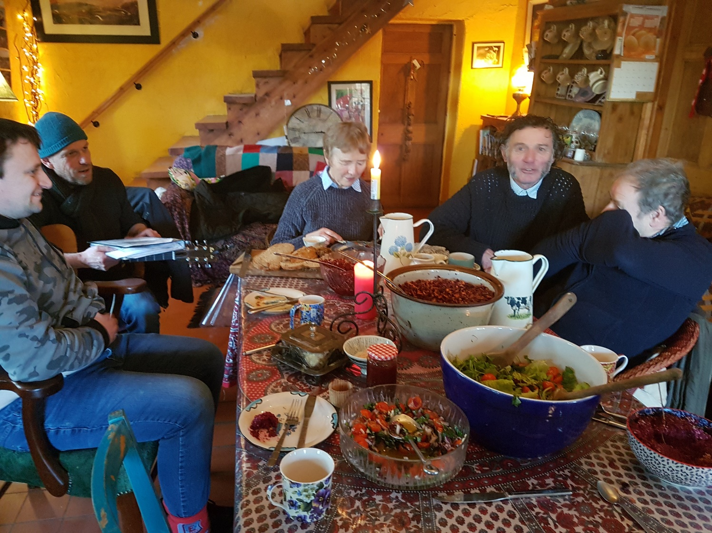
APPROACH NEEDED WORKING WITH THIS GROUP
Create a relaxed and homely atmosphere
Informal, family-type atmosphere important
Being in tune with people’s wishes and moods on a given day
Avoid excess stress or pressure from productivity demands
© Social Farming Ireland
© Social Farming Ireland

Slide 31
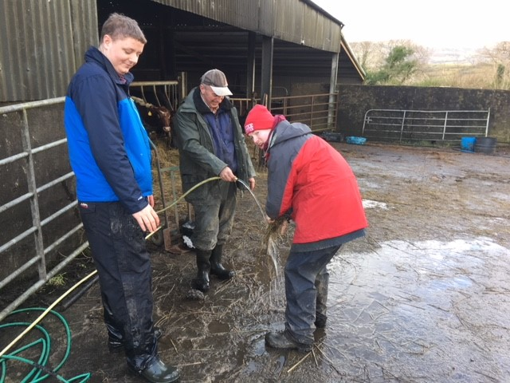
APPROACH NEEDED WORKING WITH THIS GROUP
Be authentic,‘real’ and open
Meet the person as a person
Avoid any tendency to patronise people or treat as children
Need to be able to respond to openness of participants, possibly fewer social boundaries
“I take people at face value. I don’t care what difficulties they have because I have learned through my job and life that we all have difficulties and if we can meet in one place and try and make life easier for another and build a relationship that’s what it’s all about. ….some might have cognitive disabilities but they still have 40 or 50 years on the earth and they can tell when someone genuinely sees them as an equal or doesn’t. You develop trust based on that, the lads will be quite good at reading people, they’ve seen all sides of humanity, the good and the bad.”
© Social Farming Ireland
“You have to be grounded in yourself first of all. Be yourself and let them be themselves as much as possible. Create the space for the cups of tea, they are the little oasis in the working day. The conversations go on, about football or whatever. Just normal conversation.”
Notes:
Bullet point 3: people will find themselves responding more openly and sharing more of themselves and their lives than is typical in a professional setting

Slide 32
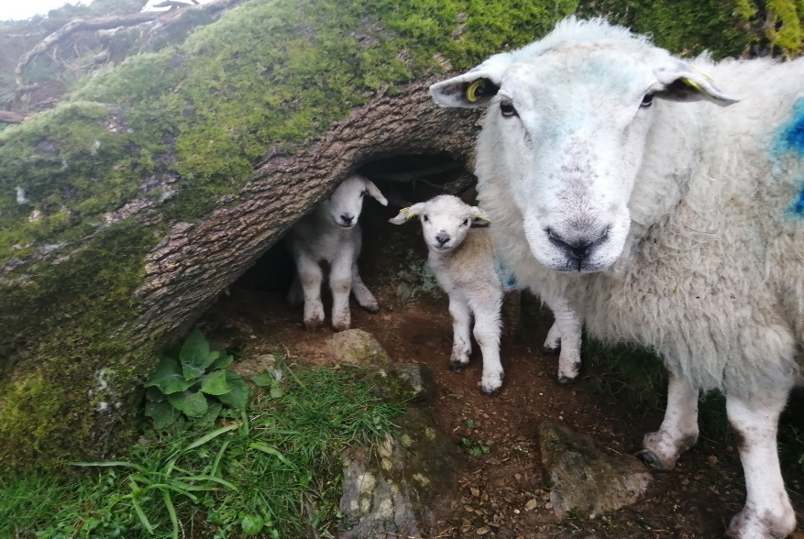
APPROACH NEEDED WORKING WITH THIS GROUP
But the farmer is ultimately in charge and in control
Necessary to ensure the safety and welfare of all and that tasks are done
Balance constantly struck where it is a place of warmth and friendship but also of work and potential risk
Different approaches needed for different people
© Social Farming Ireland
“Nevertheless, there still has to be a certain boss-employee relationship. However, I only emphasize the boss in case of emergency. If a conflict arises, then I take stronger action at that moment and also speak a few serious words. But otherwise we are quite unconventional. Everyone has their own line. It's always such a tightrope walk. The people have to know, and they can't cast doubt on that.”
“So there are some who rather appreciate this relationship boss - employee or a clear leadership role. In these cases, I give very clear instructions and I am the boss. But there are also others with whom you have to communicate in a completely different way. That's a bit difficult for me to describe. So there are some relationships that are like father - son or father - daughter.”

Slide 33
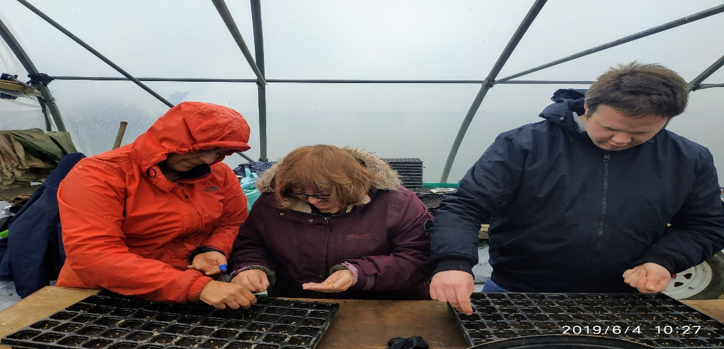
APPROACH NEEDED WORKING WITH THIS GROUP
Patience and Clarity
Patience in getting to know people, in carrying out activities, in dealing with slower pace
Very clear instructions, breakup tasks into smaller ‘pieces’, repeat and clarify
Demonstrate and show how things are done, work alongside
Continual motivation and encouragement often needed
“You have to break difficult things down into simple steps. Complex things have to be done one after the other. When you have to do a more complex job, you first try to explain it simply with simple words. And words alone are not enough. You have to show again and again, participate. If the employees have never done a certain job before, then only an explanation is not enough. You have to give practical instructions again and again. If the employees are to do a certain job, ….then I have to show them how to do it and join in…. Not only the word, but action.”
“You can’t rush people to finish things, I am happy to work on something as long as they want to….Of course some jobs have to be done but you take it at their pace, even if it takes 2 or 3 times longer.”
© Social Farming Ireland

Slide 34
Chapter 4:
Posibble behavioural references and challenges
Notes:
Generally spoken a correct basis attitude, sufficiently social skills, affinity and experience
with the target group is more important than having specific diplomas. There are several possibilities to require necessary knowledge and skills.

Slide 35
Changes in Mood
  Emotions often expressed rather than repressed (sometimes a positive)
  Changes in mood can be swift
Sensitivity to mood crucial so things can be dealt with
Famers need to above all remain calm and in control themselves
Strategies to manage potentially challenging situations before they arise
Potentially great learning environment for people in regulating emotions and dealing with other people
“And that's the way it is: When emotions are there, they are let out. Either by shouting or something is thrown. Joy is also let out right away. Every day is a new challenge.“
“And what you always have to keep in any case is calm, even if a situation escalates. If you then become hectic, that's very bad. So even in a situation like that, you have to try to remain as calm as possible.“
"They learn to deal with emotions and setbacks. They also learn tools that will help them, for example, in an incident where they throw a chair, to think about talking to the supervisor first. That this can prevent them from exploding."

Slide 36
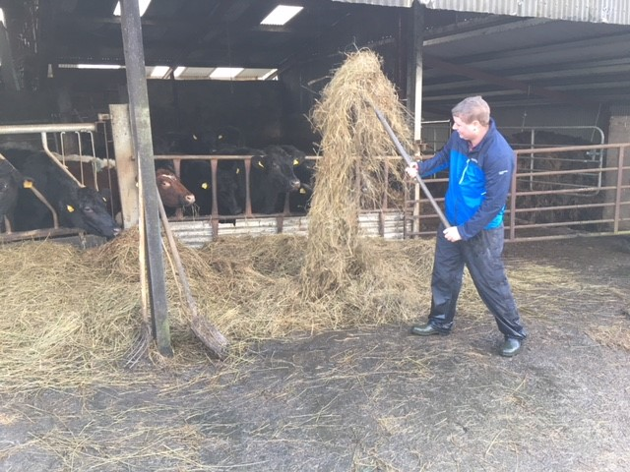
Lack of Motivation and Work Ethic around some tasks
  Reality of boring or unpleasant tasks but which must be done from everyone’s perspective
Break tasks up into intermediate goals; distribute tasks fairly; switch things around; work alongside people; make sure groups are otherwise enjoyable.
Certain level of grumbling/complaining normal – and humour can help defuse
“There are a few tasks that no one likes to do. Then there's a clear plan. It's everyone's turn, for example, to clean a pigsty. Then you take turns. Or weekend duty: Not all employees can work weekends, but some can. We currently have five employees on weekend duty. They take turns. Every Sunday, one of them is on duty.”
“Then I always try to put together a troop that harmonizes. That is a crucial factor here. The biggest challenge is to get the people involved so that they enjoy the work to some extent. That doesn't always work.“
© Social Farming Ireland

Slide 37
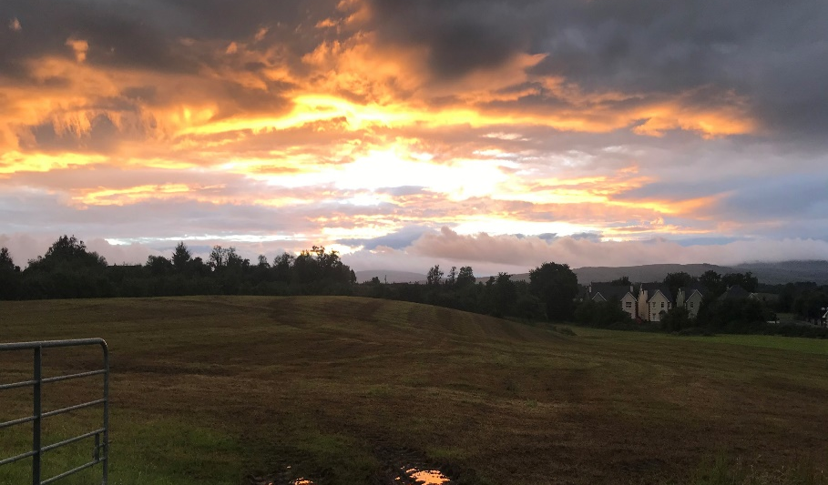
Conflict/Lack of Connection between Participants
  Can arise like anywhere but capacity to resolve can be limited
Observe and get to know the personalities, the potential clashes
Take advantage of the space and variety the farm environment offers for ‘time away’ from each other
Separate people, assigning to different tasks
Put people in harmonious sub-groupings
Minimise stressful/pressurised scenarios
“It is important to form small groups….that harmonize with each other. I can't combine everyone with everyone. It does not work…I have to recognize that and partly correct it if it doesn't work and then rearrange it again. That's an important thing that I have to pay attention to.“
“But actually we have so much space and area in agriculture that you can get out of the way. So when our farmer realizes that things are "boiling" between two people, one of them comes along on the tractor and the other one works in the landscaping.”
© Social Farming Ireland

Slide 38
Group exercise
Imagine that you are approached by a social farmer who is about to start working with people with intellectual disabilities for the first time. After this presentation, what are three key pieces of advice you would give the farmer?

Slide 39
Bibliography
Baars, E. M. Elings & Jan Hassink (2008) Qualities and effects of care farm De Hoge Born. Wageningen, Wageningen University and Research, Louis Bolk Institute, Lievegoed Zorggroep & Zideris.
Hall, E. (2010). Spaces of wellbeing for people with learning disabilities. Scottish Geographical Journal, 126, 275–284.
Fallon, G. & Kilgallon, E. (2014). The perceived impact of caring for animals on adults with a learning disability: An exploratory study. Southern Health and Social Care Trust.
Hassink J., Elings M., Zweekhorst M., van den Nieuwenhuizen, N. , & Smit A. (2010). Care farms in the Netherlands: Attractive empowerment-oriented and strengths-based practices in the community. Health & Place 16(3), 423-30.
Leck, C., Upton, D., & Evans, N. (2015). Growing well-being: The positive experience of care farms. British Journal of Health Psychology.
Patel DR, Apple R., Kanungo S, Akkal A. Narrative review of intellectual disability: definitions, evaluation and principles of treatment. Pediatric Medicine 2018; 1:11.
Rotheram, S., McGarrol, S. & Watkins, F. (2017). Care farms as a space of wellbeing for people with a learning disability in the United Kingdom. Health and Place, 48, 123 -131.
Wolkorte R., van Houwelingen I. & Kroezen M. (2019) Challenging behaviours: views and preferences of people with intellectual disabilities. Journal of Applied Research in Intellectual Disabilities 32, 1421–1427.

Slide 40
THANK YOU FOR YOUR ATTENTION
Name of Lecturer
  Institution of Lecturer
name@xyz.com

Slide 41
Farming with Refugees and forced displaced people - Agriculture as a path of inclusion © 2023 by SoFarTEAM is licensed under CC BY-NC 4.0.
To view a copy of this license, visit http://creativecommons.org/licenses/by-nc/4.0/
The slides were created by Aisling Moroney
Contact:
Social Farming Ireland
Leitrim Development Company
Church Street
Drumshanbo
Co Leitrim
amoroney@ldco.ie

