Slide 1
Farming with Refugees and forced displaced people
Name of Lecturer
  Institution of Lecturer
00
00
0000

Slide 2
  Convention and Protocol Relating to the Status of Refugees, 1951
“A refugee is a person that is persecuted for reasons of race, religion, nationality, membership of a particular social group or political opinion.
[A refugee is a person, that] is outside the country of his nationality and is unable or, owing to such fear, is unwilling to avail himself of the protection of that country […].”
Notes:
The term refugee is political agreed on by international law and leads to special rights for a person that falls in the category of refugee. However, the reasons for escaping from the native country are much broader than described by the 1951 Refugee Convention. Therefore, the term forced migration or forced displacement includes also other factors than race, religion, nationality, membership of a particular social group or political opinion. People that are leaving their country due to ecological disasters, climate change or hopelessness because of the economic situation of their country are not refugees acknowledged by international law. However, they have left their native countries because of a lack of perspective that might even be life-threatening.

Slide 3
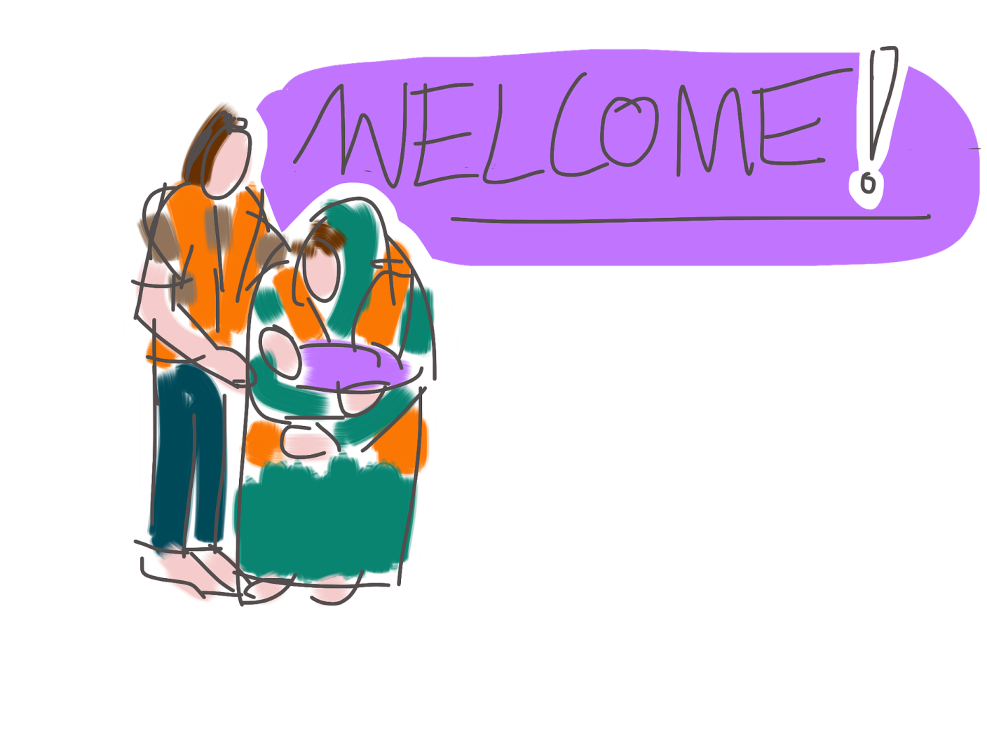
21,3 million refugees
5,8 palestine refugees
89,3 million people forcibly displaced in 2021
4,6 million Asylum seekers
Pixabay.com
4,4 Venezuelans displaced abroad
Source: UNHCR 2022
Notes:
Source: https://www.unhcr.org/62a9d1494/global-trends-report-2021

Slide 4


of all displaced abroad came from just 5 countries.
69%
Syria
Afghanistan
Myanmar
Venezuela
South Sudan
Notes:
Source: United Nations Higher Commisioner for Refugees (2022): GLOBAL TRENDS FORCED DISPLACEMENT IN 2021. (2022, Juni). United Nations High Commissioner for Refugees.

Slide 5

of all displaced persons were hosted by low and middle income countries.
83%
of all displaced persons moved to neighbouring countries.
72%
Pixabay.com
Notes:
Source: United Nations Higher Commisioner for Refugees (2022): GLOBAL TRENDS FORCED DISPLACEMENT IN 2021. (2022, Juni). United Nations High Commissioner for Refugees.

Slide 6

Less than 10% of all the world´s refugees and only a fraction of internally displaced persons are living in the European Union.
In 2021 most first-time asylum applicants in Europe came from:
Syria
Afghanistan
Iraq
Source: European Commission, 2022
Pixabay.com
Pixabay.com
Notes:
Source: European Commission. (o. D.). Overall figures of immigrants in European society. Retrieved on 9. Mai 2022, from https://ec.europa.eu/info/strategy/priorities-2019-2024/promoting-our-european-way-life/statistics-migration-europe_en

Slide 7
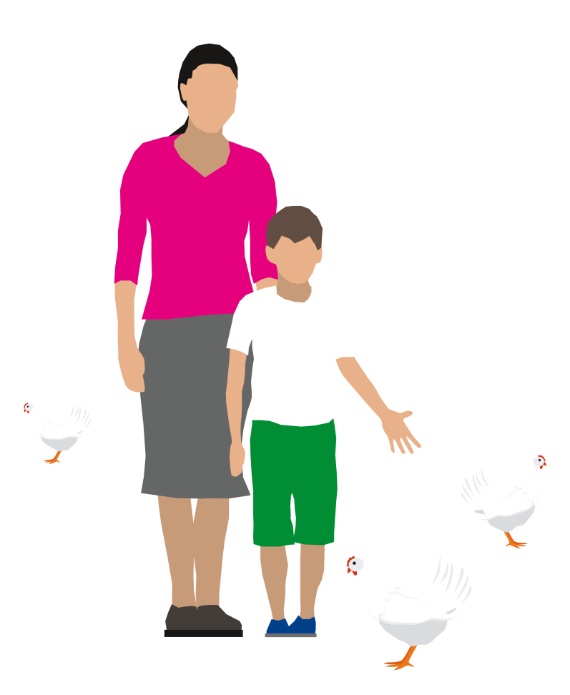
Social Farming
Specific benefits for refugees
Language learning
“The farm provides an opportunity to learn English in a very natural setting, pick up words from seeing things, pointing to things. And in terms of language acquisition, it’s certainly my preference to learning in a classroom. For learning language, it’s so much easier to be able to see and smell it in terms of learning.” (interview with social farming practitioner)
Thüringer Ökoherz e.V.

Slide 8
Social Farming
Specific benefits for refugees
earning money
“Social Farming opened up their prospects. Shortly after, one of them got a job on a local mushroom farm. Without social farming I don’t think he would have thought about doing that.” (interview with social farming practitioner)
language learning
Thüringer Ökoherz e.V.

Slide 9
Social Farming
“The fact that it’s a lived experience is so valuable. People will pick things up. Gaining cultural knowledge can only be experienced by being in the environment. For example, participants learned about seasonal events and traditions, e.g. Halloween and Christmas which are of significant cultural value and importance in Ireland but in the home/family setting.” (interview with social farming practitioner)
Specific benefits for refugees
earning money
Cultural exchange
language learning
Thüringer Ökoherz e.V.

Slide 10
Social Farming
Specific benefits for refugees
earning money
“The best thing about our work, and I'm including all agriculture here, is that we see something. We see growth, we see our daily success, so what we've done, whether we're working a furrow or hoeing a vegetable patch. Also the people who live here: We're part of agriculture, after all. I see what I have worked.” (interview with social farming practitioner)
Cultural exchange
language learning
Thüringer Ökoherz e.V.
meaningful activities

Slide 11
Social Farming
Specific benefits for refugees
earning money
choice
“What I always see with us, but that has nothing to do with the refugees, but in general, we have the opportunity to offer a very wide range of work, from physically demanding work to manual work to filigree work. Different physical skills are needed here.” (interview with social farming practitioner)
Cultural exchange
language learning
Thüringer Ökoherz e.V.
meaningful activities

Slide 12
Social Farming
“When I go to the farm and I pet a horse and put its head in my arm and I can just saddle it up. And then I get on the horse and then I just go for a ride. That's something really great.” (interview with social farming practitioner)
Specific benefits for refugees
earning money
choice
Cultural exchange
language learning
Thüringer Ökoherz e.V.
healing through nature/mental well-being
meaningful activities

Slide 13
Social Farming
Specific benefits for refugees
“So psychologically and socially I think animals, plants, people, this daily contact is absolutely important. If someone sits in the quiet chamber and always only […]processes files […] , then he will not be socially empathetic and will also not be able to show this social empathy.” (interview with social farming practitioner)
earning money
choice
Cultural exchange
language learning
Social inclusion
Thüringer Ökoherz e.V.
healing through nature/mental well-being
meaningful activities

Slide 14
earning money
choice
Cultural exchange
language learning
Social inclusion
Thüringer Ökoherz e.V.
healing through nature/mental well-being
meaningful activities

Slide 15
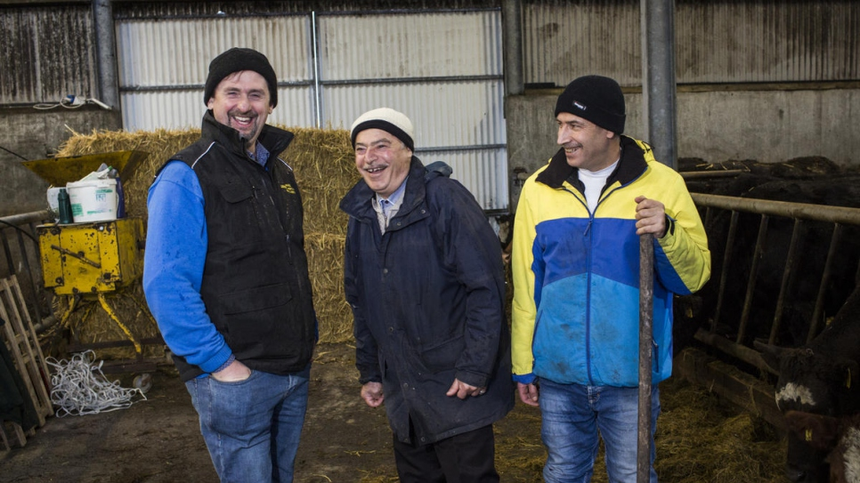
Best practice example:
Dixon farm in cooperation with social farming Ireland
Leitrim Development Company
Notes:
Oliver and Anna Dixon are organic farmers operating a medium-sized enterprise in County Galway in the West of Ireland. Olive inherited the farm from his father and has farmed his whole life. They predominately operate an organic suckler to beef enterprise but there is also some woodland on the farm and a small kitchen garden and polytunnel with vegetables, fruit and herbs. Both Anna and Oliver also work part-time with natural therapies from a purpose-built office at the farm. Oliver is a biodynamic psychotherapist, Anna is an acupuncturist and also an artist and teacher. The farm is in a very quiet and peaceful environment with both indoor and outdoor activities to suit the changeable weather. Amongst the activities available on the farm are cattle herding, livestock husbandry, organic gardening activities, tree pruning, hedge cutting, stone wall maintenance, fencing, general farm maintenance, firewood stacking.
Beginning in 2018, two Syrian refugees living locally spent 25 weeks on the Dixons farm doing social farming one day per week. The placement emerged from the engagement between the Social Farming Ireland Regional Development Officer and the support worker who was at the time employed by South West Mayo Development Company to work on the Syrian Resettlement Programme. The two gentlemen who were both farmers in Syria and it was felt that social farming could be a means to support their integration into the local area in the comfortable and (somewhat) familiar surroundings of the farm.
An interpreter was provided on the first day to ensure that there was good initial understanding around health and safety, the layout of the farm etc. However after that, everyone communicated through farming and using Google Translate. The time on the farm provided very valuable everyday language learning for the participants. Their vocabulary increased in a very natural way and setting, as they picked up words from seeing things, pointing to things, asking questions, etc. They were also able to gain everyday insight into and knowledge of ordinary family and home life, cultural norms, etc. For example, participants learned about seasonal events and traditions, e.g. Halloween and Christmas which are of significant cultural value and importance in Ireland but in the home/family setting. The participants and their families were invited over during the Christmas season. Social farming also provided an opportunity to adapt to the Irish climate and the kind of clothes and footwear needed for living in such a wet country.
Social farming proved to be a very good source of integration for these men and in different ways. The younger gentleman got a job on a mushroom farm after his social farming placement: the increased confidence, language skills and comfort levels around Irish farming culture contributing to his ability to avail of this opportunity. The older farmer is at retirement age and social farming provided an opportunity get out of the house and do something which he enjoys. Both men got to know more people- the social farmers most obviously, but also their family and neighbours, people like the vet and the postman and other people around the town. When Oliver would pick them up or drop them off at the supermarket in town, he was able to introduce them to people he bumped into in a very natural way. Social farming also contributed to breaking down barriers in the local community between newly arrived refugees and the people living in the local community.
Knowledge sharing and reciprocity were an inherent part of this placement. For example, one of the Syrian farmers had olive trees back home and was an expert pruner. He was able to take the lead on pruning the previously somewhat neglected apple trees on the farm – a job which needed to be done – and passed on this knowledge to Oliver. They were able to share and compare their own experiences of farming in very different climactic conditions, for example: how animals are fed and cared for or what is involved in organic farming. This ability to contribute was very important to these participants who had lost their livelihoods and access to farm work along with everything else. They are unable to return to their own home farms and had spent a considerable period of time in a refugee camp in Lebanon before coming to Ireland. Other mental health benefits of social farming included having an opportunity to be in a quiet, safe, peaceful and therapeutic space amongst kind and welcoming people. This time on the farm was one very valuable part of an overall package of supports which were provided to Syrian families who settled in this rural community at the time.
(author: Aisling Moroney)

Slide 16
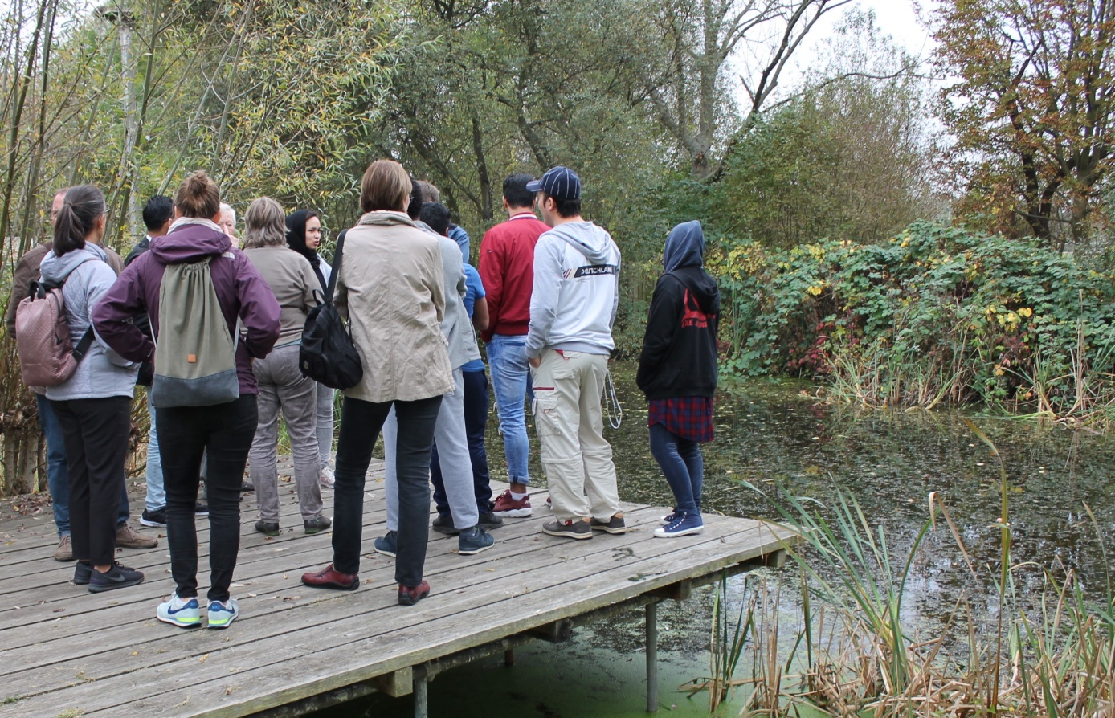
Best practice example:
Refugees in Green and Landscape Care – qualification in Green Professions (Berlin, Germany)
Natueschutz Berlin Malchow
Notes:
In the frame of a joint project, two German environmental foundations “Allianz Umweltstiftung” (Allianz Environmental Foundation) and “Stiftung für Mensch und Umwelt” (Foundation for People and the Environment) cooperated to provide training in landscape care. The project aimed at qualifying refugees through an internship. This training should support the participants in finding a job in a green profession afterwards.
In the beginning, partner organisations were sought, initial contacts were made with refugee accommodation and discussions were held with social organisations.
Participants were employed in the framework of a labour employment measure in green and landscape care activities.
The working week from Monday to Friday was divided into practical work and the refugees also received German lessons during the period of employment.
The participants were supervised in two different facilities: technical services of the city of Ludwigsburg (Technische Dienste der Stadt Ludwigsburg ) and Nature conservation Berlin-Malchow, Berlin-Lichtenberg (Naturschutz Berlin-Malchow, Berlin-Lichtenberg).
In Ludwigsburg, the participants worked jointly with town staff. They were involved in activities in the area of tree care services, landscape gardening and landscape conservation (e.g. pruning of trees, weeding, cleaning of ponds, raking of leaves, working with a string trimmer, and planting).
In Berlin-Lichtenberg participants were supervised by employees of an association for ecological conservation. Depending on the season, participants were involved in activities like biotope protection, reparation of tools and exhibits used in environmental education (e.g. trimming of pasture fences, sensing tree population, raking of hay, harvesting of fruits, construction of insect nesting aids, fixing of bird nesting boxes, supporting of information bouches and public relations)
Even though none of the refugees from the two places of employment in Ludwigsburg and Berlin-Malchow was able to obtain a job in the primary job market immediately, they all learned a lot in practice, theory and language.
Source: Hemmer, C. (2018). Geflüchtete in der Grün- und Landschaftspflege - Ein Beitrag zur Integration in Grüne Berufe. In G. Hein, T. Hövelmann, B. Linnemann, N. Menke, F. Wichert, & N. Wiersbinski (Eds.), Naturschutz: einladend - sozial - integrativ. Angebote für Menschen mit Migrationshintergrund und Flüchtlinge (pp. 70–78). Bundesamt für Naturschutz.

Slide 17
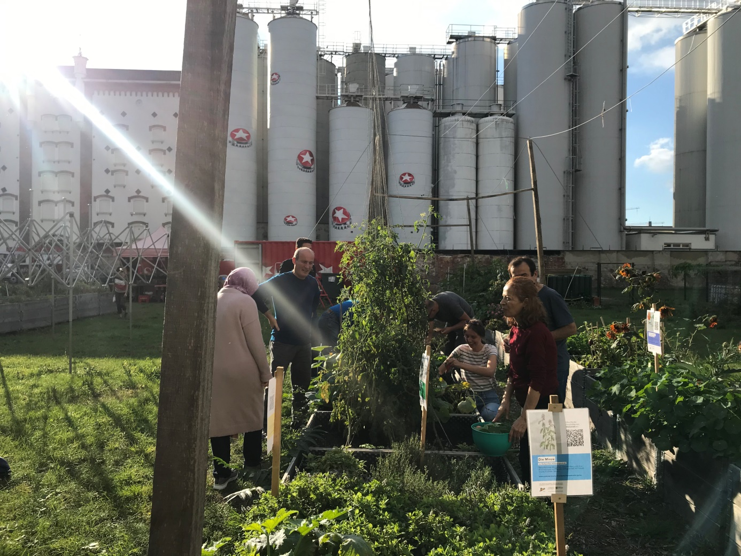
Best practice example:
Urban Agriculture “Annalinde” intercultural garden (Leipzig, Germany)
Annalinde Leipzig
Notes:
ANNALINDE is a social enterprise that runs urban agriculture projects in Leipzig (Germany). It runs a community garden in the city.
In 2017 an Intercultural Garden started in the ANNALINDE Community Garden. The Intercultural Garden was established as a fixed format in the ANNALINDE community garden with its weekly appointments and thus enriched the entire garden community. Soon there was a lively exchange between all participants and both the participants of the intercultural garden and the entire garden community enjoyed taking part in each other's garden days.
In addition to gardening, crafting and building, one focus was on joint harvesting, cooking and eating together in the summer kitchen. Here different recipes from the different countries of origin of gardeners and different methods of refining or conserving of agricultural products were tried out.
Through the cooperation with numerous institutions in the immediate neighbourhood, the project Intercultural Garden and thus the entire community garden could become even more firmly anchored in the neighbourhood during the two-year project period.
To enable the community cohesion also over the winter months, winter meetings were offered. Here, the topic of "access to work & training", cultural aspects as well as the personal exchange of experiences were given more attention.
Source: ANNALINDE. (2018, September 21). Rückblick auf zwei Jahre ESF-Projekt „Interkultureller Garten“. ANNALINDE-Leipzig. Retrieved July 18, 2022, from https://annalinde-leipzig.de/de/blog/rueckblick-auf-zwei-jahre-esf-projekt-interkultureller-garten/

Slide 18

Best practice example:
employment at the Ramser farm (Switzerland)
Thüringer Ökoherz e.V.
Notes:
In 2015, the Swiss Farmers' Union launched a three-year pilot project to support employment in the farming sector.
The refugees and temporarily admitted persons were allowed to work on Swiss farms and generate income. In turn, the public sector would be relieved financially in the area of social expenditures.
The assignments within the pilot project in 2015-17 lasted between three and twelve months. The cooperating farms paid the refugees the agricultural minimum wage.
30 working places were filled on 17 different farms (mixed, vegetables, fruit). 24 participants completed the work assignment. 14 of them received a job offer from the farm, which 10 people also accepted. Another seven people found another job in agriculture or another branch.
The final evaluation report states that the farms where the assignments could be completed were very satisfied with the participants. The farm managers noted language and professional learning progress, social and self-competence increased, and the participants were motivated and reliable.
The final report also mentions some weak points e.g. for the participants who did not have a driver's licence or a car, the often remote location of the farms was an obstacle. The introduction process of the participants on the farm was time-consuming. Furthermore, not all refugees and temporarily admitted persons were able to cope equally well with the physical work, the rhythm of work or living on the farm. There were also cultural and language barriers.
The project also resulted in the implementation of a one-year integration pre-apprenticeship. The pre-apprenticeship has been designed to meet the needs of young refugees. During the training period, they gain an in-depth insight into the work in agriculture.
Source: Schweizer Bauernverband. (2018, August 8). Gute Vorbereitung und regionale Vermittlung als Erfolgsfaktoren [Press release]. https://www.sbv-usp.ch/de/gute-vorbereitung-und-regionale-vermittlung-als-erfolgsfaktoren/

Slide 19

Social Farming
Implementation possibilities with refugees
Paid jobs
Vaccation
Volunteer work
Social-educational
individual support
Vocational training &
Internships
Thüringer Ökoherz e.V.
Foster families
Group activities at the farm (supported by social workers)

Slide 20
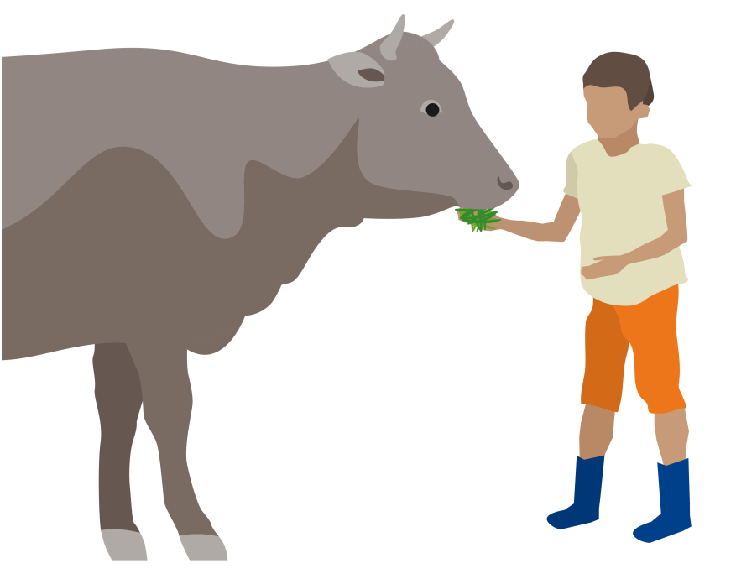
Social farming with refugees
Challenges and particularities
Work with different cultures, religions and gender roles
Language barrieres
Mental health challenges (mainly caused by traumatic experiences)
Bureaucratic obstacles (e.g. unclear residence status, funding)
transportation
Prejudice against foreigners
Thüringer Ökoherz e.V.

Slide 21
Conflict management
Some tips from practitioners
Forgive someone after something bad has happened
Pay attention to harmony
Know about each other´s religion
Have a daily exchange with your headman
Support trainers by involving volunteers
Pay attention to the social aspect (not only to work)
Limit the target group you work with (e.g. by age or educational background)
Take a firm stand if co-workers have prejudice against refugees
Get to know the story of the other person, get to know his/her culture

Slide 22

Social farming
a perspective for refugees – a perspective for rural areas in Europe
New sources of income for farmers
empowerment of sustainable farming
Manpower
Rural areas as attractive places for all people
Integration, cultural exchange
new jobs in social work
Thüringer Ökoherz e.V.

Slide 23
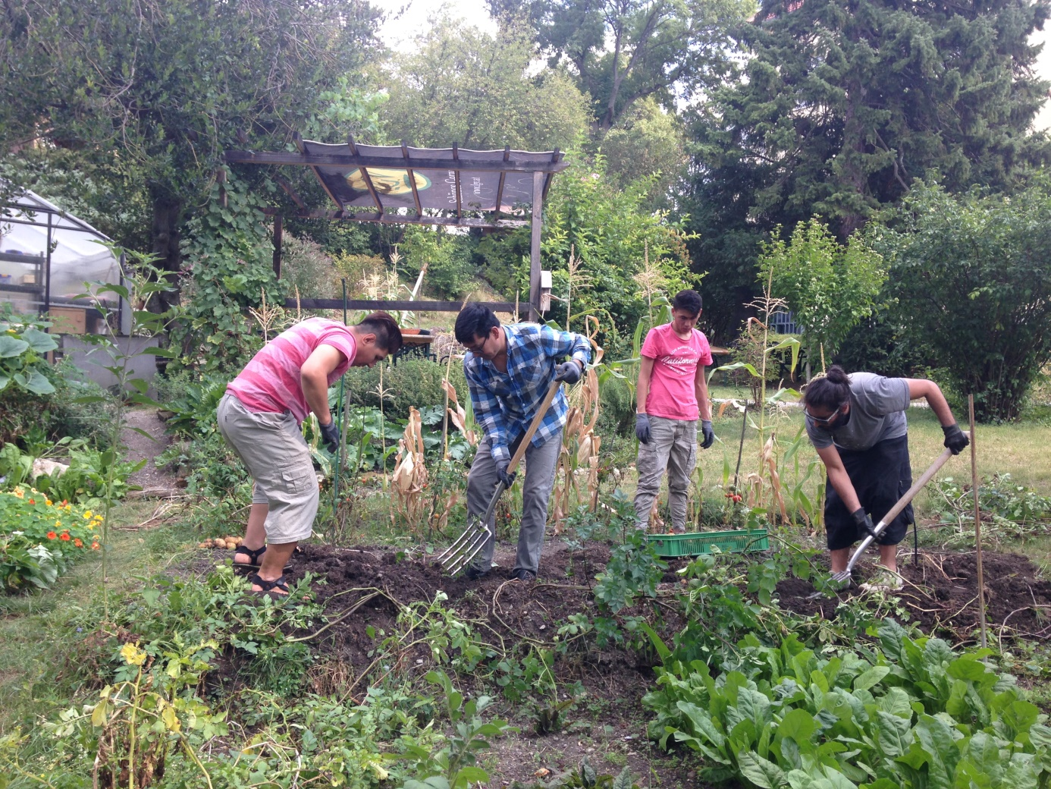
Social farming in higher education
The Therapeutic garden of the University of Agrarian and environmental pedagogy
(Vienna, Austria)
Notes:
The University of agrarian and environmental pedagogy in Vienna runs a therapeutic garden. In 2018 and 2019 activities with 10 refugees were realized at the garden.
The main goal of the project was language learning and training about gardening.
Refugees came twice a week to the garden where a garden therapist supported and assisted them.
The people involved learned various gardening skills. This should enable them to work in the gardening or farming sector later if they were interested in such an opportunity. They were involved in all kind of gardening activities, e.g. raking of leaves, constructing insect hotels, and preserving food.
An important part of the project was language learning. The people learned new vocabulary while working in the garden and were also supported in language courses given by volunteers. The focus of the language course was “garden vocabulary”.
The refugees also worked jointly with other target groups of the therapeutic garden (e.g. people with a mental disorders). Also, they came in contact with the students of the University and other Austrian citizens. Therefore, social inclusion was an important part of the project as well. (B. Strutzmann, personal communication, 3rd of June 2022).

Slide 24
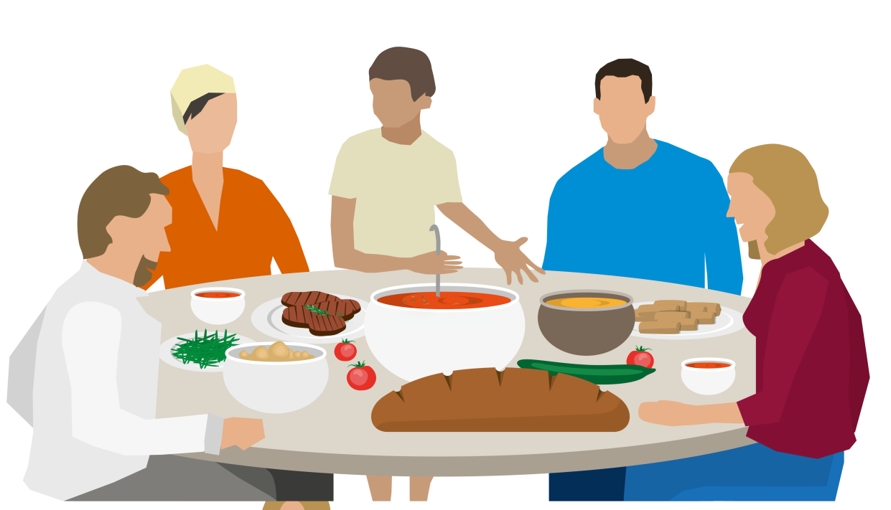
Social farming in higher education
Learning together with refugees – Let`s discuss!
Do you/ your University supports refugees/ displaced people or likes to support them?
How could you learn about the topic refugees in social farming at your local area/University?
Do you think social farming is a way to support refugees/displaced people in your region?
Thüringer Ökoherz e.V.

Slide 25
THANK YOU FOR YOUR ATTENTION
Name of Lecturer
  Institution of Lecturer
name@xyz.com

Slide 26

Farming with Refugees and forced displaced people - Agriculture as a path of inclusion © 2023 by SoFarTEAM is licensed under CC BY-NC 4.0.
To view a copy of this license, visit http://creativecommons.org/licenses/by-nc/4.0/
The slides were created by Claudia Schneider
Contact:
Thüringer Ökoherz e.V.
Schlachthofstraße 8-10
99423 Weimar, Germany
c.schneider@oekoherz.de

