Slide 1
People recovering from drug addiction
Name of Lecturer
Institution of Lecturer
00
00
0000

Slide 2
Drug Addiction
What do you know about drug addiction?
Experiences?
Notes:
Introductory and open discussion on drugs and addiction.

Slide 3
Drug Addiction
Choice or disease?
Notes:
Discussion on whether drug addiction is a choice or a disease.

Slide 4
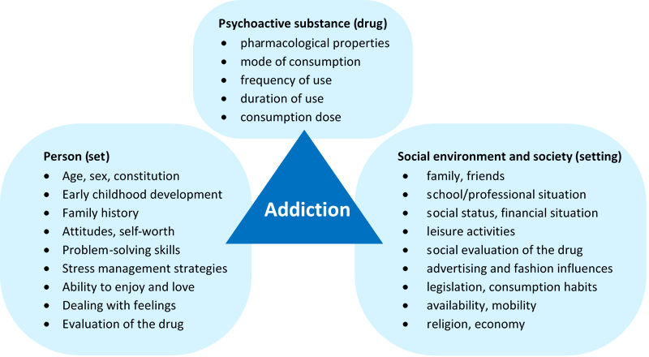
The triad of causes for drug addiction
Source: Own illustration modified after Kielholz and Ladewig 1973

Slide 5
Effects of drug addiction
Insuperable desire to procure and take the additive drug
Tendency to increase dose (tolerance increase)
Loss of control over one’s own behaviour
Effects of drug addiction
Harmfulness to the individual and to society
Psychological and mostly physical dependence on the effect of the drug
Source: Own illustration modified after World Health Organization (WHO) 2022

Slide 6
Drug Addiction
When is there a dependency?
Notes:
Discussion around when does a dependency exist.
For example, when is one dependent if one drinks alcohol? Does one beer a day already indicate dependence?

Slide 7
Dependency syndrome
Should be diagnosed if three or more of the following symptoms are met simultaneously during the last twelve months
Strong and occasionally overpowering desire or a kind of compulsion to procure and take psychotropic substances
Decreased control over the onset, termination and amount of drug use
Physical withdrawal syndromes at termination or reduction of consumption
Evidence of drug tolerance, meaning higher doses are required to achieve the same effect
Increasing focus of behaviour on the drugs respectively Substance consumption, i.e., compulsion or greed for taking the substance (also referred to as craving), progressive neglect of other interests.
Continued consumption despite negative consequences, such as liver damage due to excessive drinking, depressive mood, etc.

Slide 8
Drug Addiction
Which drugs do you know?
Notes:
Short brainstorming, possibly already with classification.

Slide 9
Classification of addiction
Substance-related addiction | Substance-free forms of addiction
Alcohol Tobacco Medicines: painkillers, sleep and sedatives Illegal drugs: cannabis (except TBC and some countries), LSD, cocaine, crack, ecstasy, speed, heroin/opium, crystal meth | Gambling: slot machines, sports betting, lotteries and scratch cards, roulette, poker, card games, casino games Eating disorders: Anorexia (diminished appetite), Bulimia (nausea), binge eating disorder (compulsive overeating) Other diagnostic subcategories of eating disorders: disorder with avoidance or restriction of food intake as well as further feeding or eating disorders

Slide 10
Effects caused by taking cocaine, crack and amphetamine
Cocaine, crack or ampheta-mine
Psychostimulants are composed of psychoactive substances with different chemical structures, which have a sympathomimetic intoxication effect.
Sympathomimetic syndrome is a constellation of symptoms caused by overstimulation of the sympathetic nervous system (part of the autonomic nervous system).
The sympathetic system primarily addresses bodily functions, which make the body more willing to perform and lead to an increased reduction of energy reserves.
With intoxication, the sympathetic overstimulation can lead to agitation (a pathological restlessness, in which violent and hasty movements of the patient occur), cardiac arrhythmias and cerebral seizures.

Slide 11
Effects caused by taking narcotics
Narcotics
Certain narcotics - for example, many potent hallucinogens, also known as psychotropic substances, are prohibited or may only be used for medical or scientific purposes with a derogation from the authorities.
Psychotropic substances cause changes in thinking and perception and can cause a greatly altered perception of reality. Typical dosage forms include tablets, capsules, drops, transdermal patches and injection preparations.

Slide 12
Substances for hallucinogens
Hallucino-gens
There are hallucinogenic plants such as the fly agaric or psilocybin-containing fungi.
Hallucinogenic effects also arise through the consumption of the Mexican magic sage Salvia Divinorum or the Hawaiian wood rose.
Also hallucinogenic is the peyote cactus with the active ingredient mescaline or a brew of ayahuasca, which contains the active ingredient DMT.
Certain nightshade plants such as hollyhock, angel’s trumpet, henbane or belladonna also produce hallucinogenic effects, but can be slightly overdosed and thus have a lethal effect
Other hallucinogens are artificially produced. Examples include the active ingredient PCP, also known as "angel dust," or the anesthetic ketamine, which produces hallucinogenic effects in low doses.
One of the most well-known artificially produced hallucinogens is LSD. The basic substance comes from the ergot, a fungus that infests cereal ears

Slide 13
Benefits for the target Group
A Selection:
Meaningful work
Participation in the rhythms of the day and year
Preparing and eating meals together with healthy food
Being part of a community, family or social structure
Save environment without judgement
…
Notes:
Possibly organize beforehand as a small group work.
With the question: What advantages/ benefits or what added value does social farming have for the target groups?

Slide 14
Case Example
The farmer Uwe Weimar of Hof Fleckenbühl knows from his own experience that there is a synergistic relationship between agriculture and addiction support, as he describes below:
"For addiction services, for the individual, working in agriculture is very good, (...) (because) the people who work in agriculture stay for a very long time. It's good for an addict to have grounding work. So that he really has the dirt under his fingernails, that he is doing an occupation, a physical work in the fresh air is very good for the soul and the recovery of an addict. In comparison, immediately starting a screen job or standing in a cellar and assemble things, that (...) is not so good for a person's soul.
The other point is that the moment you work with animals, for example, you also get responsibility for them. When you feed calves or muck out pigs. And that by taking responsibility for the animals, you also learn to take responsibility again for one's own life. (...) Regular routine, healthy and honest work, also getting up early, regular daily routine, (...) (healthy distraction).
We say also, you get sober with your hands. (...) If you have your hands in the sink, you can't hold beer bottles. So get sober with your hands. Working here is part of our program. (...) The new people get pretty busy. The don't get off work at 5 p.m. and then sit around by themselves. There is a complete program for them, so that they sit around alone as little as possible and then get bad ideas."
Source: van Elsen et al. 2012

Slide 15
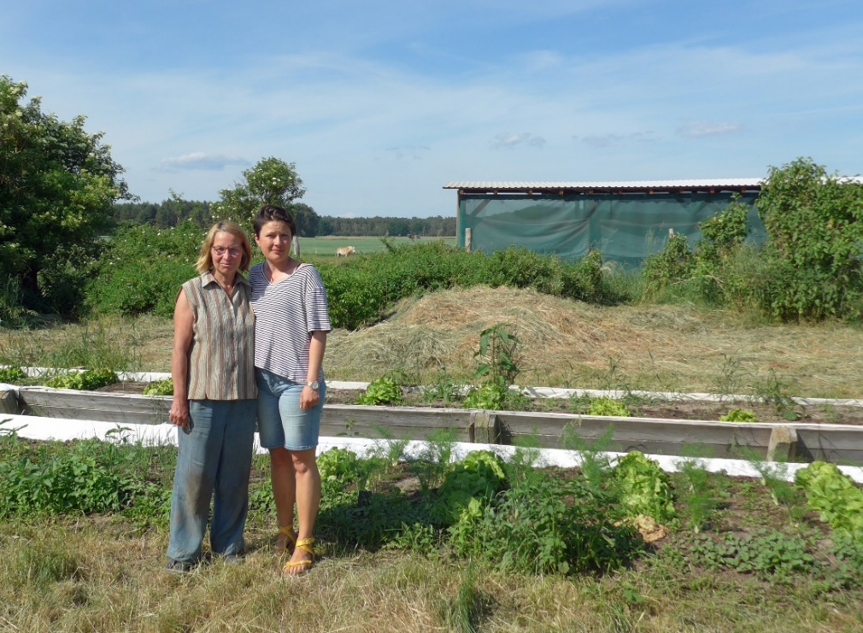
Arrival and activities on the farm
You can only encourage people to do things but you can’t make them do it. People are going back into a different environment, with maybe the wrong influences and friends. So you do your best but you can’t take it hard if things go back for them.
Picture: Harth 2022
Notes:
Social worker and farmer at Hiram Haus (Germany), who work with people recovering from addiction
Note: In the background, you can see the therapy horse of the farm

Slide 16
Drug Addiction
What activities on a farm are possible from your point of view?
Notes:
Possibly organize beforehand as a small group work.
With the question: What activities can people with drug addiction do on a social farm?

Slide 17
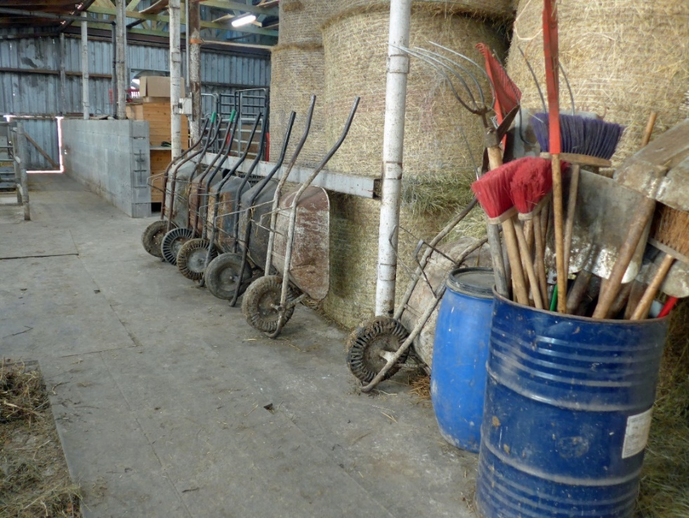
Activities on the Farm
Flower work
Gardening
Potato clearing
Sorting and packing
Straw & hay harvest
Work in the greenhouse and with vegetables
Animal care in general
Feeding and checking
Keeping chicken
Collecting Colorado beetles
and others
Working equipment and appliances in a cattle barn
Picture: Harth 2022

Slide 18
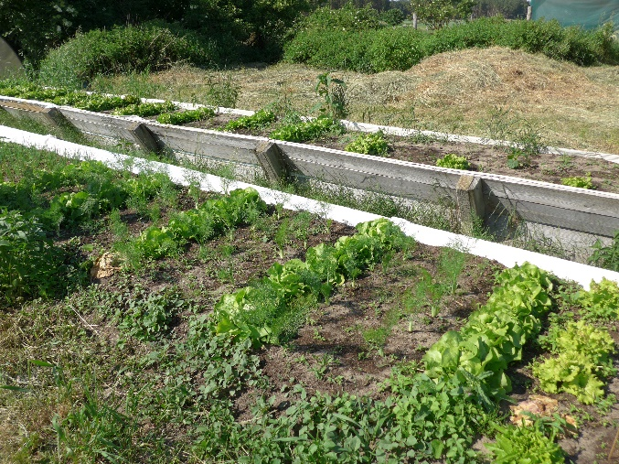
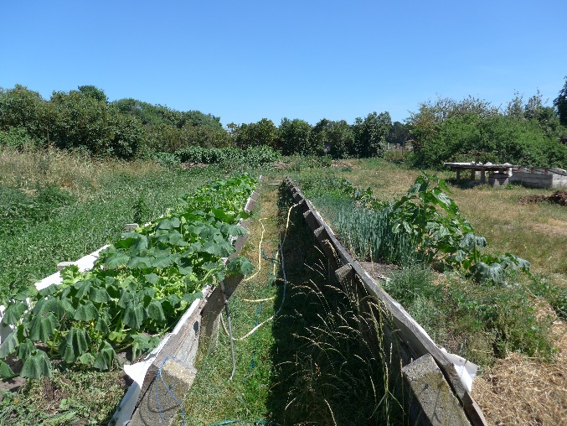
Individual Approach
In my experience, for example, participants with Korsakov's syndrome need the same work over and over again, such as routine work in the agricultural sector. This is stabilizing for this group of participants, as Korsakov sufferers have major problems with memory, especially with short-term memory. On the other hand, there are constantly changing tasks in vegetable growing, which in turn are suitable for other participants - who are looking for more variety and like the challenge.
Garden area with vegetables and salad at Hiram Haus (Germany), who work with people recovering from addiction
Pictures: Harth 2022

Slide 19
behavioural expressions
The following behavioural expressions are characteristic for people recovering from addiction
Strong desire
Feelings of guilt
Loss of control
Lack of Abstinence
Tolerance formation
Drug withdrawal symptoms
Withdrawal from social life
Source: Own illustration modified after Dilling, Mombour, & Schmidt, 2015

Slide 20
How to detect self-destructive Behaviour?
Measures to detect signs of self-destructive behaviour of people recovering from addiction
Observation/ perception
Caregivers (in confidence)
Conduct one-on-one personal conversations (without actively addressing addiction)
People recovering from addiction
Expert discussions with the network (weekly conferences)
Log changes in people’s behaviour and character
Control (urine test/breath alcohol)
Source: Own illustration modified after Gross 2016

Slide 21
Specific challenges for the target Group
Basically, everyone is to be considered individually
e.g. with regard to group work versus individual task
But, there are special features …
Addicts often times have problems building relationships
Short periods of concentration
Under the influence of medication
Understanding of gender roles

Slide 22
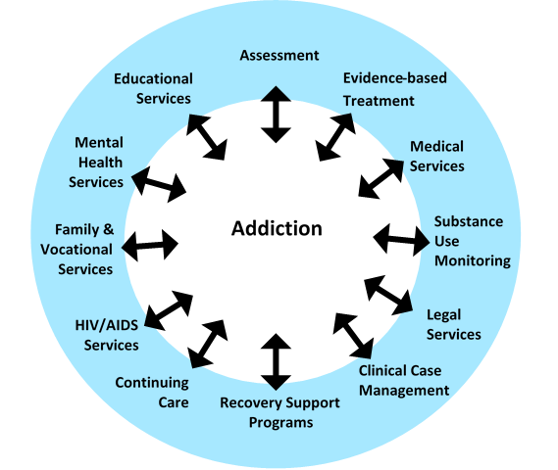
Treatment approaches for drug addiction

Slide 23
Case Study
Therapeutic self-help community for addicts Fleckenbühl
Notes:
Required information (will be provided by the lecturer in the course)
Profile of the social farm
Brochure about the project
Video (YouTube)

Slide 24
Case Study
Imagine the following situation:
The Fleckenbühl farm works with people in recovery from addiction.
The people in recovery from addiction are seen as members of a community.
In order to facilitate coexistence on the farm, rules should be introduced which apply to everyone and which lead to expulsion in case of disregard.
Notes:
Required information (will be provided by the lecturer in the course)
Profile of the social farm
Brochure about the project
Video (YouTube)
Further information material (e.g. article in newspaper)

Slide 25
Case Study
Your task:
Imagine that you are part of the management of Fleckenbühl and have to define the rules of conduct for living together on the farm
Identify the three most important rules
Give reasons for your decision
To support you in your task, you will receive further information about the
Fleckenbühl farm (video, profile, article, etc.)
Notes:
Required information (will be provided by the lecturer in the course)
Profile of the social farm
Brochure about the project
Video (YouTube)
Further information material (e.g. article in newspaper)

Slide 26
thank you for your attention
Name of Lecturer
Institution of Lecturer
name@xyz.com

Slide 27
Farming with Refugees and forced displaced people - Agriculture as a path of inclusion © 2023 by SoFarTEAM is licensed under CC BY-NC 4.0.
To view a copy of this license, visit http://creativecommons.org/licenses/by-nc/4.0/
The slides were created by Michael Harth
Contact:
University of Applied Science Neubrandenburg
Brodaer Str. 2
17033 Neubrandenburg, Germany
harth@hs-nb.de

