Slide 1
PEOPLE WITH Mental health challenges
Name of Lecturer
  Institution of Lecturer
00
00
0000

Slide 2
Overview
Chapter 1: General Characteristics of People with Mental Health Challenges
Chapter 2: Benefits of Social Farming for People with Mental Health Challenges
  Chapter 3: Social Farming in Practice with People with Mental Health Challenges
  Existing services supporting people with mental health challenges and links to Social Farming
  Activity of particular relevance and value to this target group
  Approach when working with this target group
  Particular skills and strengths of this group
  Chapter 4: Possible Behavioural References and Challenges

Slide 3
Chapter 1:
general characteristics of people with mental health challenges

Slide 4
Mental Illness – definition & description
Health conditions involving significant changes in emotion, thinking or behaviour or a combination of these….
  Associated with distress of the individual and/or problems functioning in social, work or family activities
  Does not discriminate, can affect anyone regardless of age, gender, nationality, income, social status, religion or background
  Some are mild and most people with mental health challenges function reasonably well in every day life
  ….while others will be more severe and may require intervention and supports
  Prevalence is significant and growing…. Up to 1 in 4 at some stage of life
  A private issue for individuals AND a public health issue for government and wider society
…such as social farming

Slide 5
Classification of mental health disorder (ICD)*
Classification of Mental Health Disorder | Symptoms and Typical Behaviours
Mood Disorders | Depression – constant low mood, loss of interest in previously enjoyed activities, lack of motivation and interest. Often experience poor sleep or appetite, low energy, multiple physical complaints with no apparent physical cause. Bi-polar disorder – unusual changes in mood, energy levels & ability to engage with normal daily life. Periods of ‘high’ mood associated with creativity but also over-activity and inflated self-esteem.
Anxiety or fear-related disorders | Generalised Anxiety Disorder – A disproportionate worry/anxiety about a range of everyday situations in a way that disrupts everyday living. Panic disorders – people experience regular panic attacks or feelings of panic of varied levels of severity, usually accompanied by physical symptoms. Phobias – including social phobia; simple phobias (centred on objects or scenarios); and agoraphobia Obsessive-Compulsive Disorder (OCD) – constant stressful thoughts and powerful urge repetitive actions/tasks Post-traumatic stress disorder (PTSD) – can occur after experiencing or witnessing deeply stressful/traumatic event(s) or scenario(s)

Slide 6
Classification of mental health disorder (ICD)*
Classification of Mental Health Disorder | Symptoms and Typical Behaviours
Personality disorders | The type of mental health problems where the person’s attitudes, beliefs and behaviours cause them long-standing difficulties in their lives and in their relationships with others.
Schizophrenia and other psychoses | Distortions in thinking, perceptions, emotions, language, sense of self and behaviour. Common psychotic experiences include hallucinations and delusions.
‘Burnout’ | Syndrome resulting from chronic stress (from workplace or otherwise) which has not been successfully managed. Feelings of energy depletion, increased mental distance from job or others, feelings of negativity or cynicism, reduced efficacy
‘Disorders due to substance use or addictive behaviours | Discussed as a separate client group in this textbook/set of lectures on Social Farming

Slide 7
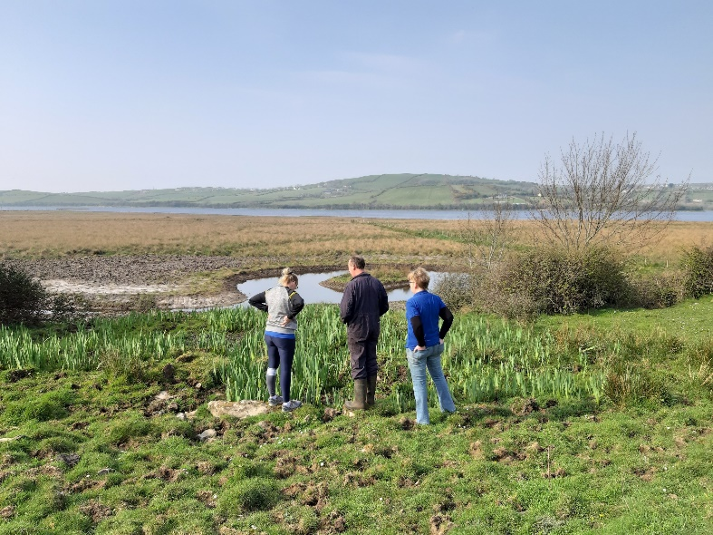
But everyone is an individual first and foremost!
Everyone comes with their own individual set of qualities, challenges and struggles. Factors such as…..
……will all impact on their behaviour, their experience on the farm and the benefits they experience
  People’s own personalities
  The level of severity of mental illness
  Age
  Gender
  Social status and income
  Their level of interest in farming and nature
  Quality of professional support systems
  Cultural norms of society
© Social Farming Ireland
Notes:
The ‘quality of professional support systems’ and the ‘cultural norms of society’ are particularly import. Both in concert can determine the likelihood of someone receiving support for their mental health challenges, the level of that support, the willingness to try innovative options such as social farming and overall, how people with mental health challenges are perceived. It can be a good exercise in class, especially if it is a group of agriculture students, to ask what they think cultural attitudes to mental health are in the society they live in.

Slide 8
Chapter 2:
Benefits of Social Farming for people with mental health challenges

Slide 9
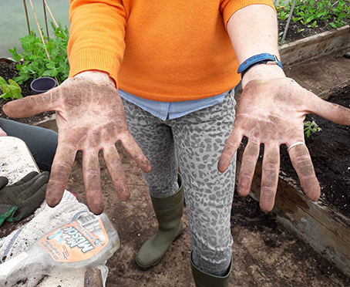
Positive effects of time in nature
“…For those with mental health challenges, there is a timelessness to it like the sea. You feel small but in a good way. It brings us out of ourselves. We are part of the everyday miracles of nature.”
“Nature is working on us all the time anyway. Social farming facilitates this.”
Nature as restorative and nurturing
Quietness, a sense of space and peace
The Value of ‘doing green’ (getting our hands dirty)
Biological cycles (life and death) and the fundamentals of life
Opportunity to care for animals - declines in levels of anxiety and depression, improved self-efficacy
Notes:
You can reference the Biophilia hypothesis and Attention Restoration Theory, both of which suggest that humans are innately drawn to and need time in nature in order to feel whole and to be ‘restored’ to ourselves.

Slide 10
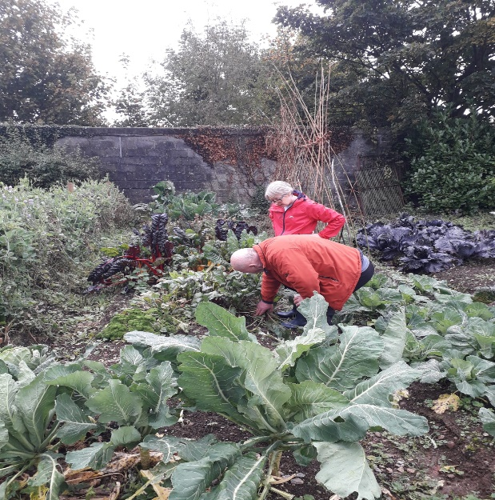
Opportunities for meaningful activity
Benefits of occupation generally to mental health
Opportunities for skill acquisition, confidence building, productivity, feelings of meaning and purpose
….leading to opportunities for progression towards training, employment, etc.
Particular value to the kind of activities undertaken and modes of working on social farms
Feeling part of something, feel needed, feel that something is expected of you.
“It’s meaningful work that needs to be done. We are not making it up, it’s not contrived. And unlike other work experiences, we aim for full participation.”
© Social Farming Ireland
Notes:
Bullet point 5: These include: the care and welfare of animals and plants; doing socially valuable work; you can see – and even eat - the outcomes of the work in a very real way

Slide 11
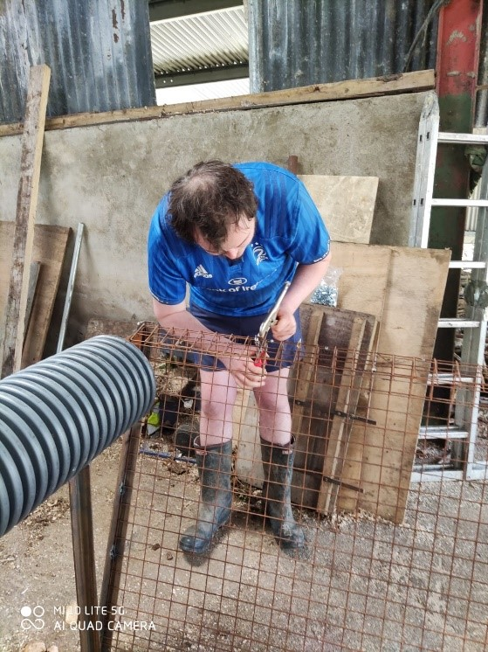
Skills acquisition & gaining positive experiences
“It is giving people a sense of accomplishment and building their self-esteem. They achieve, it’s as simple as that.”
An empowerment oriented, strengths-based intervention
Skills acquired inherently practical and valuable
Sense of purpose and hopefulness key to recovery
Huge variation in the work, continual adaptation and flexibility
Discovery process for people for what they can do, where their interests lie
People get to have positive experiences again, to be somewhere where things to go right for them.
“You can discover things about people, the capacities they have. One chap it turned out he was a mechanic and he helped fix my tractor. He just came alive when he was doing his thing.”
© Social Farming Ireland
Notes:
All of this is in the context of people maybe having had negative experiences, of things going ‘wrong’ for them, of feeling worthless or lacking in some way. These are all typical feelings and perceptions associated with mental ill health.

Slide 12
Social connection and building social skills
“That’s one of the big outcomes, participants are yacking [talking] away to one another and bonding and sharing information that’s useful. We do see improved social skills, people’s ability to interact with us and others.”
Immediately expands the social network of participants
Can break the cycle of isolation, feel less alone
People are part of something, are seen, missed
Approached as ‘normal’ people and not ‘cases’ or patients, respect without prejudice
Warmth and ease can encourage an ‘opening up’
New connections in the wider community
New connections and friendships with peers (peer support)
Non-threatening opportunities for social interaction, working side by side, focus not on people’s problems
Something to talk about outside of social farming
“People do open up. The occupational therapists often comment that the participants talk about things on the farm they never hear them talk about, things like their background and their family.”
Notes:
Bullet point 5 re. opening up; something about working side by side with people, the ease of it creates moments and opportunities for people to be more free in what they say. They feel they are speaking to friends rather than professionals. It would be common for people t o share things while they are social farming that they might not have done in years of professional engagement with psychologists, counsellors, etc.
Re bullet point 7; the importance of peer support is increasingly being recognised in mental health recovery. The social farm provides a space and a place where people who have perhaps shared some of the same struggles in life can meet and talk and even support one another but it’s not a formal ‘support group’
Bullet point 9: sometimes people with mental health challenges can lead quite narrow or ‘small’ lives – social farming, the things that happen on the farm, the fun that’s had: it all gives people something new to talk about. If someone asks them what they did recently, they can say, I was farming!

Slide 13
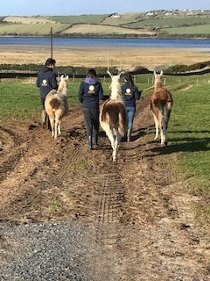
Physical health and well-being
Opportunity for everyday movement and activity
For a useful purpose and out in the fresh air
NOT labelled ‘exercise’, better fit for some than other options (more ‘a’)
Improved sleeping patterns – better routines, feeling ‘good’ tired from having done a good days work
Better diet and focus on healthy, nutritious foods, eating regularly
© Social Farming Ireland
“The change can be quite visible. With the current participant, I thought he would fall asleep standing up on the first day but that’s no longer the case. It’s because he wasn’t in a good routine, he was up all night. But now he’s coming here, he has to go to bed at a decent tine. It’s broken the cycle. He says himself he feels fitter and now that he is, he want to do more exercise. Also, people are encouraged to eat better and try new things, more nutritious things. The fresh air and exercise is so good for people ”
Notes:
Re bullet point 3: some of the options typically available (e.g. yoga, meditation, etc.) while very useful and beneficial, might not really resonate with some people and perhaps with men in particular. The experience of doing activity on the farm, being outside in nature might deliver many of the same benefits but is more culturally relevant/acceptable.

Slide 14
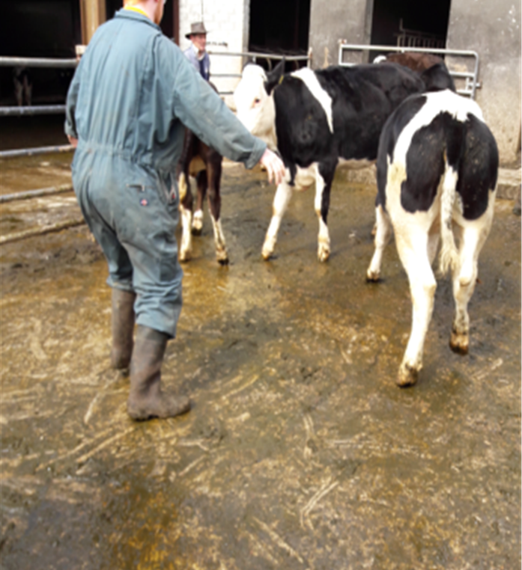
Group exercise
Imagine you are a social worker who works with people with mental health issues.
You are sure that one of the people you work with would benefit greatly from time spent on a social farm but they are very nervous and unsure.
What would you say to reassure them that social farming could be good for them and is worth a try?
© Social Farming Ireland

Slide 15
Chapter 3:
Social farming in practice with people with mental health challenges
  Existing services supporting people with mental health challenges and links to Social Farming
  Activity of particular relevance and value to this target group
  Approach when working with this target group
  Particular skills and strengths of this group

Slide 16
Existing services supporting Mental health (WHO)
Frequency of Need
Costs
Long stay facilities & tertiary services
Psychiatric facilities in hospitals
Community MH Services
Self-care
Low
High
MH Services in Primary Health Care
Informal community care
High
Low
Quantity of Services Needed
Notes:
This pyramid is adapted from the World Health Organisation, describing the optimal mix of services for mental health. It demonstrates that acute downstream services at the top of the pyramid are more high cost but with low frequency of need. It might be a good question in class to ask: where in the pyramid do you think people are most likely to able to access social farming supports?

Slide 17
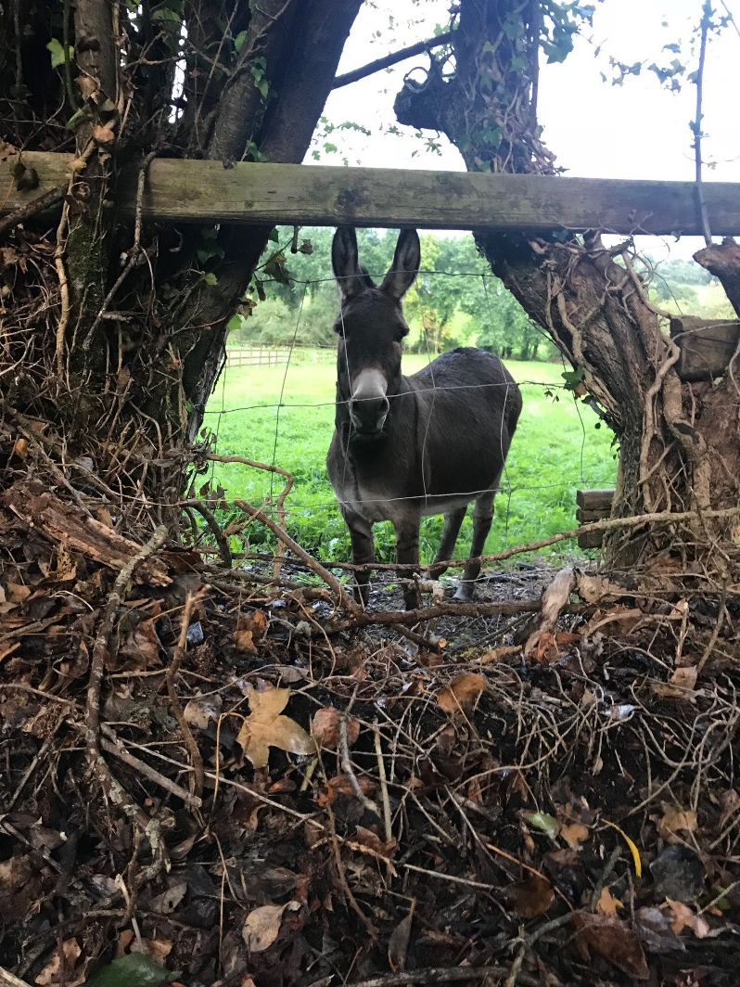
Accessing social farming within MH systems
  People may have the opportunity to access social farming supports at every level of the pyramid:
  Self-care and informal care - people may access nature or green therapies using own resources, community and family networks, etc.
  Primary health care - may be possible to access via social prescribing or use of health insurance.
  But Community Mental Health Services and long stay psychiatric facilities are the more natural source from which social farming is currently funded and supported.

Slide 18
Accessing social farming within MH systems
  There is broad consensus on the need to shift from a model of care based on traditional, large psychiatric institutions (medical) to modern, community-based models of care BUT
  progress has been uneven and
  responses to growing needs largely inadequate

Slide 19
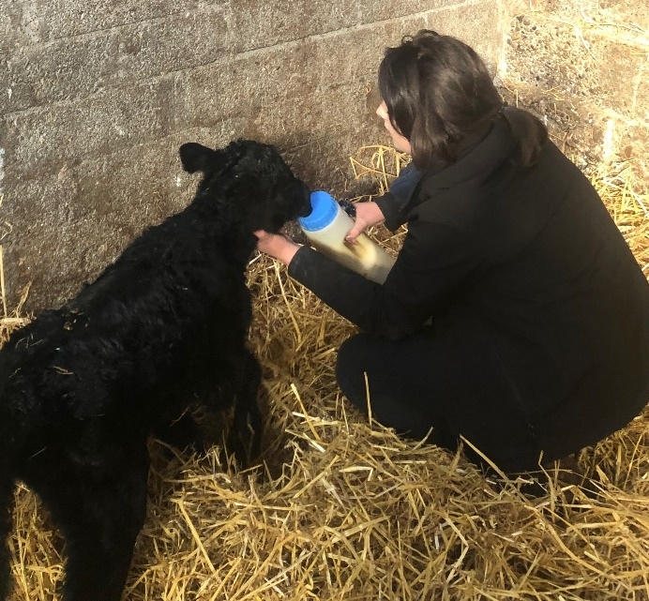
Activity of particular relevance & value
Early days should be a process of discovery for both farmer AND participants
A very flexible and individual approach is needed to deciding which activities to do, when to do them and with whom to do them
“So I divide into gross and fine motor skills, for example, there are the people who passionately like to wheelbarrow back and forth and muck out or move soil or something or [names participant] digs and works in a foil tunnel and transplants compost. That's the kind of stuff he likes to do and then there are the others who are passionate about pricking out or working anything on a small scale in the microcosm. Manageable and beautiful. And then there's those who love animals and actually need that. So that depends more on temperament and inclination…”.
© Social Farming Ireland

Slide 20
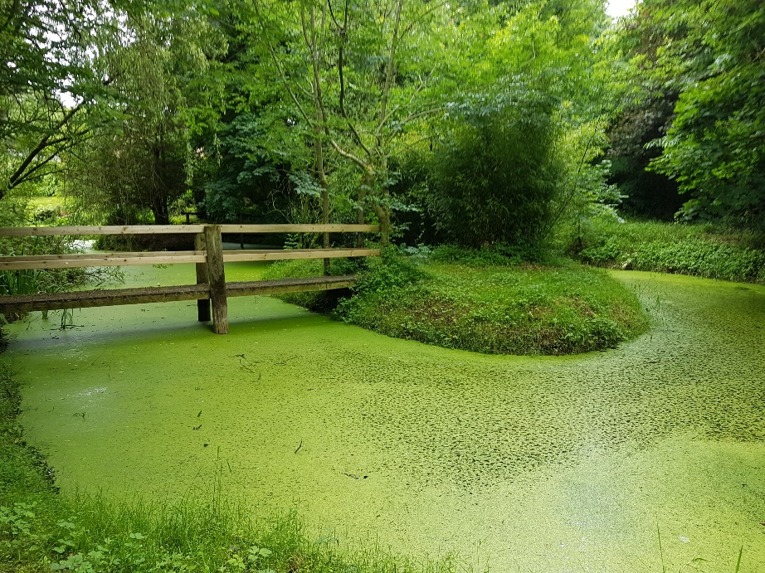
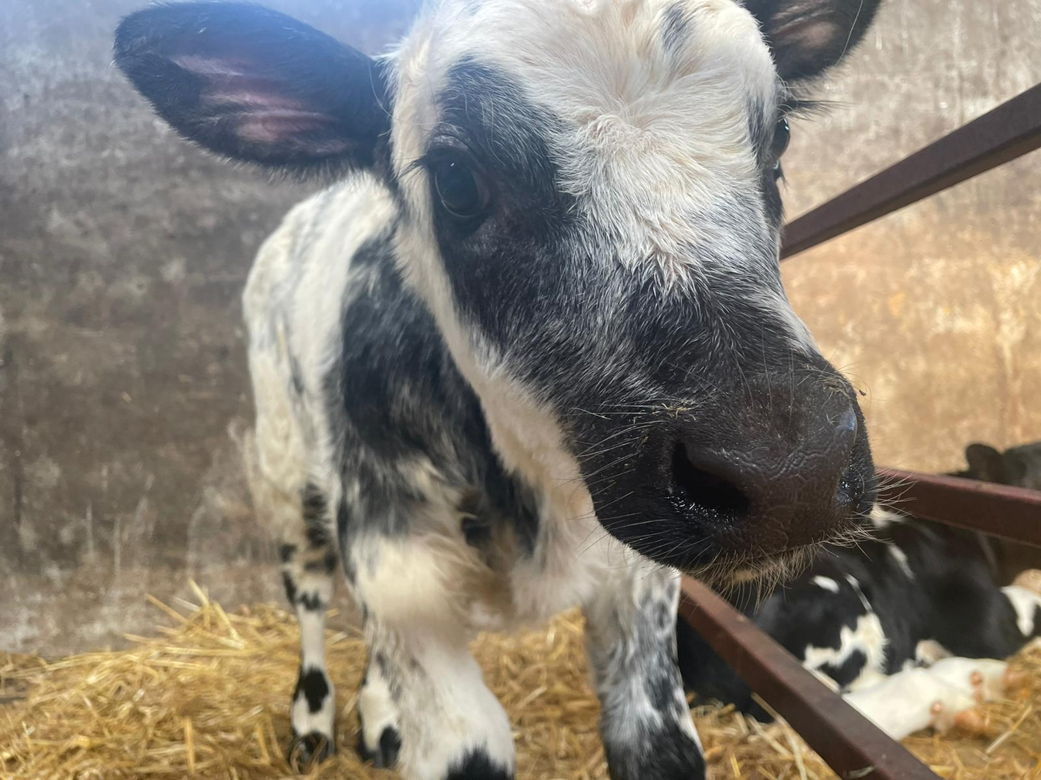
Activity of particular relevance & value
Getting close to nature
  Everyday, provide opportunities to connect with the soil, plants, woodlands, animals, the cycles of life and the seasons….
  Grounding people, connecting them with the essentials of life
“When people are too much in their heads, I say: go and weed with your hands instead of with the hoe, because then you are closer to the soil.”

Slide 21
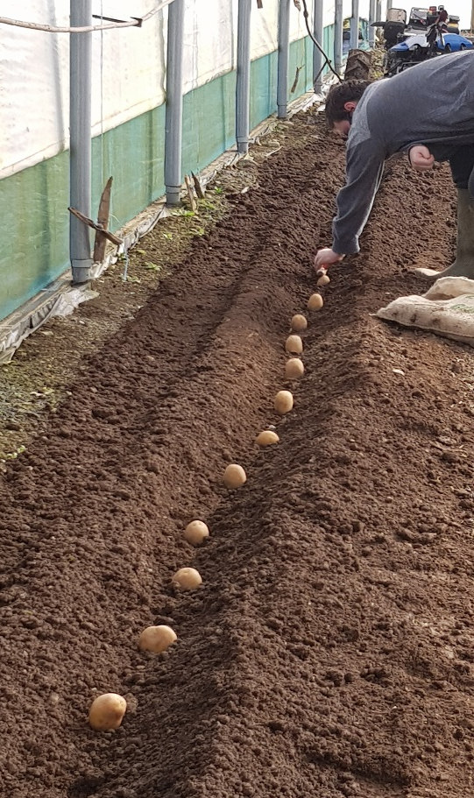
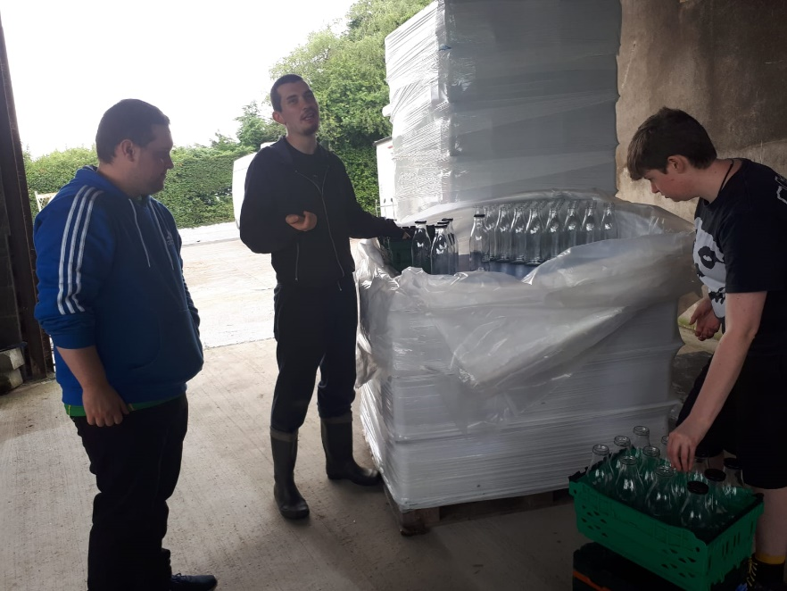
Activity of particular relevance & value
Provide meaningful & necessary tasks
  Tasks which are ‘real’, which give genuine feeling of accomplishment, contributing to something bigger them themselves
  Mix of routine tasks – where they can see themselves growing in capacity and confidence – and new projects where they can stretch themselves
  Provide a level of challenge and appropriate risk
“Knowing how to push people and how much to push. The animals are a great means of getting people out of their comfort zone. Oftentimes, people are capable of so much more than they have been doing. The doing things alongside other people, in the real world is very valuable.”

Slide 22
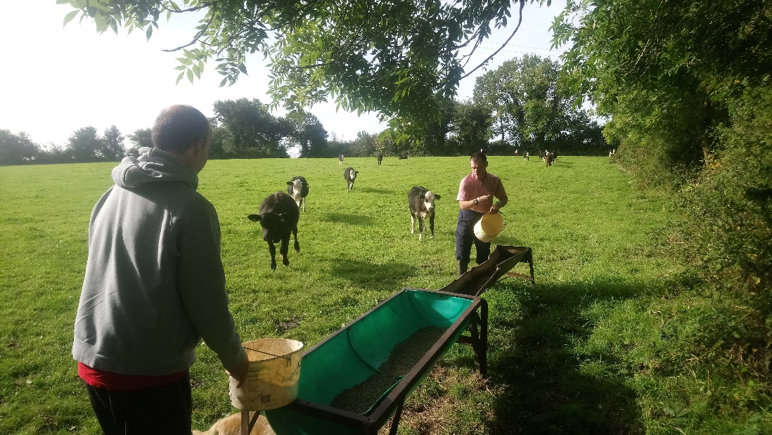
Activity of particular relevance & value
Providing structure and rhythm
  People can often lack structure and routine, detrimental to mental health. SF can support people to overcome unhelpful patterns (or none)
  Reliable rhythm according the season, time of day & tasks which need to be done, all of which should show the value and importance of good habits.
“Important to do key tasks every day because then they can see their own learning and progression. There is a confidence that; ‘it’s time to do the nuts now’ and they know how many we need. That is the nature of it, repetition.”
© Social Farming Ireland

Slide 23
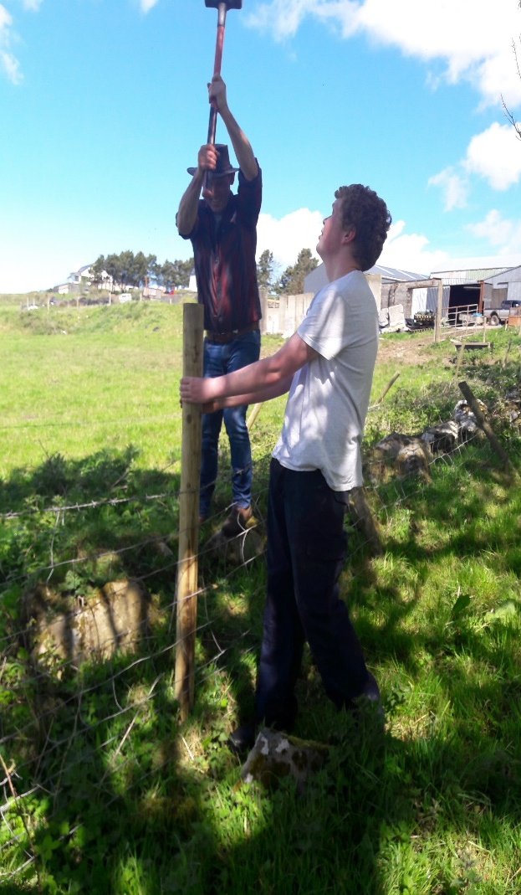
Activity of particular relevance & value
Activities which encourage team work, sharing, friendship
Working together on shared tasks automatically encourages conversation and cooperation, building of trust and confidence between people
Participants encouraged to work in pairs or in groups around particular tasks.
Easy, non-confrontational topics and ways for people to otherwise ‘open up’
Other ‘moments’ and opportunities for social connection and fun should be encouraged; celebrating birthdays, feast days, singing, telling stories….
“…just having fun together. I think for participants it adds value to their lives. Their world is generally small, they interact with the public here and get to know more people.”
© Social Farming Ireland
Notes:
This photo demonstrates the trust which is built on farm; the farmer trusting the participant to hold the post, the participant trusting the farmer not to hurt him.

Slide 24
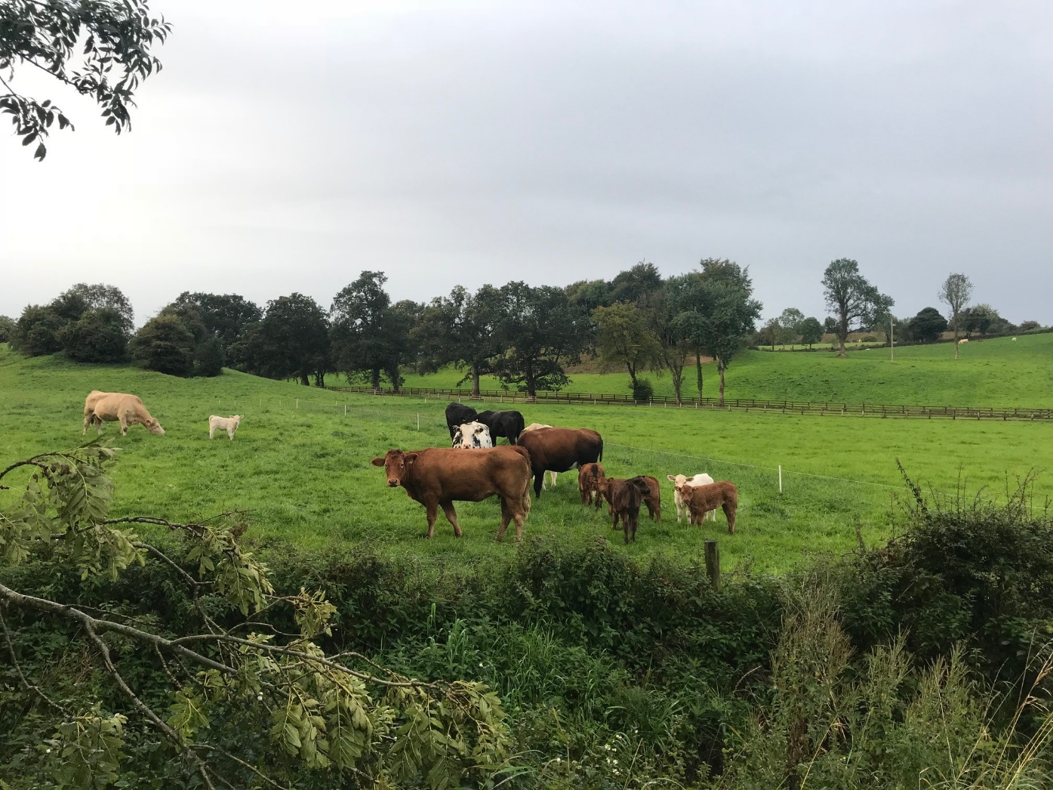
Approach when working with this target group
Being present, grounded, intuitive
“It’s the effortlessness and being in the present that gets results. It’s that sense of connection that you get with people and that can only happen if you are reasonably relaxed and grounded.”
“You need empathy and interest in any case. And then you also have to have patience and be able to be calm and not shy away from conflict. You need a certain stability…”

Slide 25
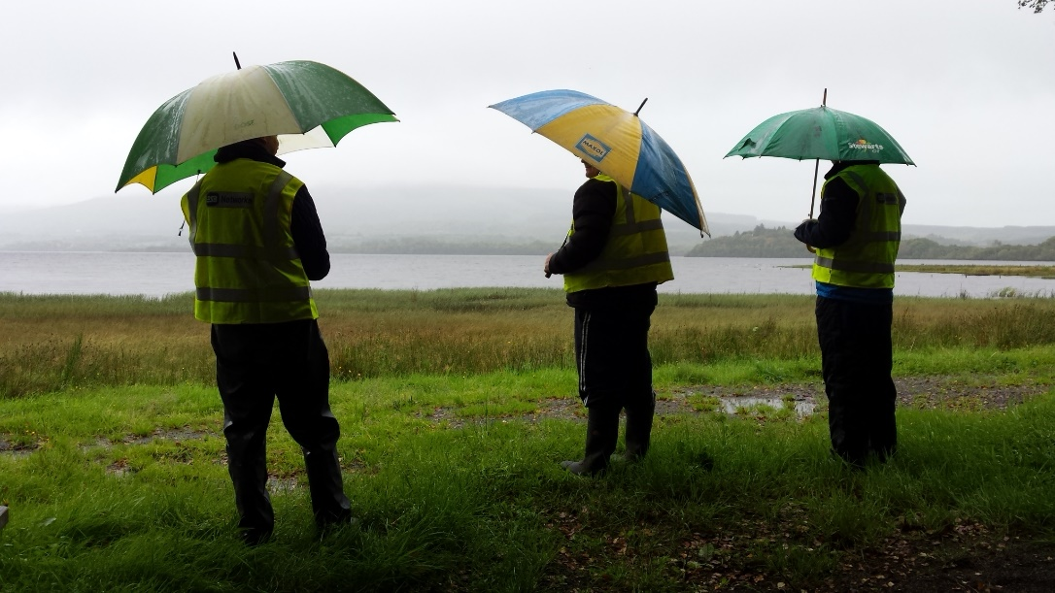
Approach when working with this target group
“One of the things that social farming can offer is that they don’t know the person at the beginning – unlike the service who only know them in one way. Farmers can really have a sense that they can flourish and have potential. If we can keep that in mind, that belief in itself can bring people on. You are creating a space for people to flourish because you assume that you can. They feel amazing when they do.”
Treating people as people
Crucial to see people as people not as their diagnosis or disorder
…and to see people as having potential and as having something to offer
A two-way relationship with benefits for both sides
Extends to respecting people enough to raise issues with behaviour or where things are going wrong
Avoid demarcations or hierarchies in clothes or appearance
© Social Farming Ireland
Notes:
This photo shows how ‘ordinary’ social farming is, it’s just three men standing and chatting together looking out at the rain. And the great thing is, you don’t know who is the farmer and who are the participants.

Slide 26
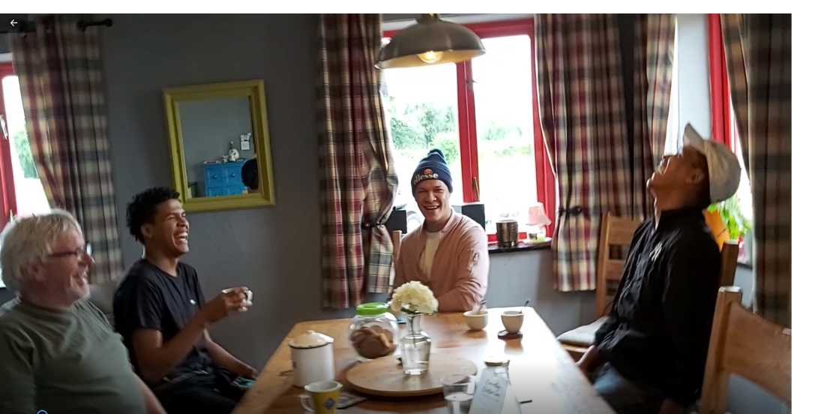
Approach when working with this target group
Role modelling
  Can be issues with lack of self-care around diet, exercise, routines, use of substances, personal care.
  Time spent on the farm should, at a minimum, provide the opportunity for good, wholesome food, good structure and routine, a break form more unhelpful habits.
  Every-day and subtle examples and modelling of self-care without ‘lectures’, can get through to people in a way professional advice doesn’t
“You can provide good modelling in terms of personal hygiene, hand-washing etc. because lack of self- care can be an issue.”
“They also like the interaction with us, with G [other social farmer] especially. I think they find him quite inspiring as a person and it might inspire them to make some changes.”
© Social Farming Ireland
Notes:
The farmer might say at the end of the day something like ‘I can’t wait to get into the shower, you’d feel very mucky after the day on the farm’ or ‘I’ll have an early night tonight after that day’s work’. Or he/she might talk about what’s good to eat, what you need to eat to make you feel good and able to do your work. All of these subtle messages can have an impact as people often look up to and admire the farmers.

Slide 27
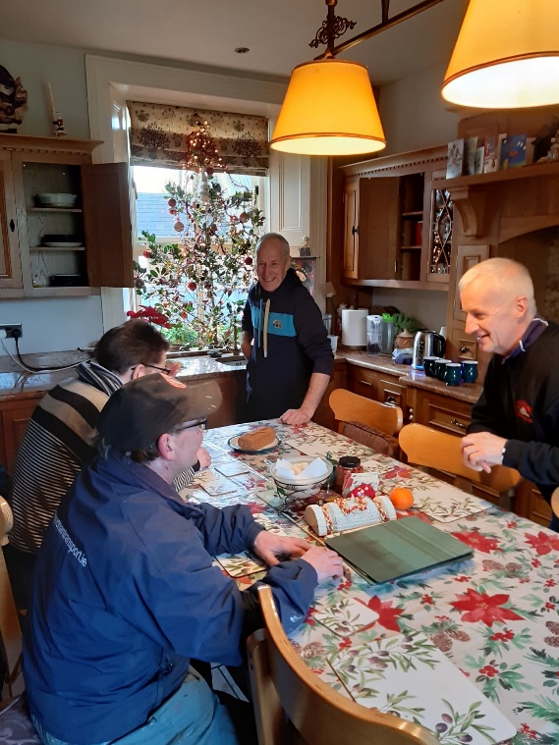
Approach when working with this target group
Creating a sense of belonging
  Important that people feel that they matter, that they are not alone, that they are missed when they are not around.
“Standard if someone is not there then he is missed [...] we will call: what is going on? Why do we miss you? Short lines and see how we can help someone.”
“[important that] they feel that they are not alone in their problems or in their lives and that they are surrounded by the environment of our gardens and the presence of other clients and employees.”
© Social Farming Ireland
Notes:
It is common for people with mental health challenges to feel they are unseen, that they don’t matter, that they are only a burden to other people. The relationships which develop on a social farm, where people are making a contribution, are part of a team…. All of these help people feel part of something, that they are valuable, that other people notice and care whether they are around or not.

Slide 28
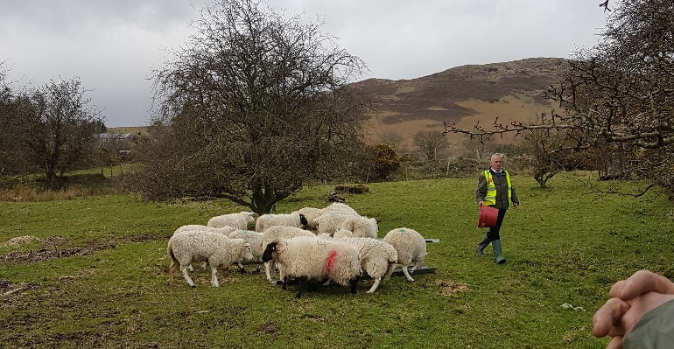
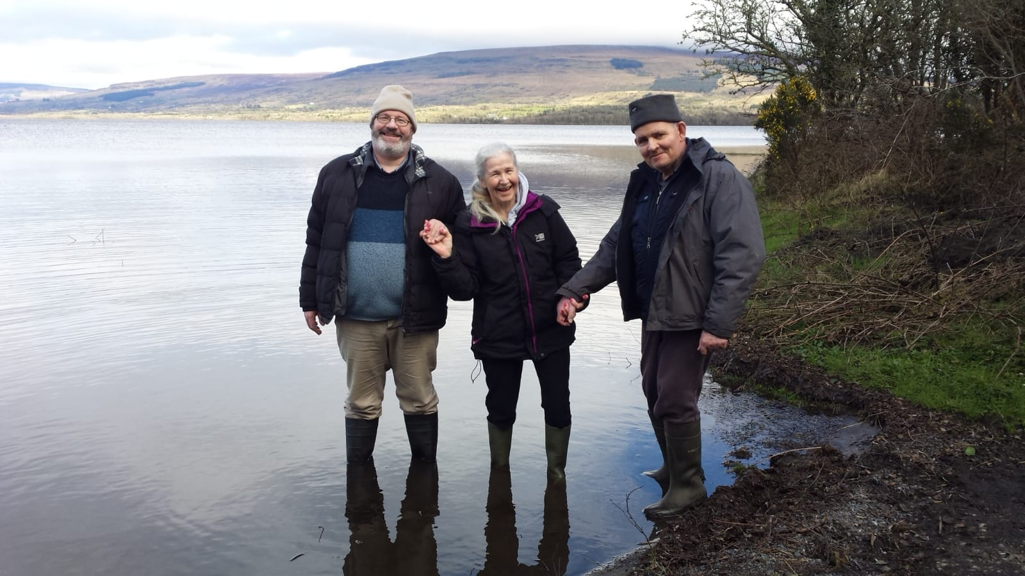
Particular skills & Strengths of Target group
Inherent feature of social farming is its capacity to uncover, draw out and build upon people’s strengths and areas of competence.
In line with a STRENGTHS BASED APPROACH to mental health recovery
People who may have experienced their own health struggles may be more empathetic & supportive of others and display resilience and fortitude in their commitment to their own recovery

Slide 29
Particular skills & Strengths of Target group
Specific Disorders:
  Bipolar: strongly linked with creativity and high energy levels
  ADHD: may also have high energy levels and be very productive if channelled correctly. ‘Out of the box’ thinkers
  ASD: people may be very proficient and knowledgeable about subjects which interest them. Can be very structured and rational and can contribute to planning and developing activities on the farm
  People with anxiety disorders may be very diligent and detail oriented and more hyperaware of themes and patterns
  People with ‘burnout’ may have a high capacity in the work that they do, prone to perfectionism with very high standards

Slide 30
Chapter 4:
Possible behavioural references and challenges

Slide 31
Possible behaviour references and challenges
Lack of motivation and engagement
  People may not participate fully and energetically even if physically present
  Attendance can be problematic, regardless of the quality of the experience
Farmers need to manage their own expectations of how people will be and not take it personally
The need to accept people where they are…..
…but also work to build people’s engagement and interest
“
“If people are disengaged it is very hard. Sometimes you have to almost accept that, emphasise the positive, what has been achieved, reinforcing the qualities of the person.”
“You just have to accept that people are going to zone out and try to bring them back, don’t panic about it. You can’t take it personally if they do.”
“I have also learned that people can behave in a certain way because they have to and it’s become a pattern. But we can gently challenge and change that pattern.”

Slide 32
Possible behaviour references and challenges
Anxiety and Social Anxiety
  People may experience anxiety about this new environment, about their capacity to handle things, about specific aspects of social farming
Over-exuberance/over-activity
Need to be allowed take time and space to ease themselves into the farm and in particular, to deal with the things which may provoke anxiety.
Farmers can work with participants and mental health professionals to assess the correct strategies for dealing with particular issues (avoidance, gradual exposure, etc.)
Ensuring the safety and welfare of everyone on the farm, including the participant displaying this behaviour, is THE key priority.
© Social Farming Ireland
Notes:
Specific aspects: For example, people may be anxious about things like handling animals or having meals with others

Slide 33
Possible behaviour references and challenges
Aggressive and obviously challenging behaviours
  In a small number of cases, participants may show aggression or anger towards the farmer, staff or other participants
Farmers and staff need to remain alert to people’s moods and seek to avert situations before they arise.
They also need to remain calm in the face of provocation and not take the aggression personally
In cases of significant aggression or anger, ensuring the safety of everyone on the farm becomes the main priority…
This includes removing or closing access to any tools, machinery or sites which could cause harm to self or others

Slide 34
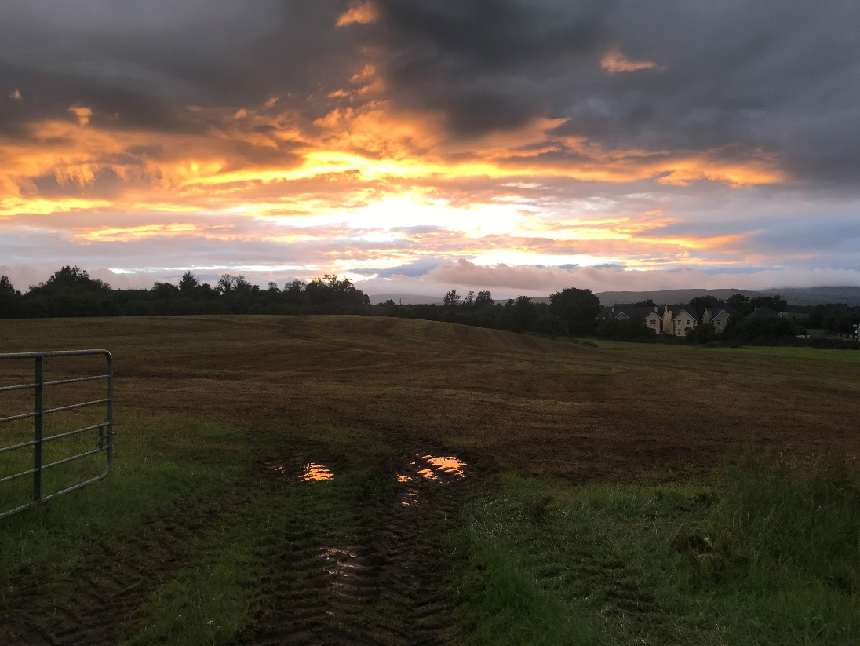
Group exercise
From your learning today, describe three key ‘Do’s’ and three key ‘Don’ts’ in working with this target group on a social farm.

Slide 35
Bibliography
Berget, B., Ekeberg, Ø., Pedersen, I., & Braastad, B., O. (2011). Animal-assisted therapy with farm animals for persons with psychiatric disorders: Effects on anxiety and depression. A randomized controlled trial. Occupational Therapy and Mental Health, 27, 50-64.
Elings, M., D. Haubenhofer, J. Hassink, P. Rietberg & H. Michon (2011) Effects of care farms and other day activity centres for people with mental-ill health and/or drug-addicted history. Wageningen, Wageningen University and Research & Trimbos-Institute.
Elsey, H. (2016). Green fingers and clear minds: prescribing ‘care farming’ for mental illness. British Journal of General Practice, February 2016.
Iancu, S.C., Zweekhorst, M.B., Veltman, D.J., van Balkom, A.J., Bunders, J.F., (2014). Mental health recovery on care farms and day centres: a qualitative comparative study of users' perspectives. Journal of Disability and Rehabilitation, 36, 573–583. Loue, S., Karges, R.R. & Carlton, C. (2014). The therapeutic farm community: an innovative intervention for mental illness. Procedia Social and Behavioural Sciences, 149, 503 – 507.
Pedersen, I., Ihlebæk, C., Kirkevold, M., (2012). Important elements in farm animal assisted interventions for persons with clinical depression: a qualitative interview study. Disability and Rehabilitation, 34, 1526–1534.
Pedersen, I., Patila,G., Bergetb, B., Ihlebæka, C. & Thorsen Gonzalez, M. (2016). Mental health rehabilitation in a care farm context: A descriptive review of Norwegian intervention studies. Work, 53(1), 31-43.

Slide 36
THANK YOU FOR YOUR ATTENTION
Name of Lecturer
  Institution of Lecturer
name@xyz.com

Slide 37

Farming with Refugees and forced displaced people - Agriculture as a path of inclusion © 2023 by SoFarTEAM is licensed under CC BY-NC 4.0.
To view a copy of this license, visit http://creativecommons.org/licenses/by-nc/4.0/
The slides were created by Aisling Moroney
Contact:
Social Farming Ireland
Leitrim Development Company
Church Street
Drumshanbo
Co Leitrim
amoroney@ldco.ie

