Slide 1
Social entrepreneur-ship in Social Farming
Name of Lecturer
  Institution of Lecturer
00
00
0000

Slide 2
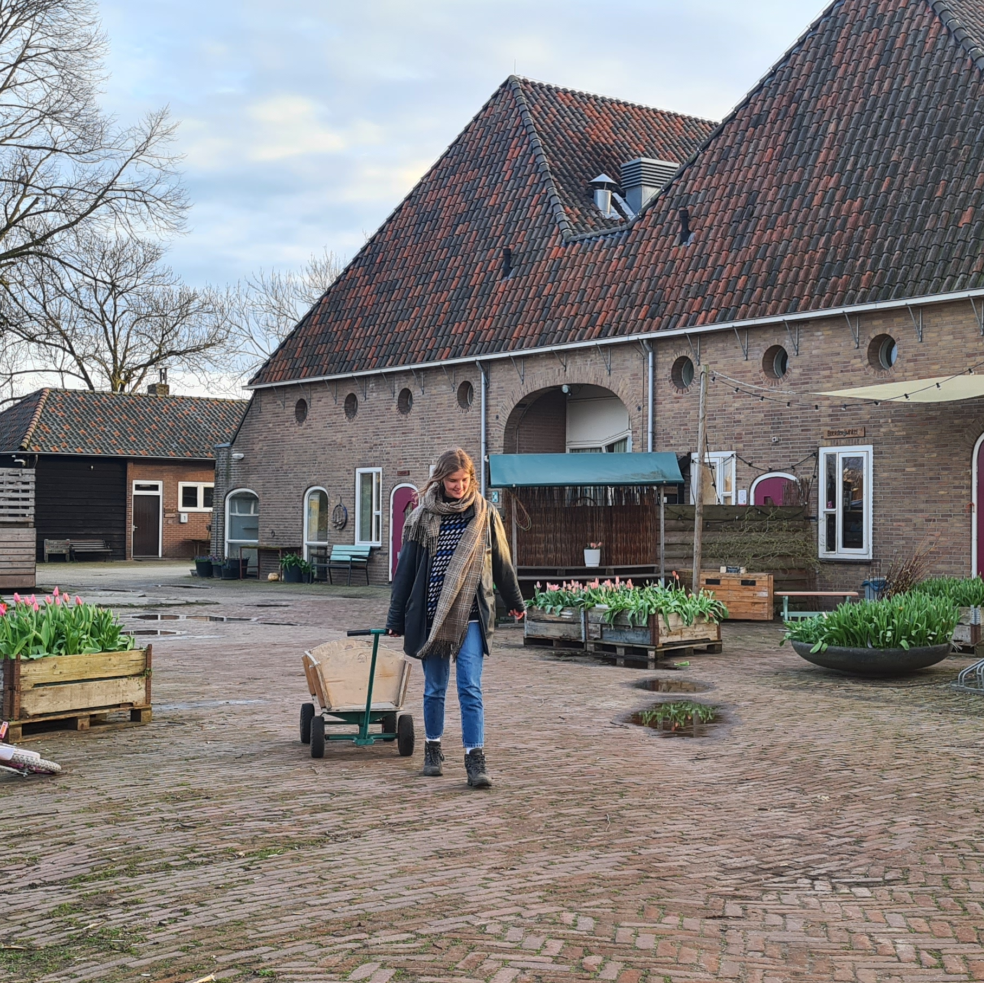
content
Social Enterprise
  Assignment
  Key Successful Factors
  - Having entrepreneurship
  - A good funding mix
  - Diversity of products and services
  - Different target groups
  - Connection with others
  - Location
  - Understanding health care sector
  - Expertise
  - Passion and perseverance

Slide 3
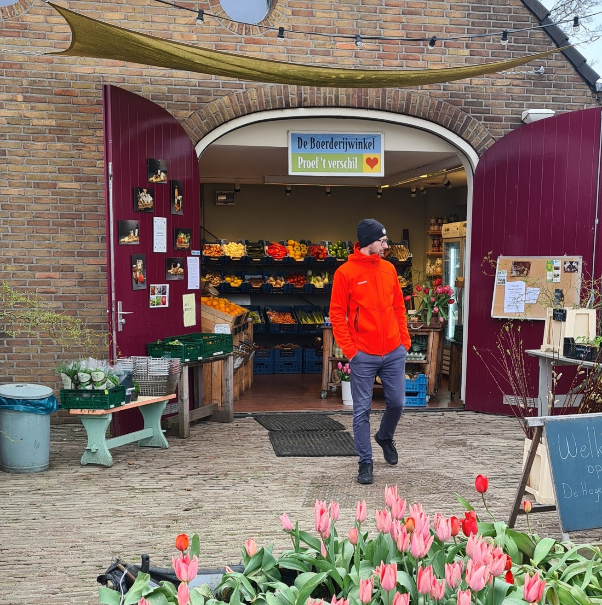
Social enterprise
Social enterprises are independent companies that provide a product or service and have primarily or explicitly a social goal.

Slide 4
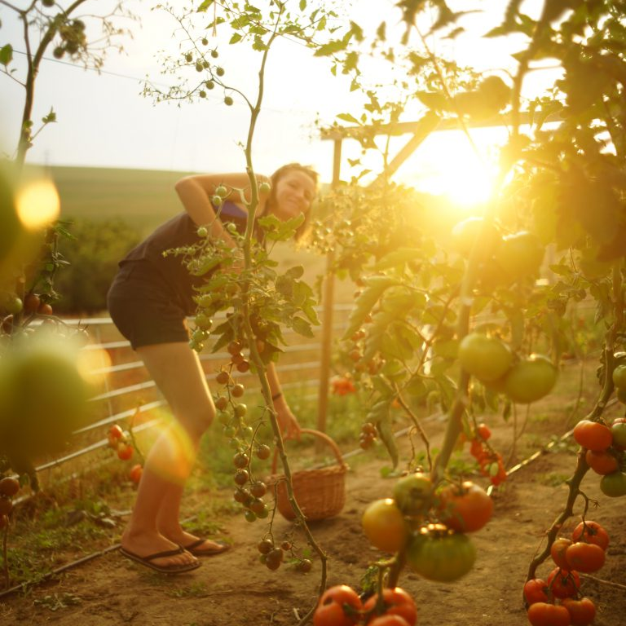
Assignment
Sonja thinks about taking over her
parent’s business
In the future she wants to convert her conventional farm to a social farm
The farm now consist of a large arable farm focused on 3 crops: sugar beet, potatoes and onions
Sonja has a family with 2 young children. Both she and her husband now have a job outside the farm. What questions should Sonja ask herself to come to a good decision?

Slide 5
Some questions Sonja might ask herself:
Which target group would I like to work with?
Does working with vulnerable people suit the farm as it is designed today?
What activities or services are needed in the area (demand-side)?
If I will run a social farm how do I make sure I keep private and work separately and in balance?

Slide 6
Some questions Sonja might ask herself:
What activities can I offer people here on my farm?
Can people easily reach the farm (logistics)?
What kind of person am I? Does entrepreneurship suit me? Which target group would suit me best?
How can I make my enterprise economically sound? How can I finance my social farm?
What does the social map in the area look like?

Slide 7
Key Success Factors

Slide 8
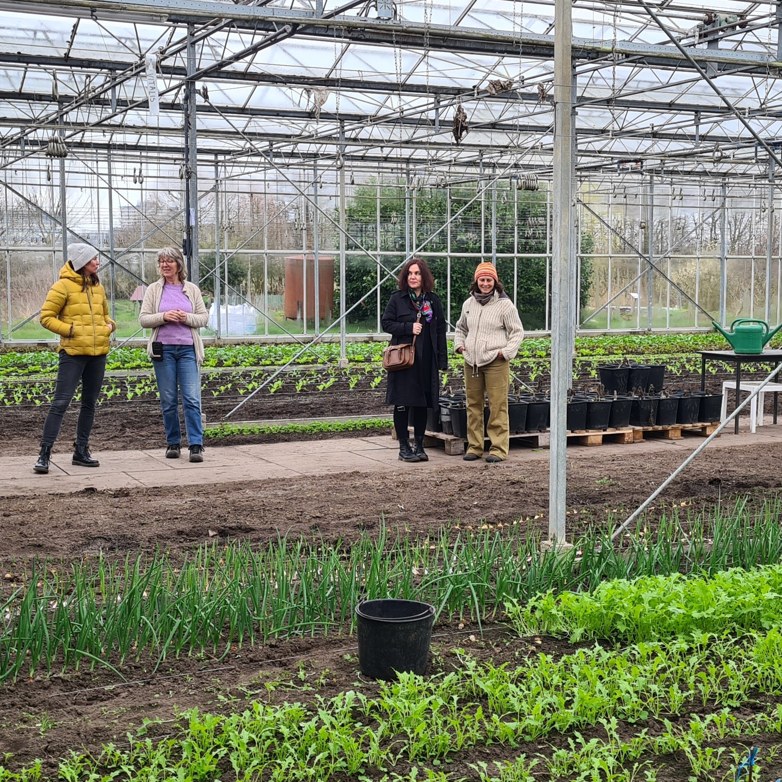
Entrepreneurship
Like to run a business
See opportunities and dare to take risks
Seek your way into legislation
Can delegate work
Know what your qualities are and how other staff can add to these qualities

Slide 9
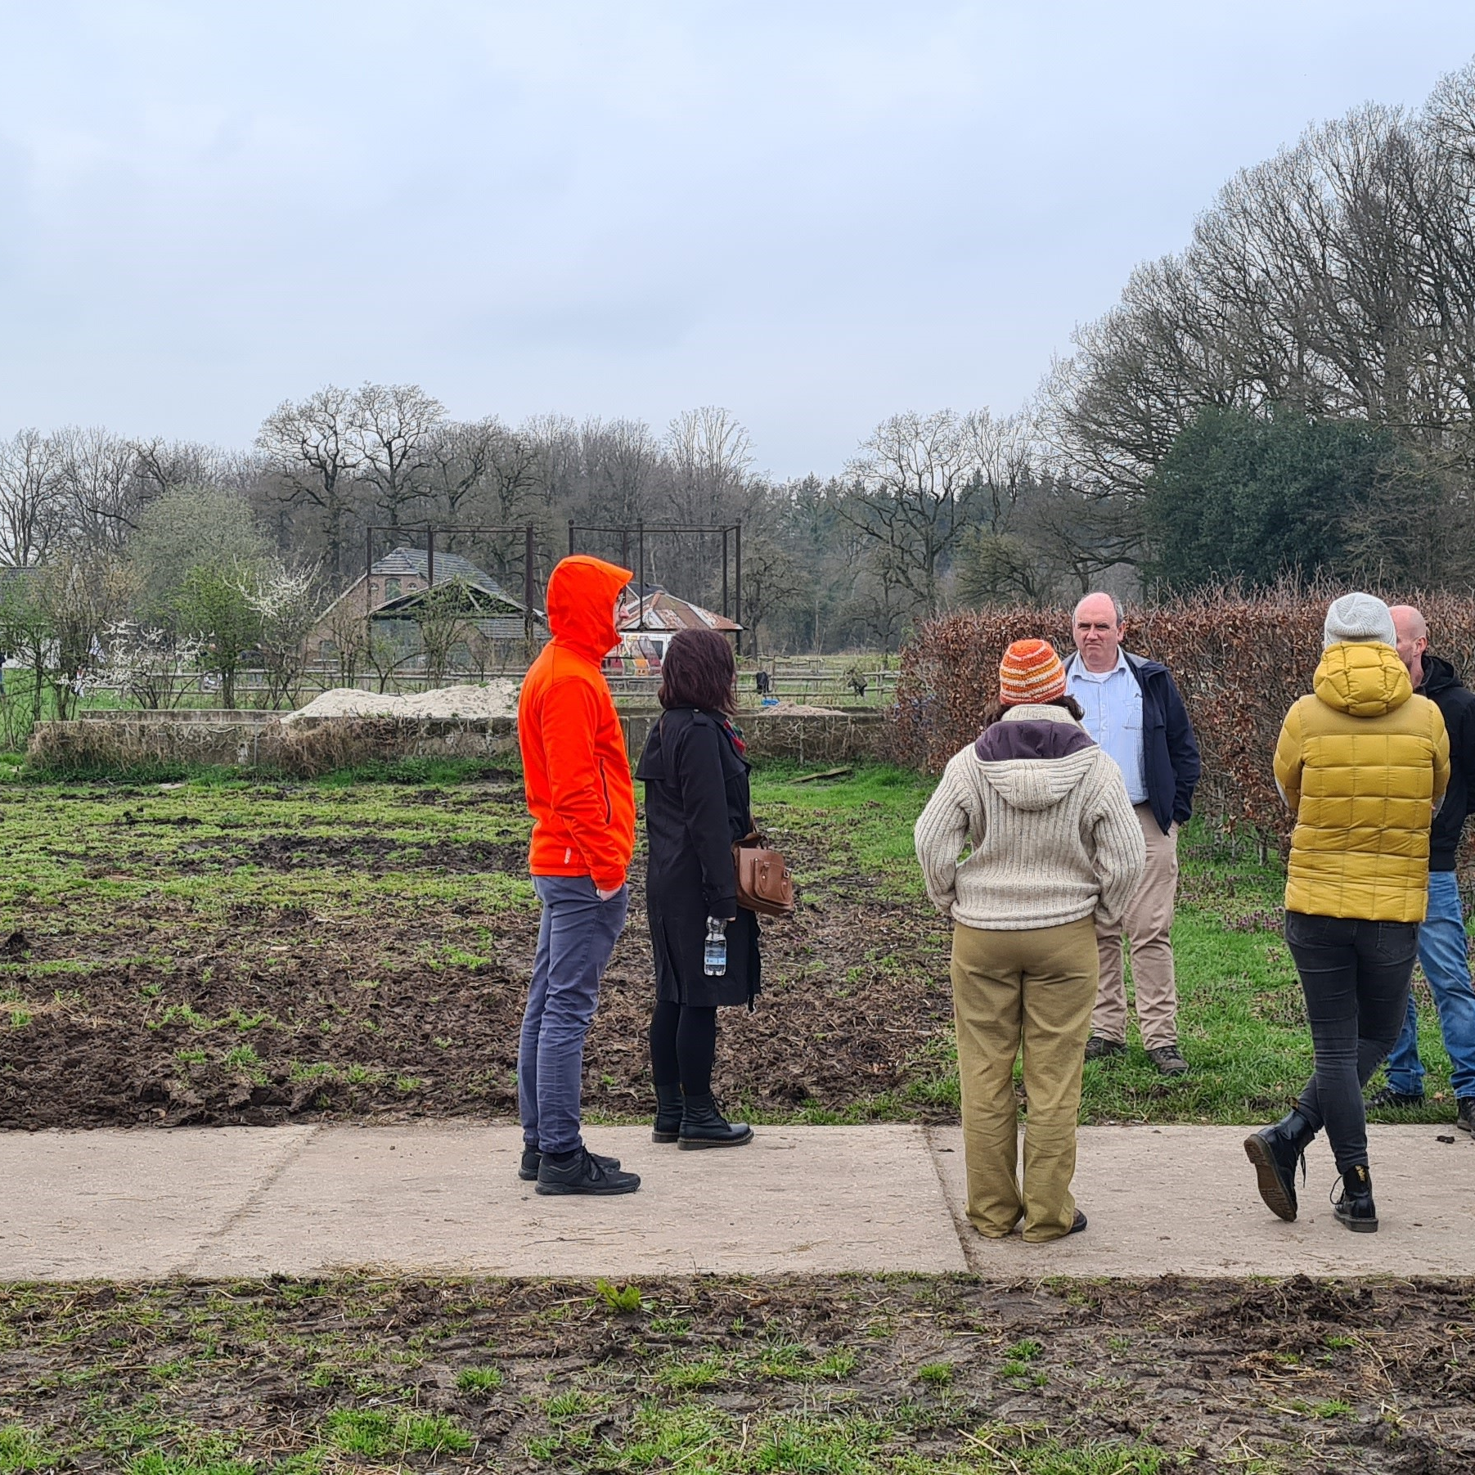
A good funding mix
Commercial activities
Income from providing care
Subsidies, sponsorship and donations
Think carefully about the legal form of your enterprise
Subsidies, donations and crowdfunding are important to show funders that others also have faith in the concept

Slide 10
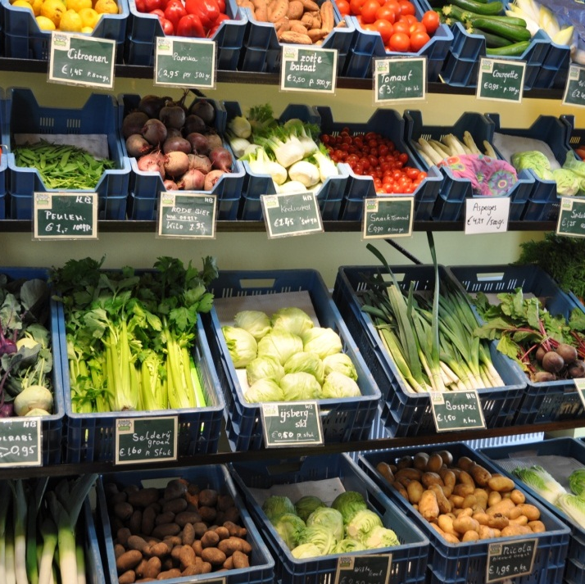
Diversity of products and services
Different crops to spread risk
Influence of weather, diseases and pests
Different products and services makes you less dependent in the whims of the market
Diversity is maybe less efficient but applies maybe better with social enterprises

Slide 11
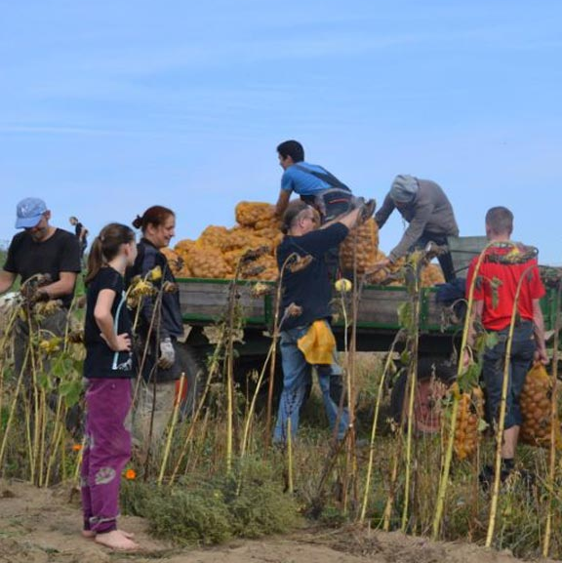
Diversity of products and services
Select those products and services that match the development goals of your target group
F.i. variety of activities offers more opportunities for development of skills
If your work is already fixed, it is good to find the right target group f.i. think of work pressure

Slide 12
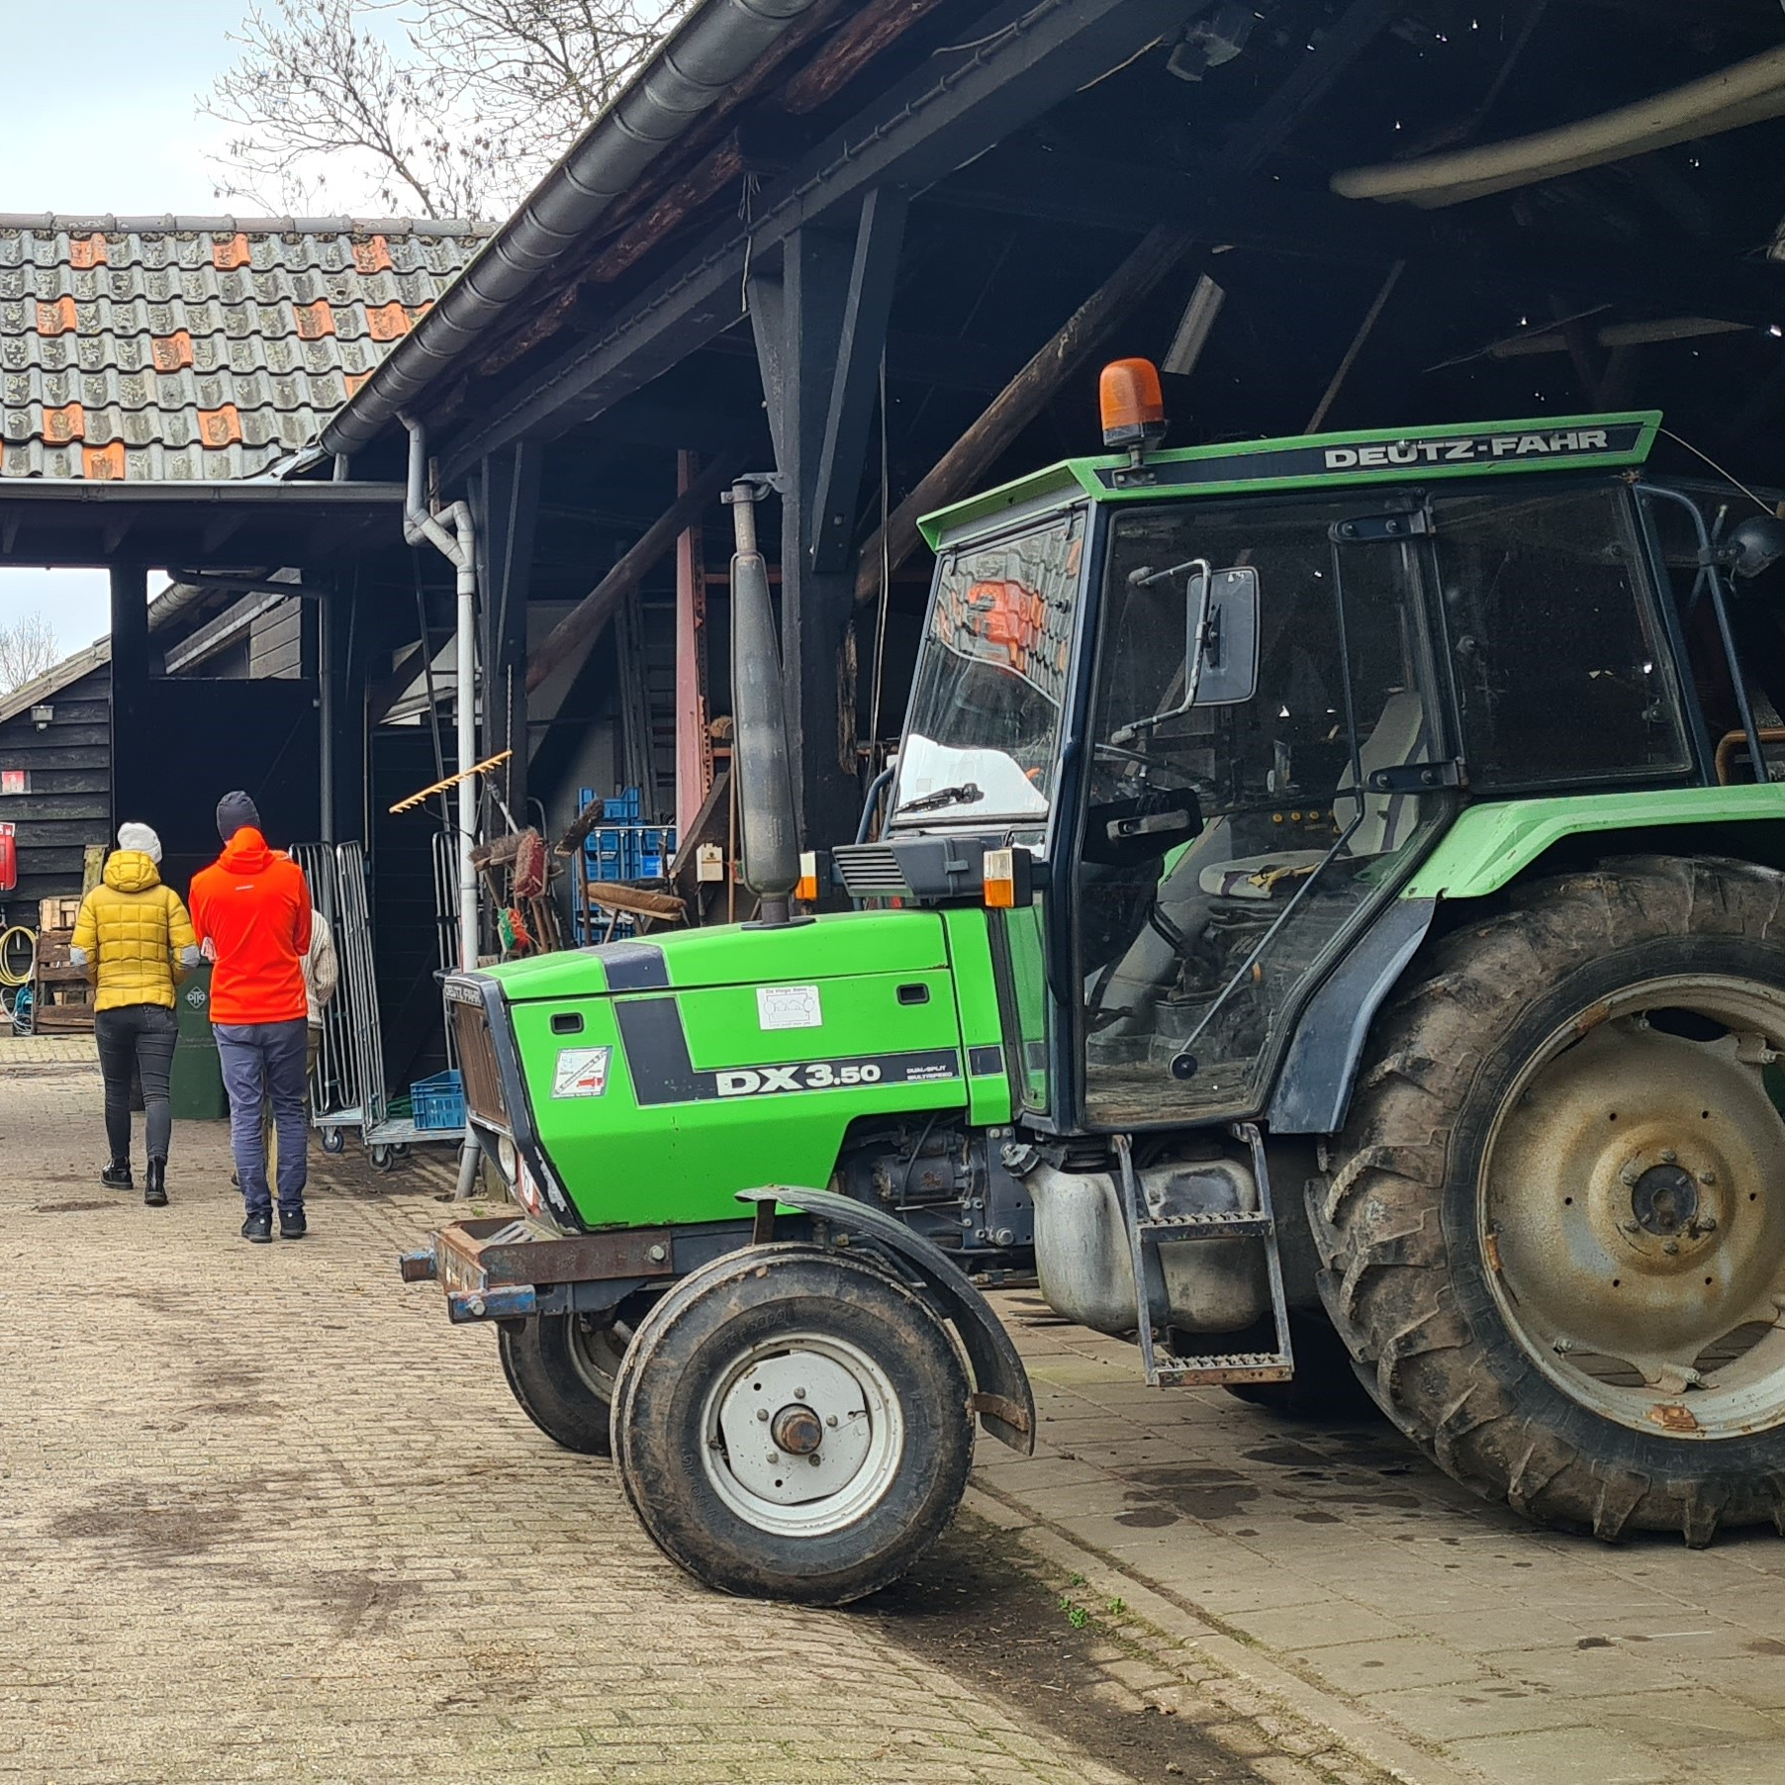
Diversity of products and services
Year round activities especially winter can be a problem
Especially for urban agriculture projects other activities than only crop production can contribute to the financial result
F.i. urban agriculture is not commercially viable in big cities

Slide 13
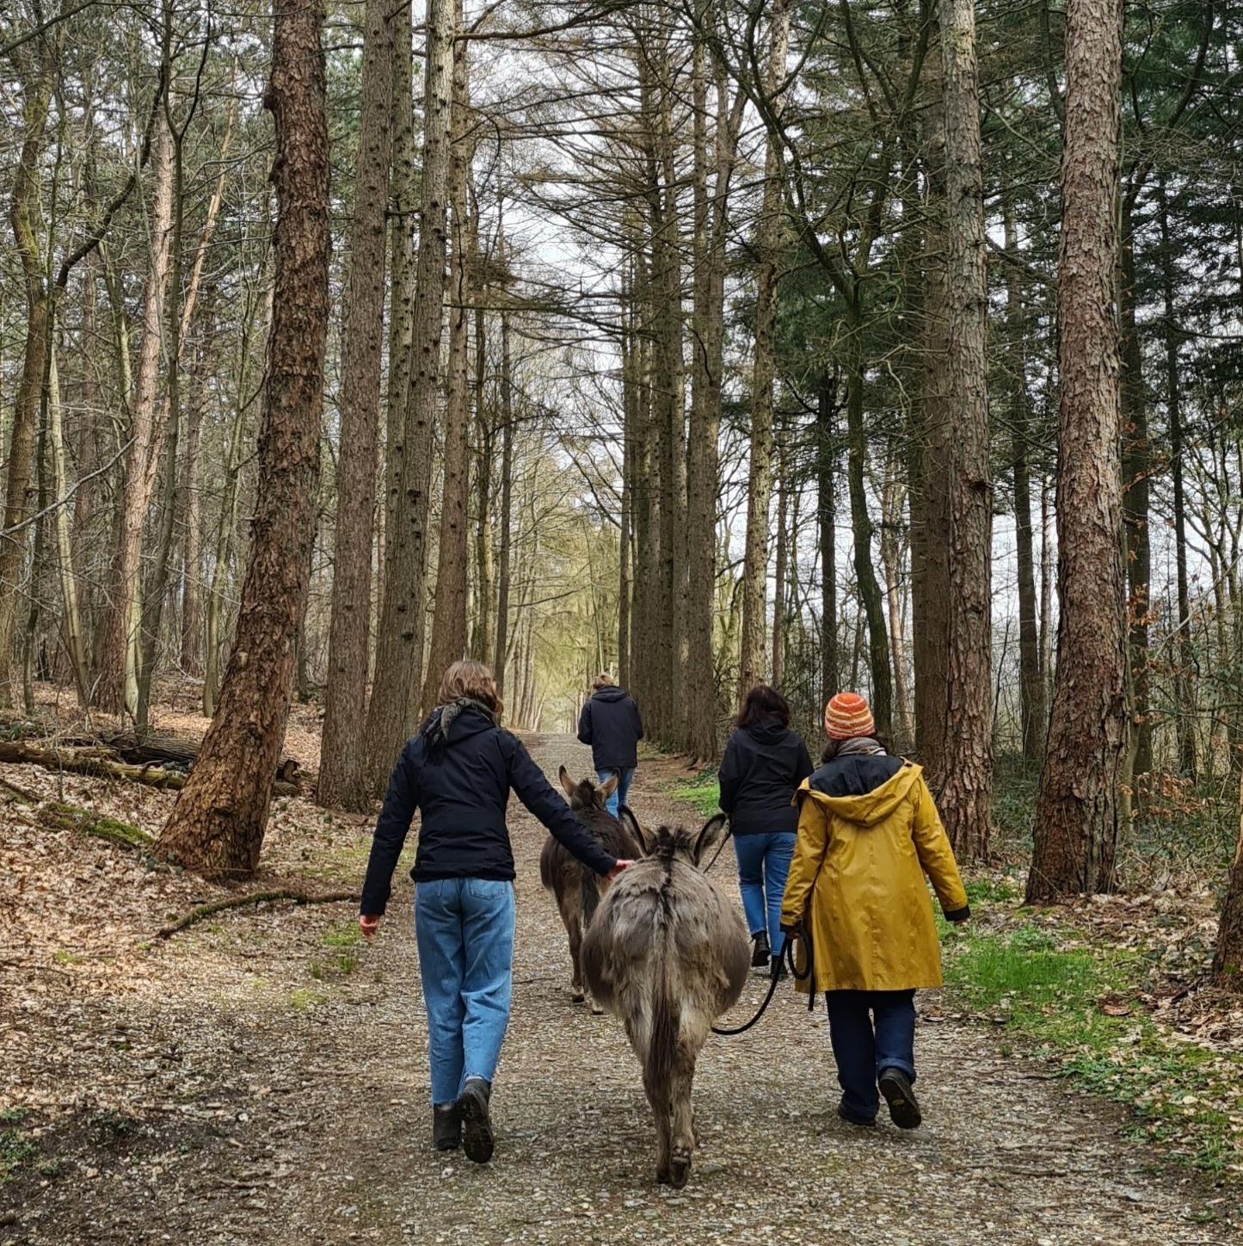
Different target groups make the social enterprise more robust
Take into account changing laws and regulations
Different target groups makes an enterprise less vulnerable for changes in health care

Slide 14
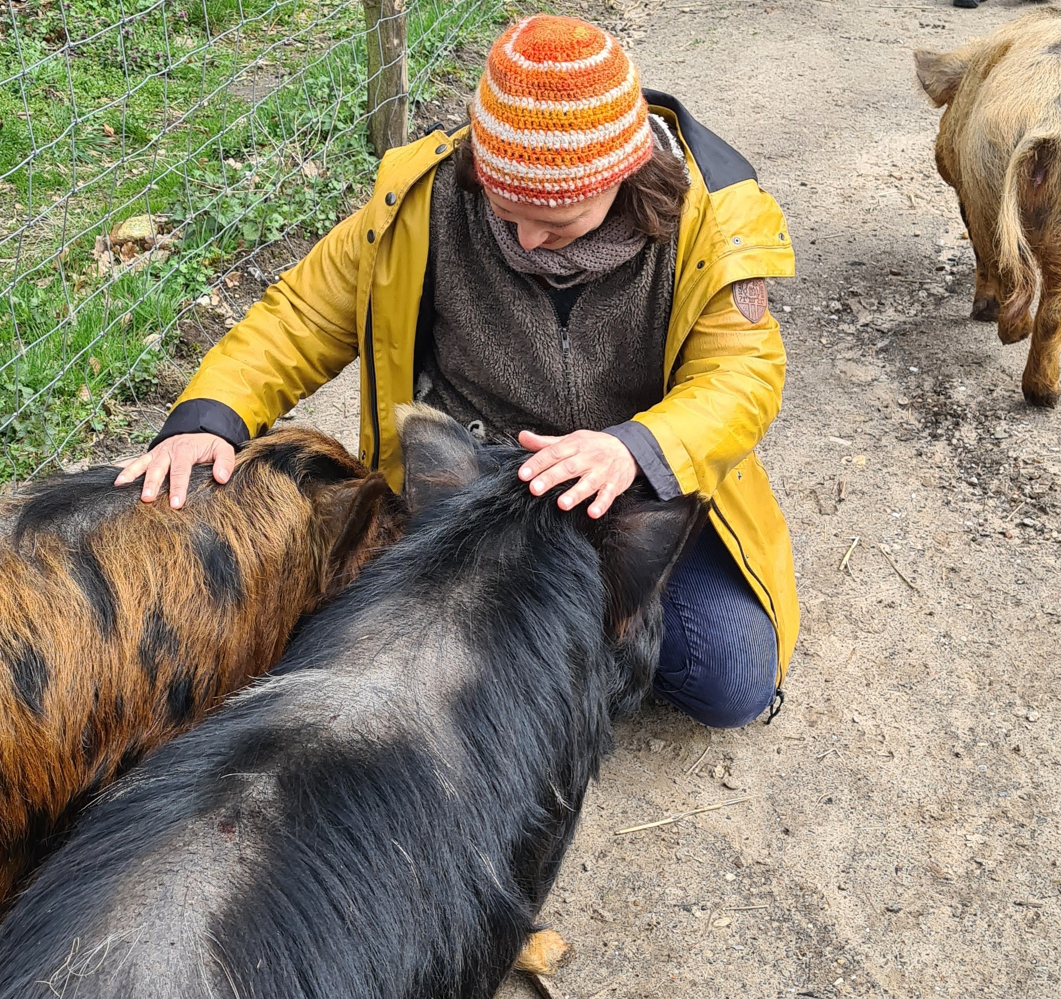
Connecting governments, businesses and citizens to your social enterprise
The ‘award factor’ is important f.i. in finding land or having activities on your place/farm
Bind authorities to your project f.i. by having an open day and inviting companies from the neighbourhood
Make the impact of your enterprise visible
Ask how your initiative fits in with goals, problems or challenges of authorities like the municipality f.i. school drop-outs

Slide 15
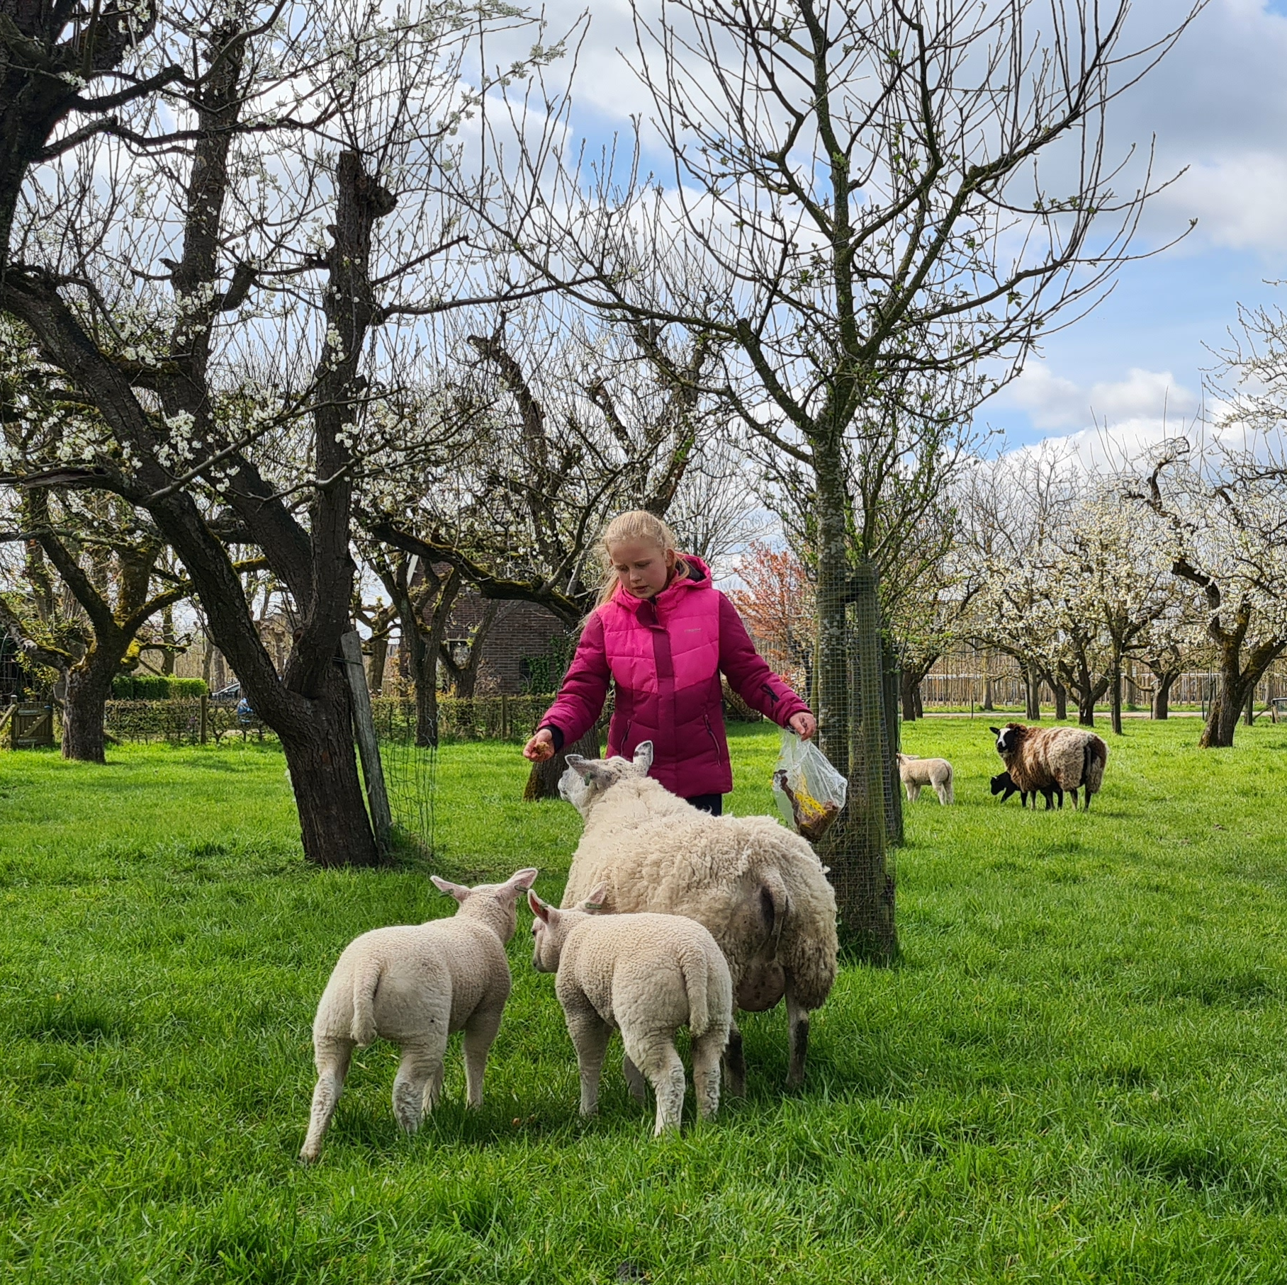
Connecting governments, businesses and citizens to your social enterprise
Connect to companies and citizens that can sponsor in money or in kind.
‘Club of 100’
Crowdfunding

Slide 16
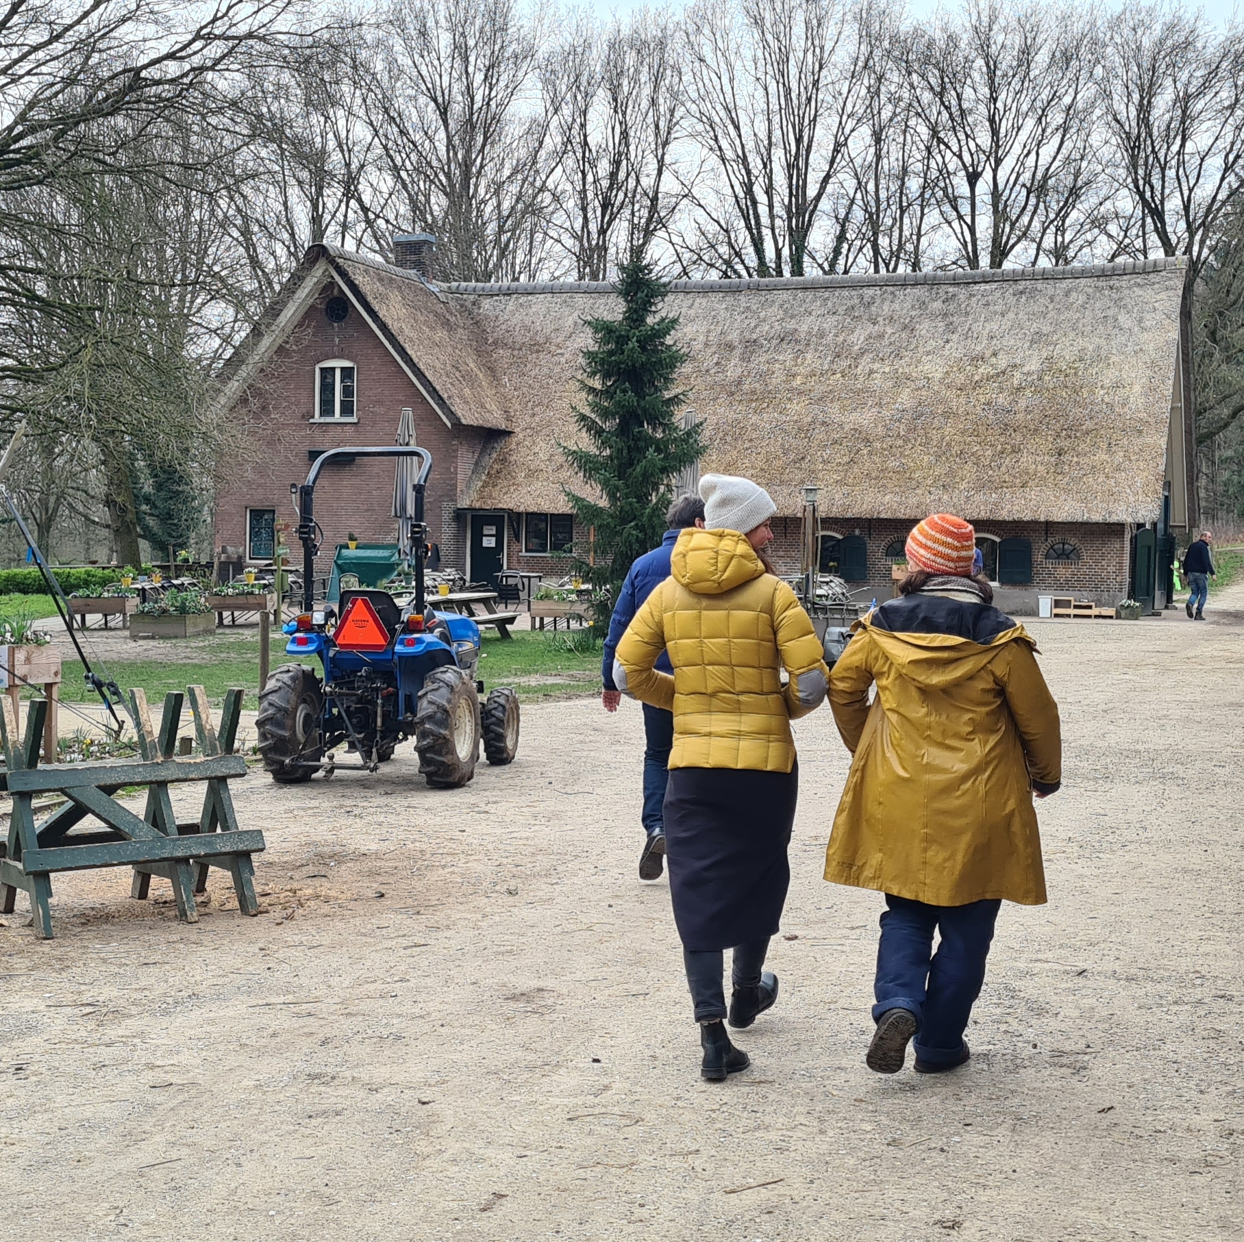
Location
Suitable land where you can grow products
Land that you own or can lease for a longer period
Right place where costumers can find you
Logistics, the distribution of your products
Accessibility for the target group

Slide 17
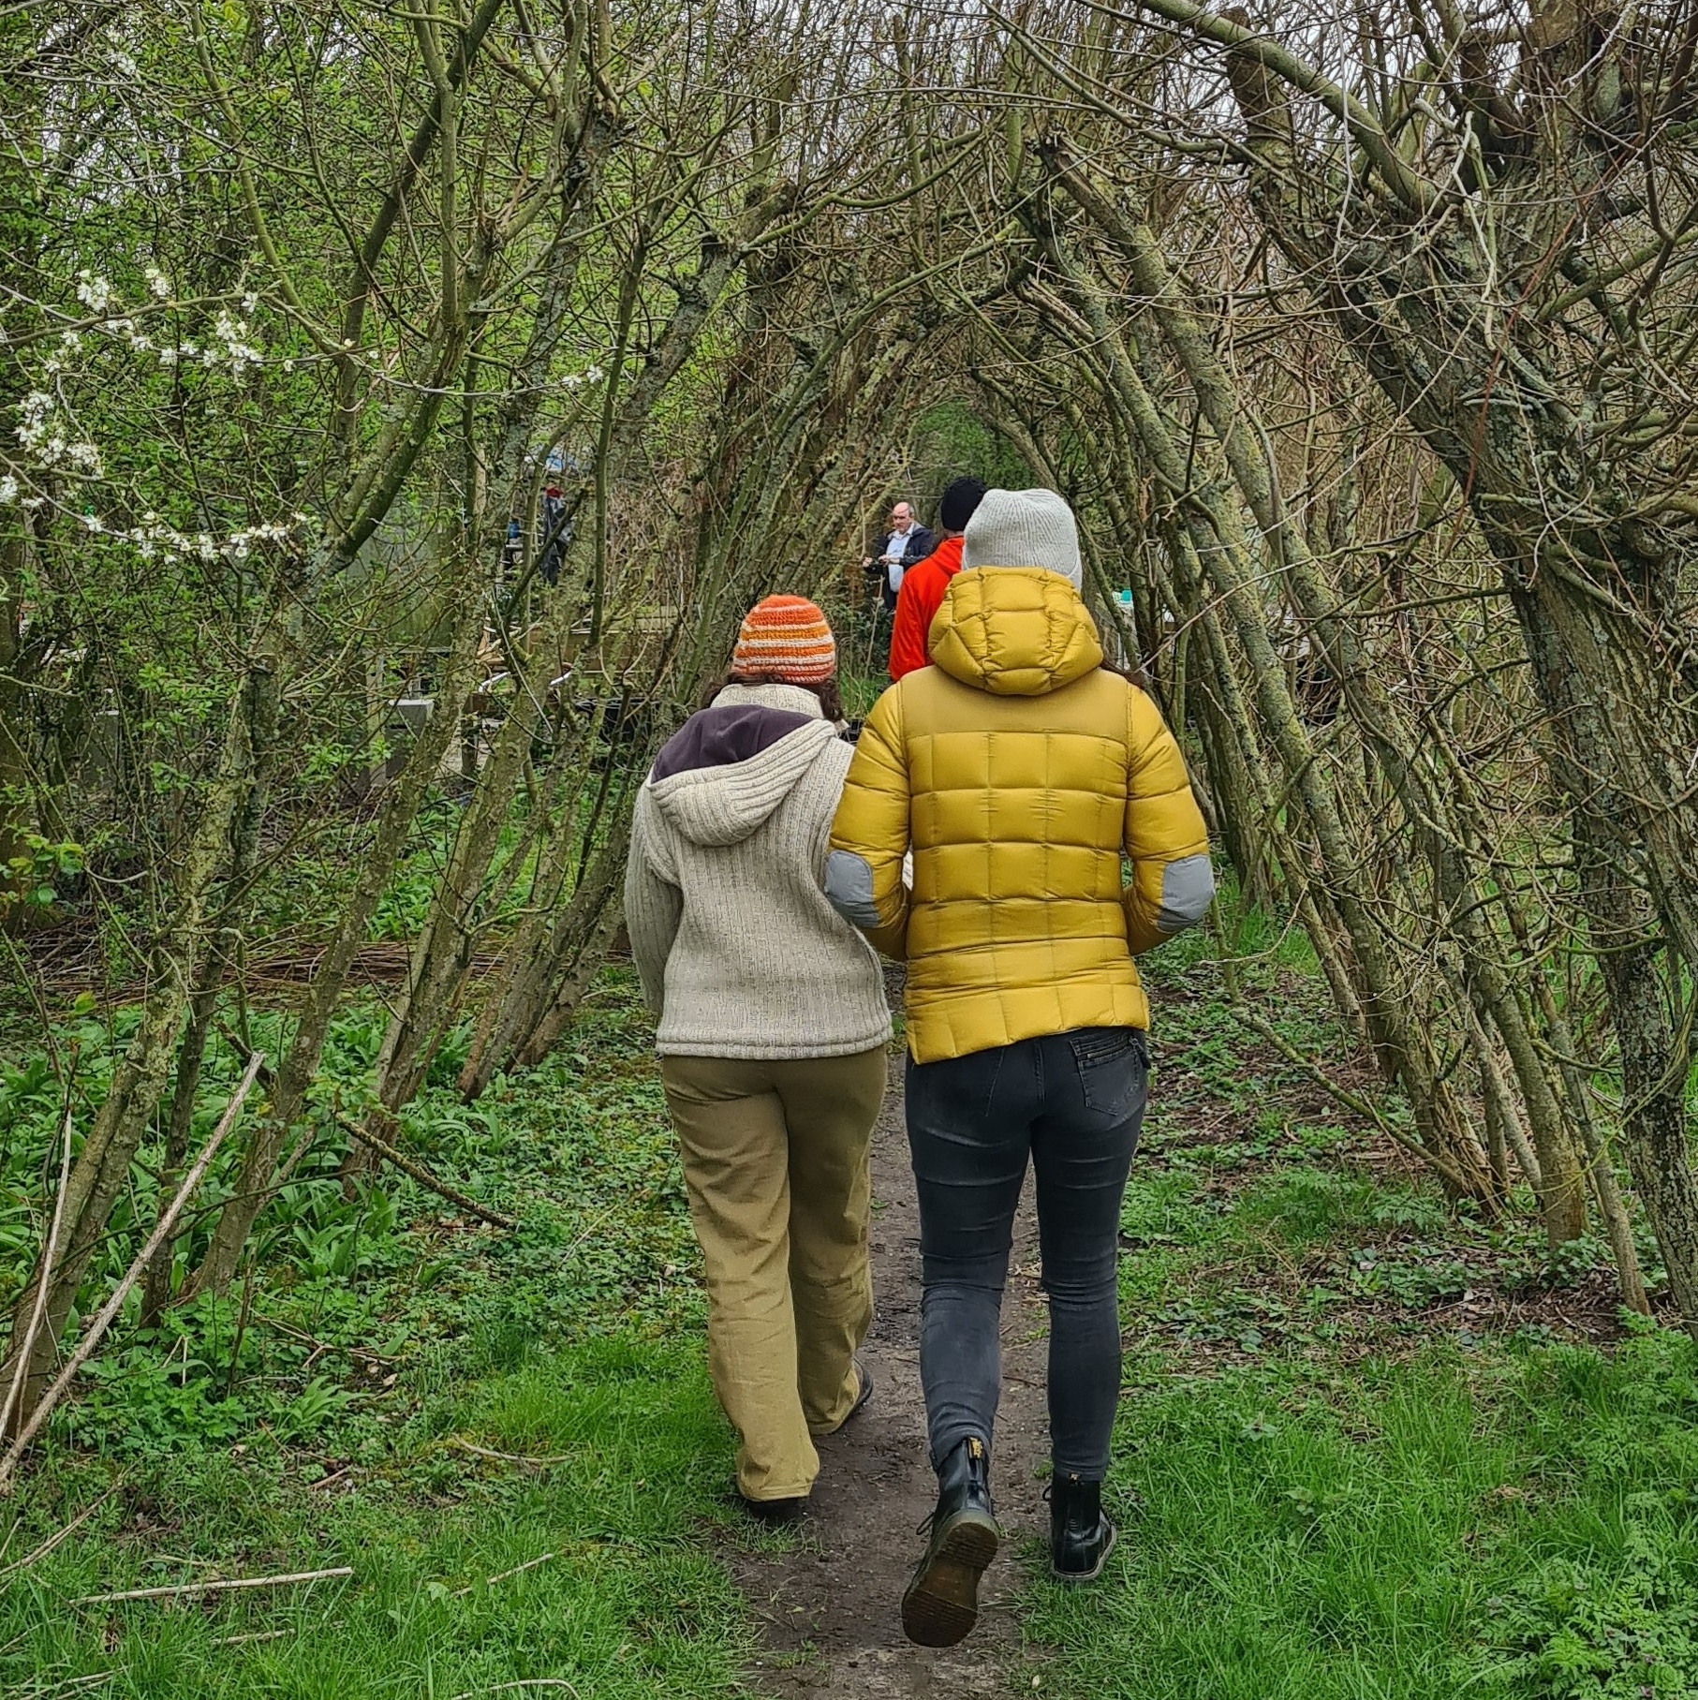
Understanding healthcare (financing)
Knowledge of social map in region
Knowledge of how healthcare sector is organized and financed

Slide 18
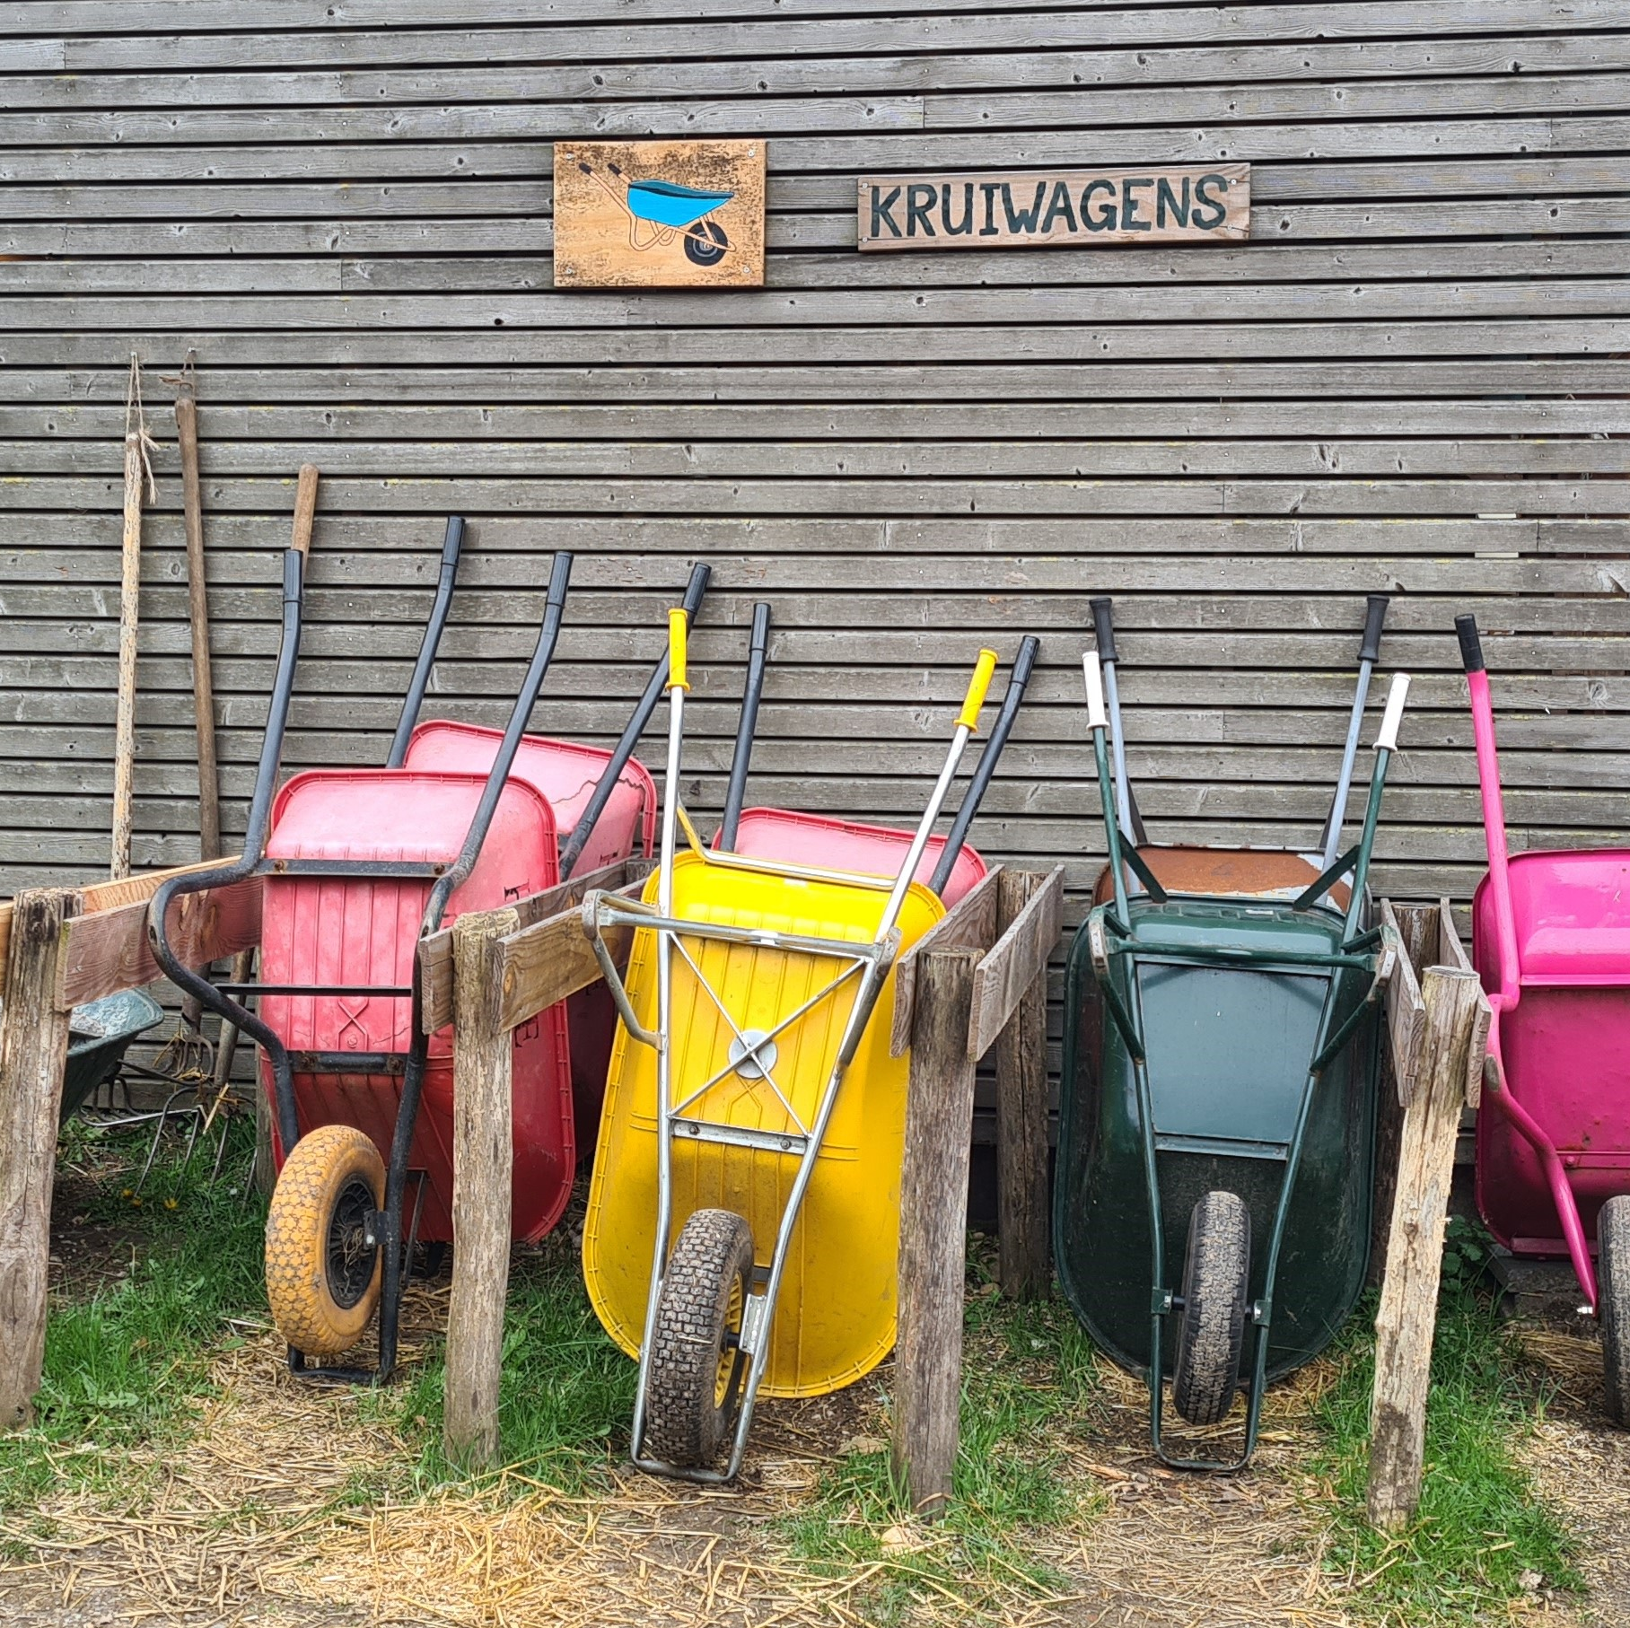
Expertise
Know how of the product and services and deliver high quality
To be a role model for your employees
Deliver high-quality product, you need to understand the business
Affinity for working with people
Education in health care or social work? Non-medical atmosphere
Find the right competences by doing training, being coached or hire personnel.

Slide 19
Passion and perseverance
Having passion for your products and working with the target group
The beginning is always difficult
But at the end you look back to a great process and result!

Slide 20

Assignment:
Starting as a social farming entrepreneur
What factors do you think are important when starting a business in social farming?

Slide 21
thank you for your attention
Name of Lecturer
  Institution of Lecturer
name@xyz.com

Slide 22

Farming with Refugees and forced displaced people - Agriculture as a path of inclusion © 2023 by SoFarTEAM is licensed under CC BY-NC 4.0.
To view a copy of this license, visit http://creativecommons.org/licenses/by-nc/4.0/
The slides were created by Marjolein Elings
Contact:
Wageningen University & Research
Droevendaalsesteeg 1
6708 PB Wageningen, Netherlands
marjolein.elings@wur.nl

