Slide 1
People with physical disabilities
Name of Lecturer
Institution of Lecturer
00
00
0000

Slide 2
List of contents
General characteristics and performances of physical disabilities
Classification of physical disability
Benefits of social farming for people with a physical disability
Possible behavioural references of people with a physical disability
Different services provided for people with a physical disability

Slide 3
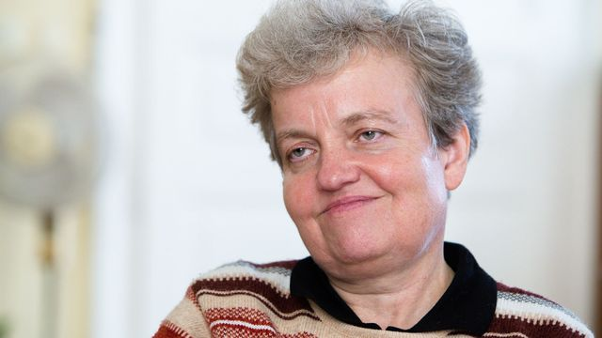
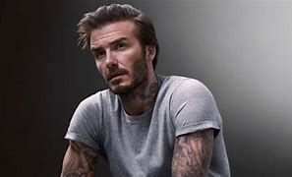
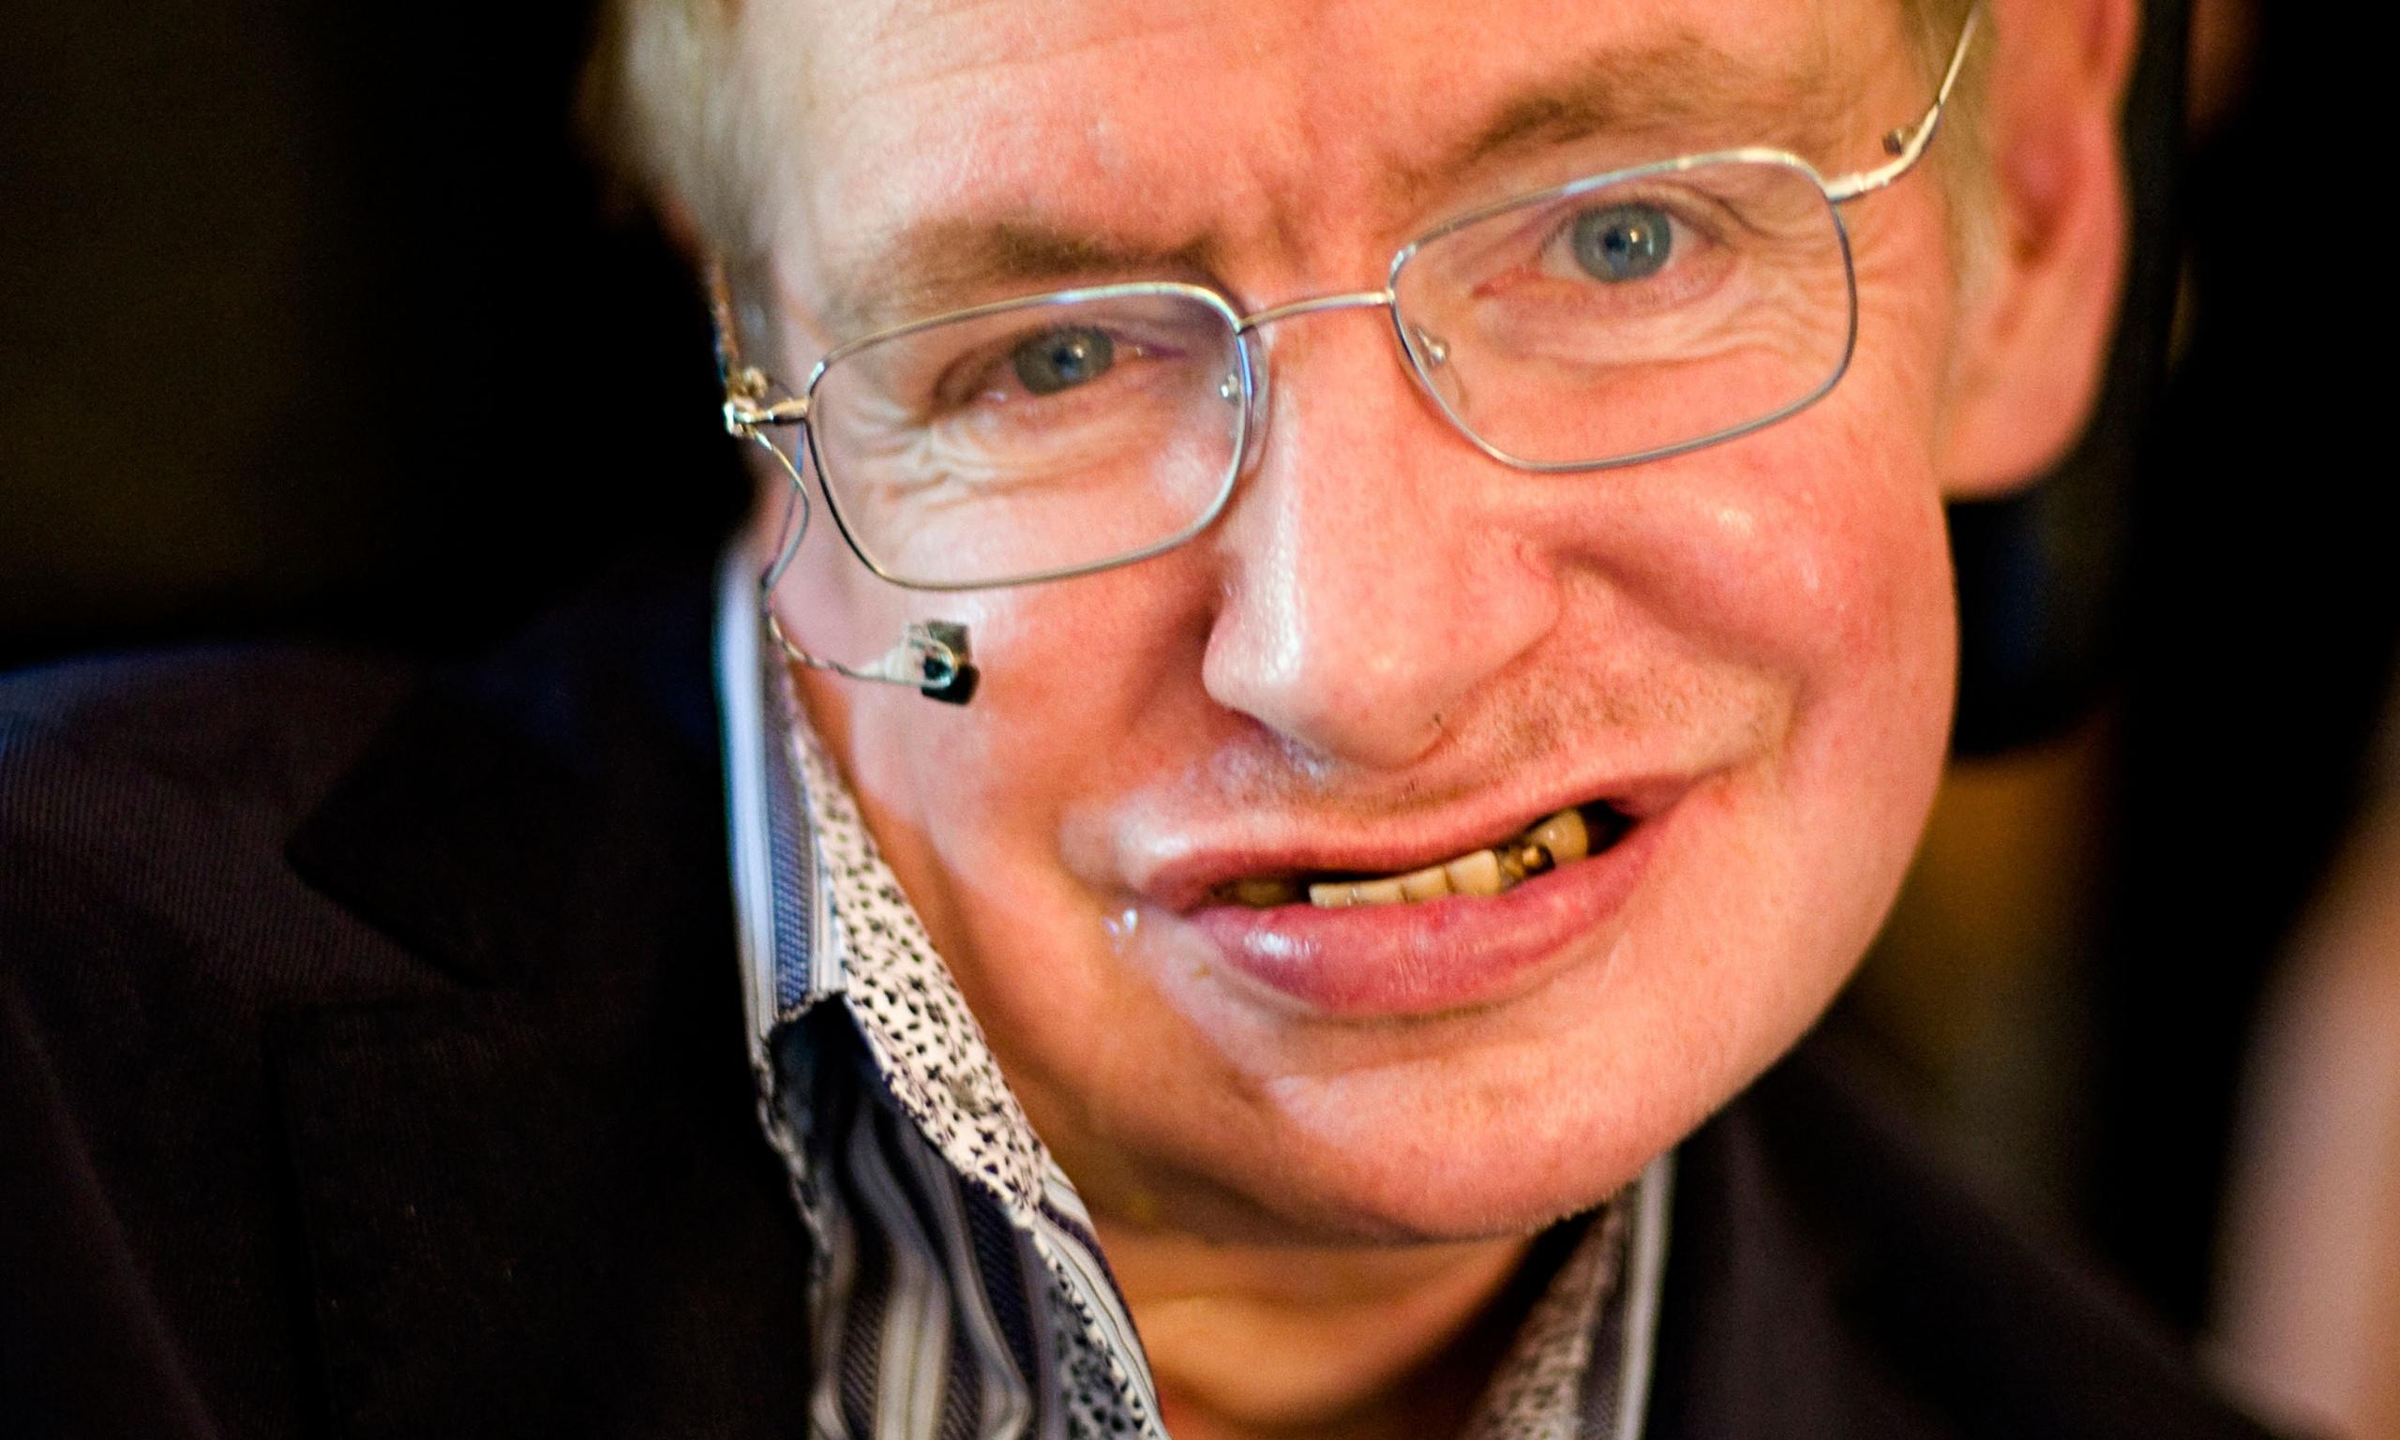
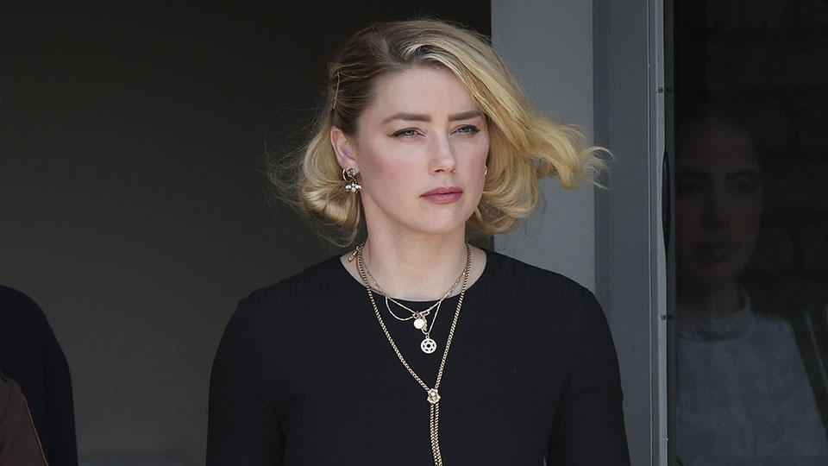
Notes:
Find photos of celebrities who have disabilities. Discuss how their disability affects their performance. Discuss the "halo effect" concept.
Edward Thorndike, early behaviorist who delved into the psychology of learning. First recognized the halo effect (tha halo error) with empirical evidence and introduced the term in 1920 in his article „A Constatnt Error in Psychological Ratings“. Thorndike discovered that a person‘s attractiveness signigficantly influended how that person‘s other attributes were assessed.
The halo effect is a cognitive attribution of bias that involves the unfounded application of general judgement to a specific traits. For example, if you perceived a person to be warm and friendly, we will attribute a number of other associated traits to that person without any knowledge that they are true, such as they are generous.
According to the psychological concept the halo effect, one patent attribute of a certain person leads an observer to draw generalizing conclusion about that person (Ellis, 2018).
A single positive quality of a person may induce a positive predisposition toward every aspect of that person while one negative attribute of that person may induce an overall negative impression of that person.
„A more recent study examined residual cues to intelligence in male and female faces while also seeking to control for attractiveness associated with the halo effect (Moore, Filippou & Perrett, 2011).
Out of over 300 photos of British college students, pictures of high-intelligence composite faces were created from the photos rated the highest in perceived intelligence, and pictures of low-intelligence composite from the photos rated the lowest in perceived intelligence. Then each group of photos was further divided into male and female faces. The participants of the study, which comprised 92 males and 164 females, were to rate the composite faces for attractiveness and intelligence. For the male composites, the high-perceived intelligence group was rated as notably more attractive than their low-perceived intelligence counter parts.
Moreover, the attractive male faces were also perceived to be friendlier and funnier by women as well as men. The results seemed to indicate that intelligence might be a crucial component of attractiveness in male faces.“ (Halo Effect: Definition and Examples | Simply Psychology)
Edward Thorndike, early behaviorist who delved into the psychology of learning. First recognized the halo effect (tha halo error) with empirical evidence and introduced the term in 1920 in his article „A Constatnt Error in Psychological Ratings“. Thorndike discovered that a person‘s attractiveness signigficantly influended how that person‘s other attributes were assessed.
The halo effect is a cognitive attribution of bias that involves the unfounded application of general judgement to a specific traits. For example, if you perceived a person to be warm and friendly, we will attribute a number of other associated traits to that person without any knowledge that they are true, such as they are generous.
According to the psychological concept the halo effect, one patent attribute of a certain person leads an observer to draw generalizing conclusion about that person (Ellis, 2018).
A single positive quality of a person may induce a positive predisposition toward every aspect of that person while one negative attribute of that person may induce an overall negative impression of that person.
„A more recent study examined residual cues to intelligence in male and female faces while also seeking to control for attractiveness associated with the halo effect (Moore, Filippou & Perrett, 2011).
Out of over 300 photos of British college students, pictures of high-intelligence composite faces were created from the photos rated the highest in perceived intelligence, and pictures of low-intelligence composite from the photos rated the lowest in perceived intelligence. Then each group of photos was further divided into male and female faces. The participants of the study, which comprised 92 males and 164 females, were to rate the composite faces for attractiveness and intelligence. For the male composites, the high-perceived intelligence group was rated as notably more attractive than their low-perceived intelligence counter parts.
Moreover, the attractive male faces were also perceived to be friendlier and funnier by women as well as men. The results seemed to indicate that intelligence might be a crucial component of attractiveness in male faces.“ (Halo Effect: Definition and Examples | Simply Psychology)

Slide 4
About physical disabilities
The visibility of handicaps is linked with prejudices and fear („the halo effect/error“)
A contradiction between mental and psychical independence and complete physical dependence on external care and support
They are individual and unique
Two persons with the same physical disability have no the same functionning impairments
Notes:
Negative attitudes are often associated with adverse social reactions, compassion and aversion

Slide 5
Definition BY BARKER (2003)
„A disability can be defined as a temporary or permanent reduction in function; the inability to perform some activities that most others can perform, usually due to a physical or mental condition or infirmity. The restrictions in movement and other limitations may influence self-determination and social interaction and can lead to changes in cognition.“
Notes:
Negative attitudes are often associated with adverse social reactions, compassion and aversion

Slide 6
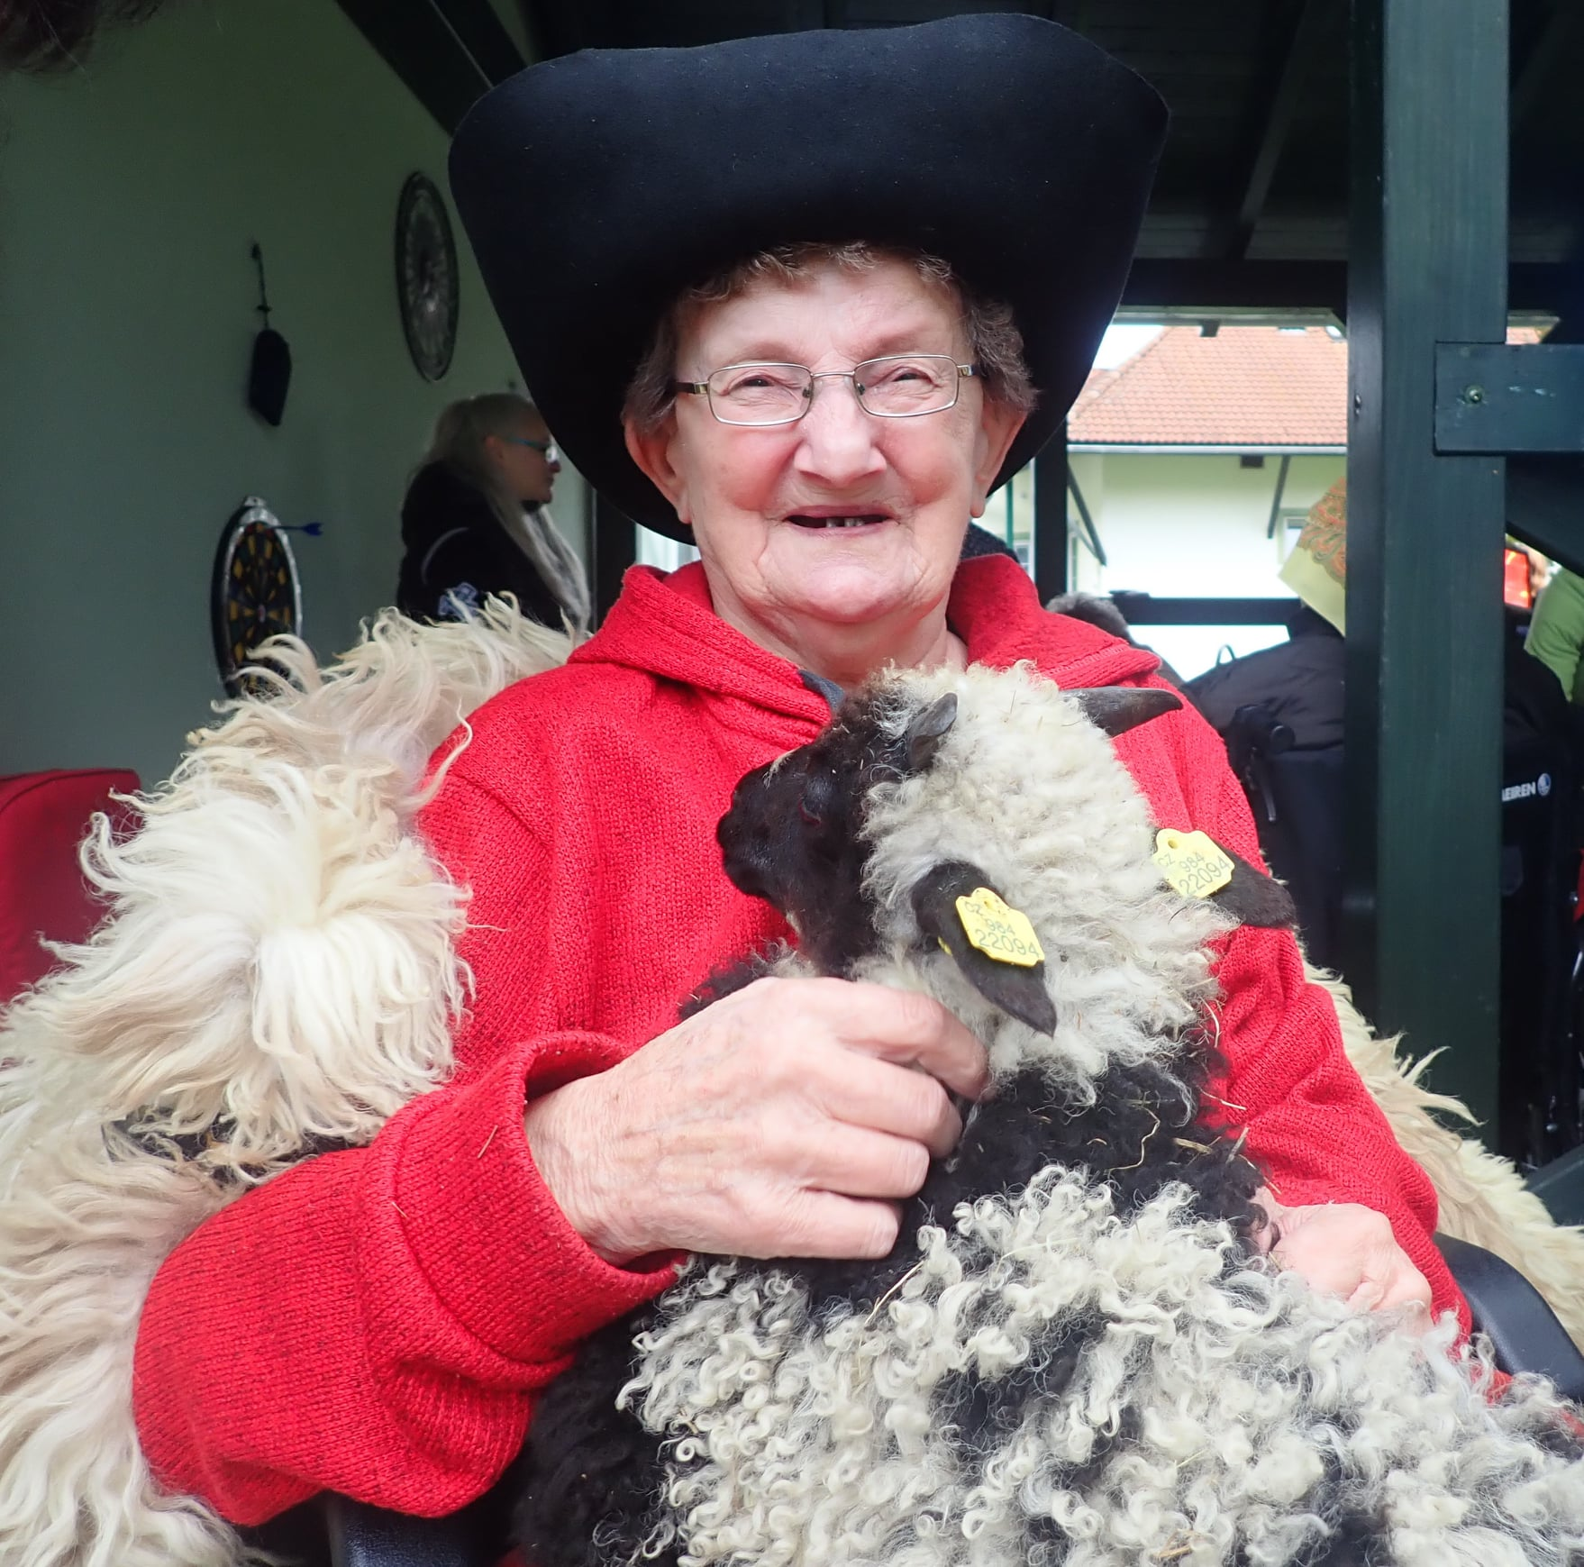
Physical disability classification
Type
Disorders of the motor system
Long-term illnesses
Health impairment
Cause
Congenital
Acquired
Spinal deformity; injuries; consequencies of the disease
Aetiology
Body abnormalities
Physical developmental defects
Injuries
Consequences of diseases
Cerebral palsy
Long-term chronic disease (allergies, asthma), etc.
Photo: Older woman with limited mobility. Author: Gabriela Žitníková.

Slide 7
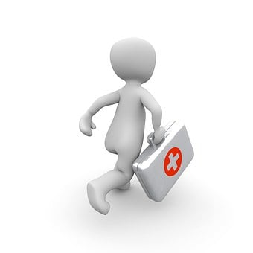
Conceptualisation of a physical disability
Medical perspective
A loss of body part or failure to develop a specific bodily function or functions, whether of movement, sensation, coordination or speech due to the disease, trauma or other health condition which require sustaine medical care.
Picture: https://pixabay.com/

Slide 8
Conceptualisation of a physical disability
Socio-critical perspective
Physical disability depends on how society constructs physical norms. In this model, disability is not an individual attribute but rather a complex collection of conditions, many of which are created by the social environment.
Picture: https://pixabay.com/

Slide 9
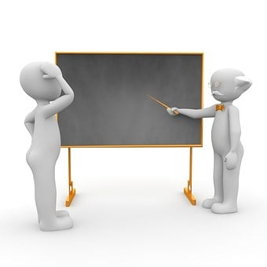
Conceptualisation of a physical disability
Educational perspective
People with physical disabilities at different age levels are limited in their learning process, social behaviour, verbal communication or psychomotor skills, making participation in social and school life more difficult.
The educational or pedagogical perspective aims to teach behaviours and practices that replace dysfunctional body parts or a body limited by illness and trauma.
Picture: https://pixabay.com/

Slide 10
The participation or involvement of people in all areas of life, and the participation restrictions they experience (functioning of a person as a member of society)
The environmental factors which affect these experiences (and whether these factors are facilitators or barriers
The body functions and structures of people, and impairments thereof (functioning at the level of the body)
Multi-dimensional concepts of functioning and disability described by the ICF (2001)
The activities of people (functioning at the level of the individual, impairments – problems in body function and structure such as significant deviation or loss) and the activity limitations they experience
Notes:
The ICF lists the following broad domains of functioning which can be affected (ICF – International Classification of Functioning, Disability and Health) :
Learning and applying knowledge;
General tasks and demands;
Communication;
Mobility;
Self-care;
Interpersonal interactions and relationships;
Community, social and civic life.

Slide 11
Possible bahavoural references and challenges
They may be reliant on others to provide their care;
They are not able to work and support themselves financially;
They lack opportunities for socialisation and civic activation;
Their engagement in different situations is limited due to equipment such as a wheelchair, which can be embarrassing for others;
They are restricted in participation in work, housing and intimate relationships;
They perceive a lower health-related and global quality of life than a reference group.
Notes:
Every person with a physical disability meets different challenges and needs. Coping with their of tricky situation is also reflected in their behaviour, which is therefore necessary to understand.

Slide 12
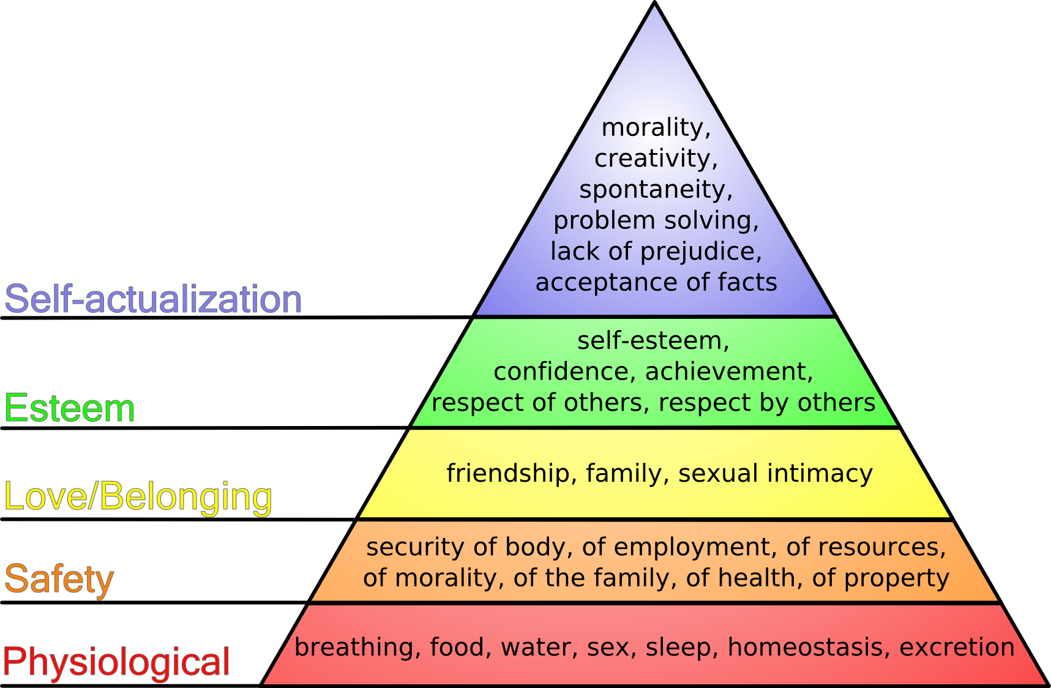
Human Needs
Physical aspects (food, shelter, safety, health care and protection)
Personal fulfilment (education, rest, values, aesthetics, religion, achievement)
Emotional needs (sense of belonging, mutual care, community)
Self-concept (self-confidence, self-esteem, personal identity) (Barker, 2003)
Celebration and mourning, integrity, interdependence, play and spiritual sharing (Rosenberg, 2012)
Maslow's hierarchy of needs | Psychology Wiki | Fandom

Slide 13
Participant
Social: Barrier-free social environment, social services
Pedagogic: School integration, distance education, e-learning courses
Work: Open, sheltered and integration employment, work from at home
Medical: Medicine, physiotherapy, prosthetics
Psychological: Family and friends support, psychotherapy
Legal: Anti-discrimination measures, legislative support
THE SYSTEM OF COMPLEX
REHABILITATION
(SLOWIK, 2007)
Leisure rehabilitation
Architectural solutions
Financial support
Notes:
Networks of support, principle of subsidiarity: participant in the centre: (1) selfhelp; (2) family, friends, neighbours; (3) general services and community facilities (4) system of formal services

Slide 14
Benefits of social farming
Elings, 2011
Hemingway, Ellis-Hill, Norton, 2016
Attitude and engagement of farmer and co-workers
Useful and divers activities
Social community
Green environment
Informal non-care context
Social and physical connections
Facilitates learning involving practical activity
Develop sensual ability
Enhance memory by experience, support joy, adventure and sense of achievement
Facilitates autonomy
Leads to a crucial understanding of belonging and being without prejudices.

Slide 15
Benefits of social farming - SoFarTEAm
Physical disabilities are found in combination with other disabilities (intellectual)
Safe working environment – spatial adaptation based on participant‘s needs and the type of physical limitation
Raised beds
Ramps
Fairly wide roads with a non-slip surface
Alleys with a low slope due to people in wheelchairs
Places for relaxation, rest and meeting together
Barrier-free toilets
Notes:
The farm environment has a beneficial effect on the human psyche due to the meaningful and structured work activity with regular daily/seasonal rhythms and a rapidly visible result of work. It mediates contact with nature, which can be a source of stimuli, interest and joy for individuals. Engaging in various farming activities across different target groups reduces feelings of anger, confusion, depression, tension and fatigue. At the same time, it helps individuals with unique challenges to feel better. These benefits are caused by the outside and physical work when inexperienced people acquire new skills and competencies.

Slide 16
„We have an employee who needs a walker. He uses a rollator. He does activities he can do sitting down: for example, planting tomatoes in the greenhouse. He does the work sitting down in the greenhouse“
Photo: Farmyard Bludička, Czech Republic
Author: Radoslav Žitník

Slide 17
Benefits of social farming - SoFarTEAm
Lower work pressure plays a vital role as they may naturally have limited capacity to perform work. The tasks are adapted to be the most suitable for participants.
Rotation of activities
Adjusted working hours
Team shifts
Individual / team work
Work arrangements
„It is important for boys
in a wheelchair that they
can chop wood with an axe
and feel like "normal" guys.“

Slide 18
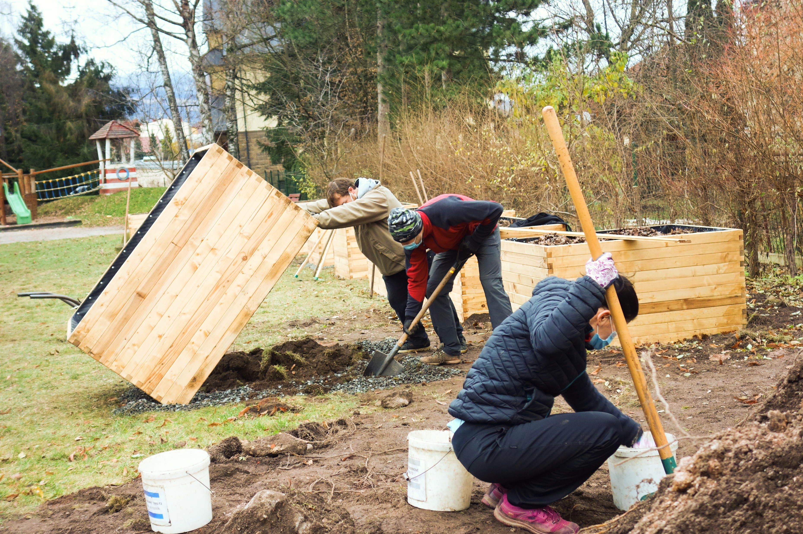
Raised flower beds
Photo: Day care centre with productive garden (Vrchlabí, CZ). Author: Diakonie ČCE Vrchlabí

Slide 19
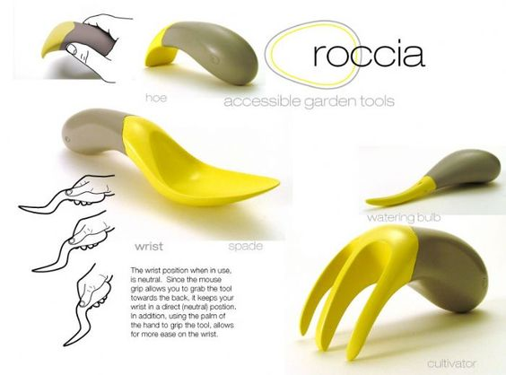
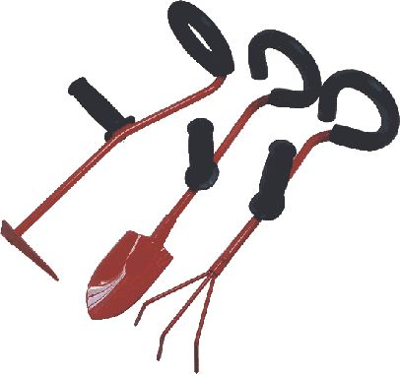
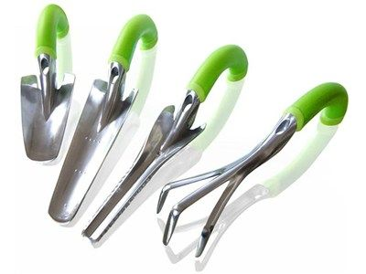
Benefits of social farming - SoFarTEAm
Adapted tools – not too heavy, too long or maladapted in any other way
Some task are not allowed to not trained personel
Conversely people with physical disabilities can work with tools that would otherwide be denied to them

Slide 20
Benefits of social farming - SoFarTEAm
Simple activities and work tasks in which participants feel confident
- Wool processing - Change the water for animals
- Feeding chickens - Feeding the sheep
- Help giving birth to sheep - Rake the leaves
- Chop the wool - Feed the rabbits
- Planting - Peeling
- Harvesting - Cutting

Slide 21
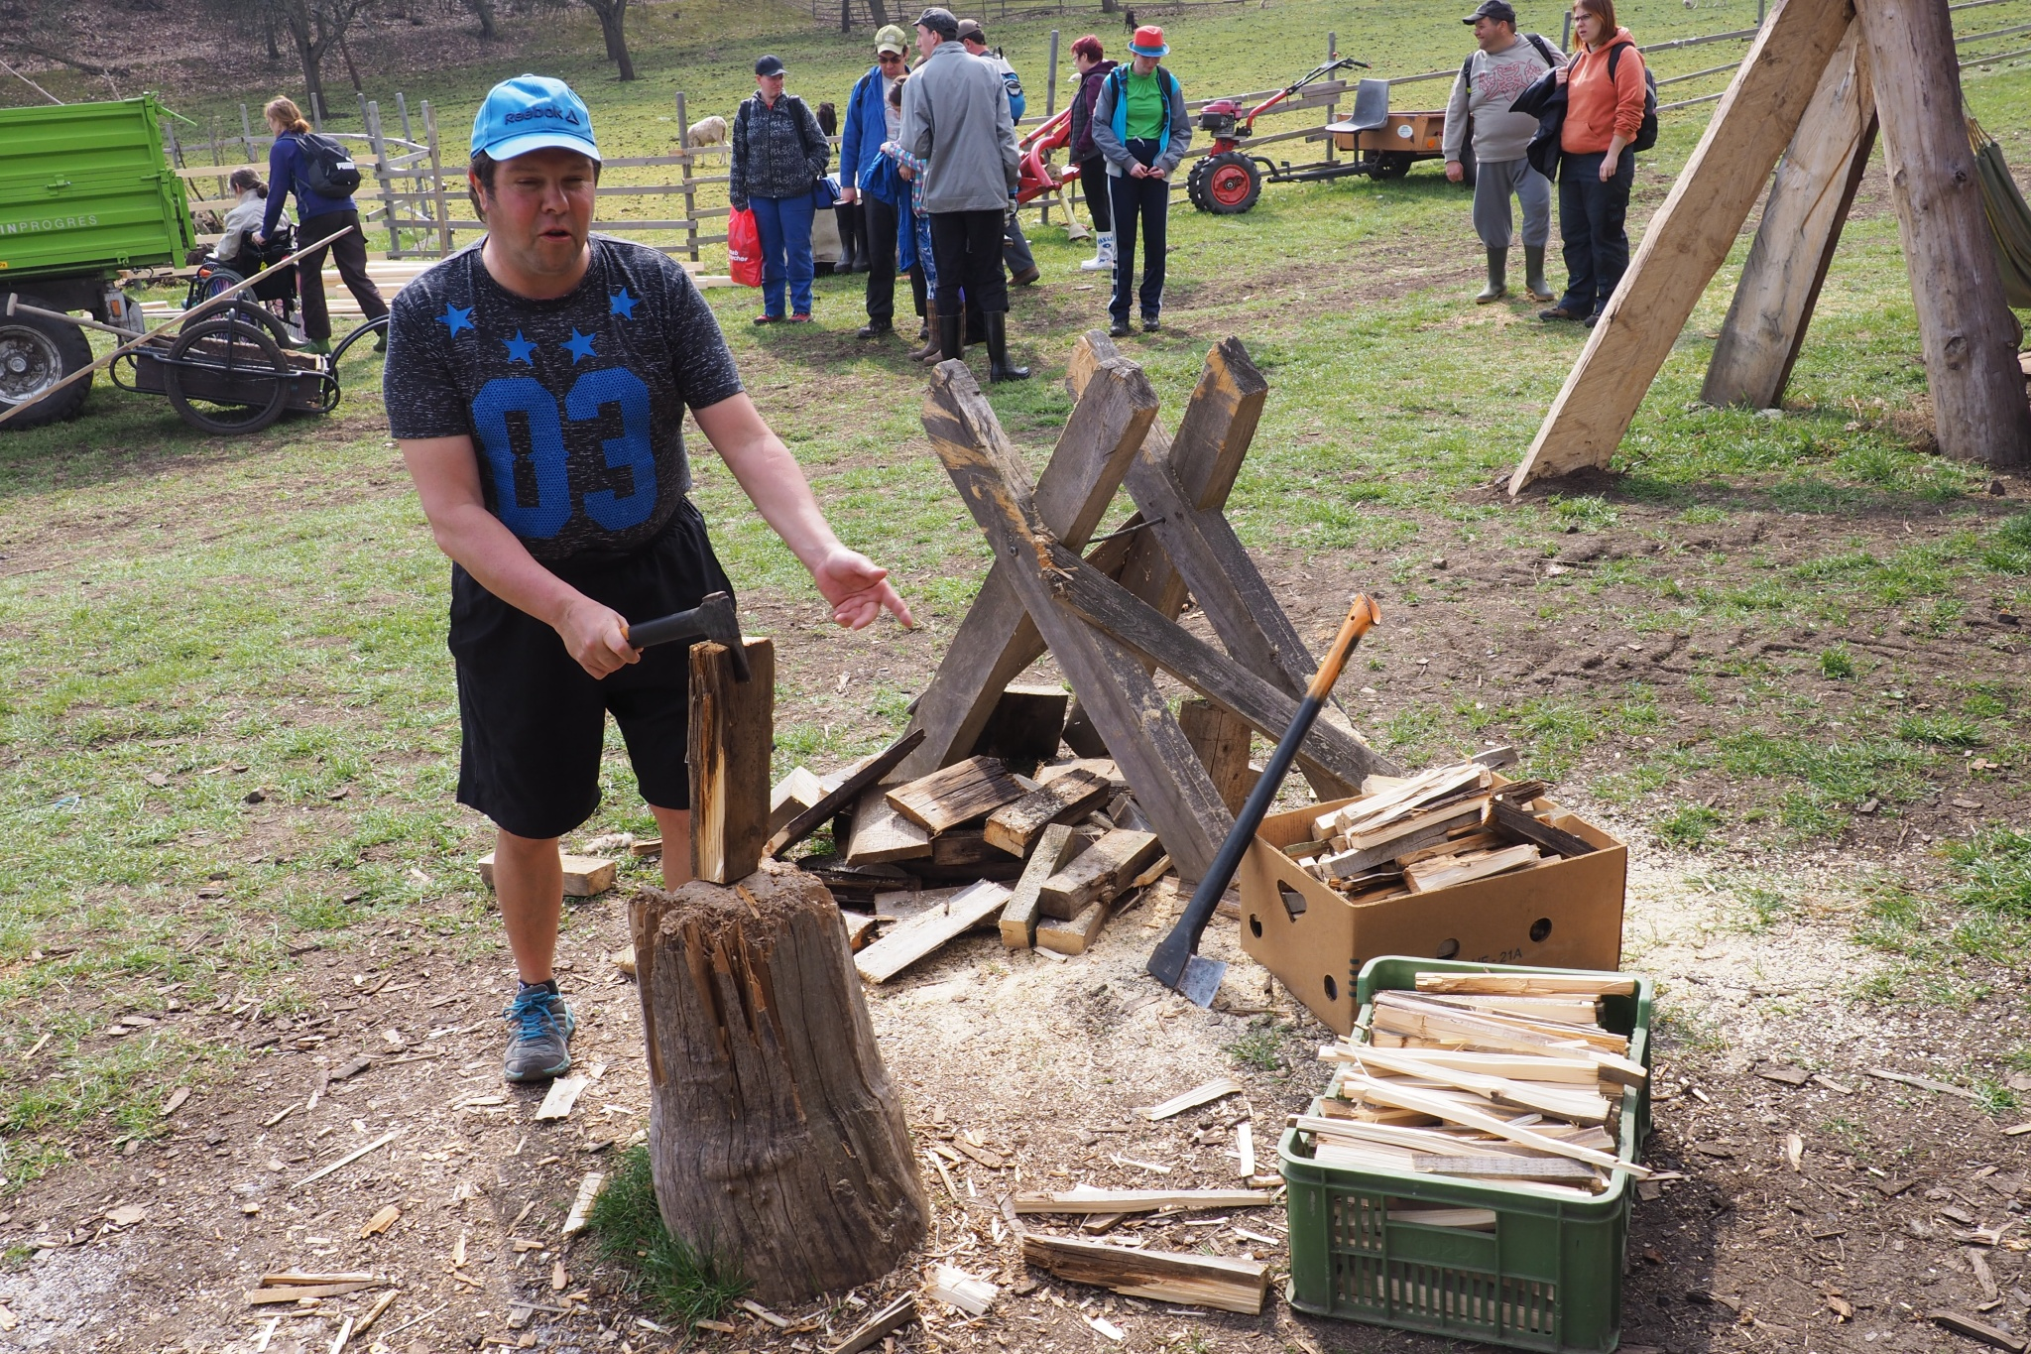
Diverse activities
Photo: Venkovská škola Bludička (CZ), sheltered workshop. Author: Gabriela Žitníková
Photo: Cutting wood, Biostatek farmyard (CZ).
Author: Vojtěch Veselý

Slide 22
Benefits of social farming - SoFarTEAm
An accepting environment: overal approach of the farmer or farm community such as empathy, patience, mental resilience and stability, authenticity, open mind, flexibility, presence, humour and optimistic world vies, affinity with nature and agriculture and technical skills in agriculture
"I listen to them, I say my opinion,
we are planning work. They can confide in me.
I am not from a family. I am not a doctor.
I see their world from a different perspective.
It can take 30 minutes or 1 hour.“

Slide 23
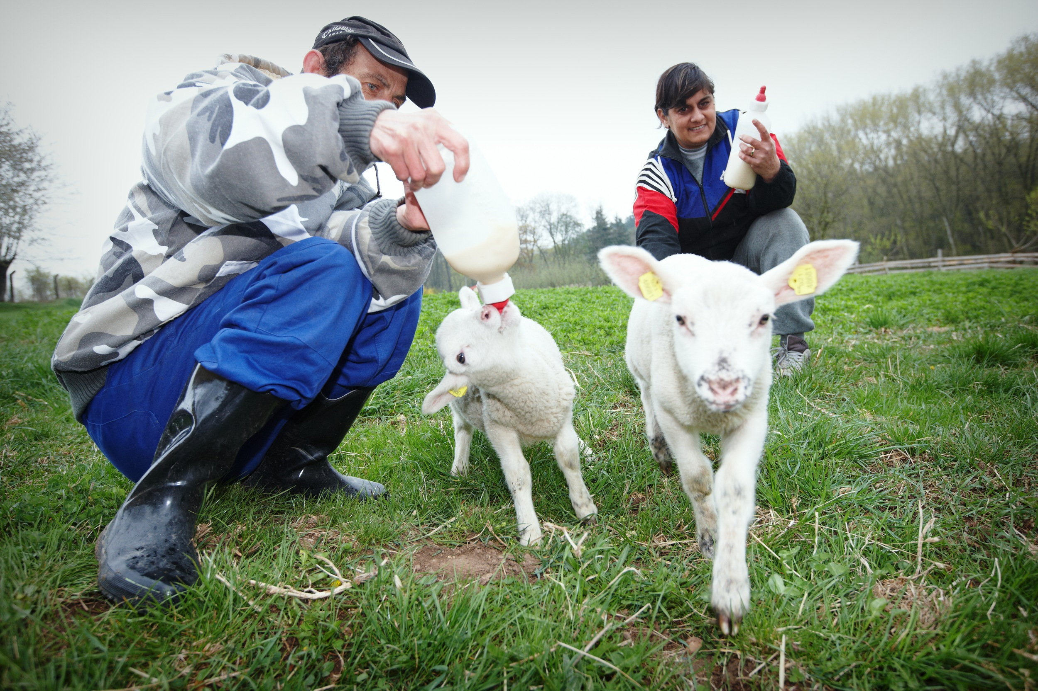
Benefits of social farming - SoFarTEAm
An invididual approach
Photo: Milking lambs, Biostatek farmyard (CZ). Author: Vojtěch Veselý
"One of the participants has a physical disability which impedes his ability to undertake some tasks fully, so he spent a lot of time standing back, taking photos, etc. He was encouraged by the farmer and the support worker to get more involved and did so though at a slower pace and less frequently than the other participants." (Quotation from a participatory observation)

Slide 24
Possible behavioural references and challenges
Person not born with a physical disability
Need to adjust to the emotional and pysical challenges their physical disability now poses:
frustration
depression
feeling hopeless about their future
anxiety
anger that they cannot perform tasks thex were used to managing
egoistic or oversensitive

Slide 25
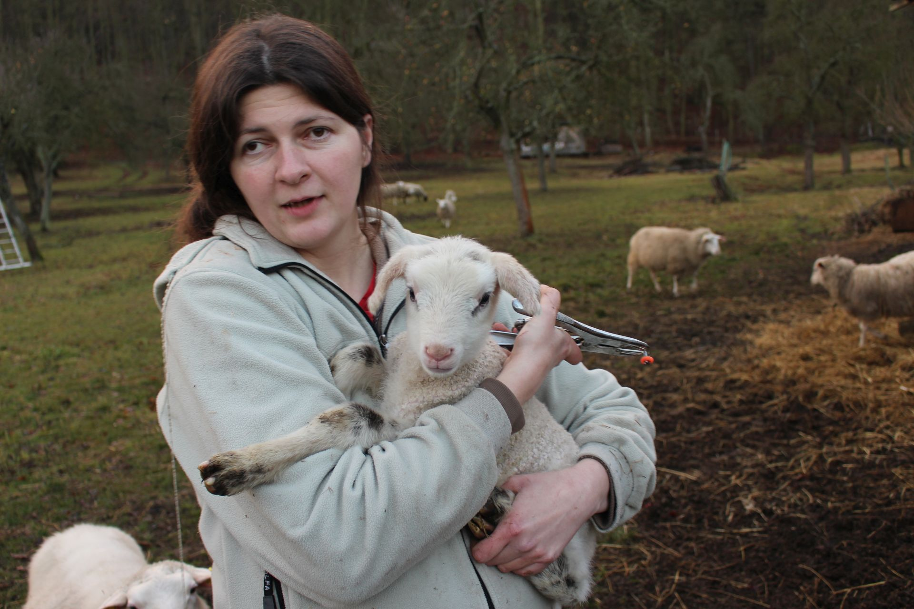
Possible behavioural references and challenges
The offer of social farming
Experience skills in very practical and useful activities
Learn to participate and cooperate with other people
Instead of thinking only of themselves, they find that animals and plants depend on their work which increases their self-esteem
Relaxing environment
Experience of hopefulness
Photo: Care about animals, Biostatek farmyard (CZ).
Author: Vojtěch Veselý

Slide 26
Possible behavioural references and challenges
Person born with a physical disability
Typically, individuals go through periods of mixed or different feelings, such as becoming depressed. Families of a person with a physical disability may also have all kinds of emotions as they deal with the patient's physical care, financial burden, and unanswered questions about the future
The offer of social farming
Agriculture in general still contains stability in its cyclical nature (seasons repeat, the cycle of life repeats). The social farm contains a variable environment where one can be alone with oneself and in a group. There is plenty of time to observe and to participate in the work. All this can help a person with a disability and at different stages of experiencing their health condition.
Photo: Ekozahrada Raková sheltered workshop (CZ).
Author: Ekozahrada Raková archive

Slide 27
Possible behavioural references and challenges
Children with a physical disability
Often limited by deprivation of stimuli and experience
Intellectual abilities can be lower, resembling younger children
In case of organic damage to the brain problems with attention and memory
Many other issues that may develop in educational situations include the following:
difficulties with reproduction, differentiation, synthesis, analysis, perception,
problems differentiating shape, colour, amount, size, and creating groups
Cerebral palsy is also associated with speech problems, poor vocabulary and grammar
The emotional reactions are often not adequate
Children have issues controlling their responses and may develop hyperkinetic movements

Slide 28
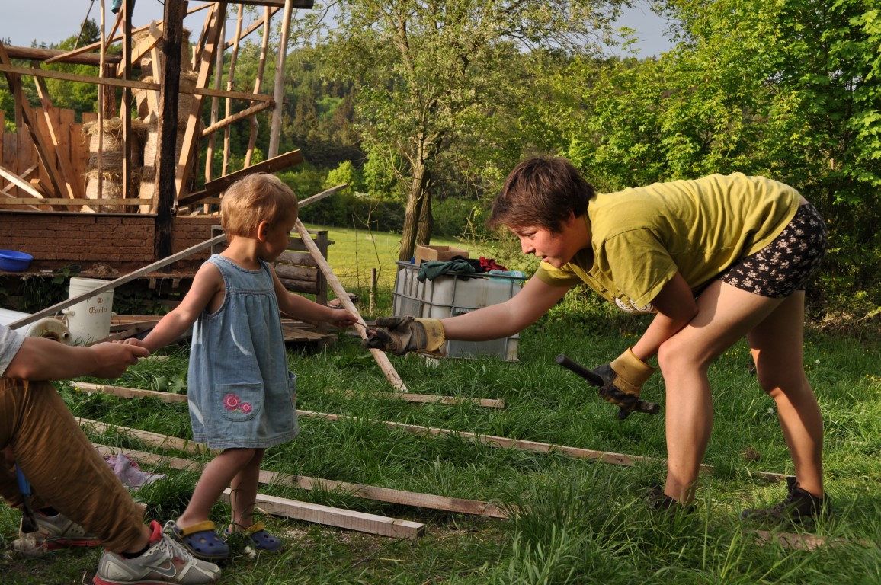
Possible behavioural references and challenges
The offer of social farming
Staying and working on a social farm allows to practice fine and gross motor skills in a non-violent way
Learning of new things and have experiences they wouldn't have elsewhere
Practising all senses, stimulating sensations and creating new experiences that they can integrate with new knowledge
Photo: Constructing yurta, Biostatek farmyard (CZ).
Author: Vojtěch Veselý

Slide 29
Possible behavioural references and challenges
Young adults with a physical disability
Restriction in daily activities and participation in social roles
Facing more difficulties in employment, leisure activities, mobility, and preparing meals or have less experience with intimate and sexual relationships
Less experience with teenage activities such as mixed peer contacts and small jobs such as babysitting or delivering papers (Roebroeck et al., 2009)
General quality of life is often influenced by chronic impairment-related pain
Association with inactivity, poor physical fitness, fatigue and higher levels of depressive and stress symptoms

Slide 30
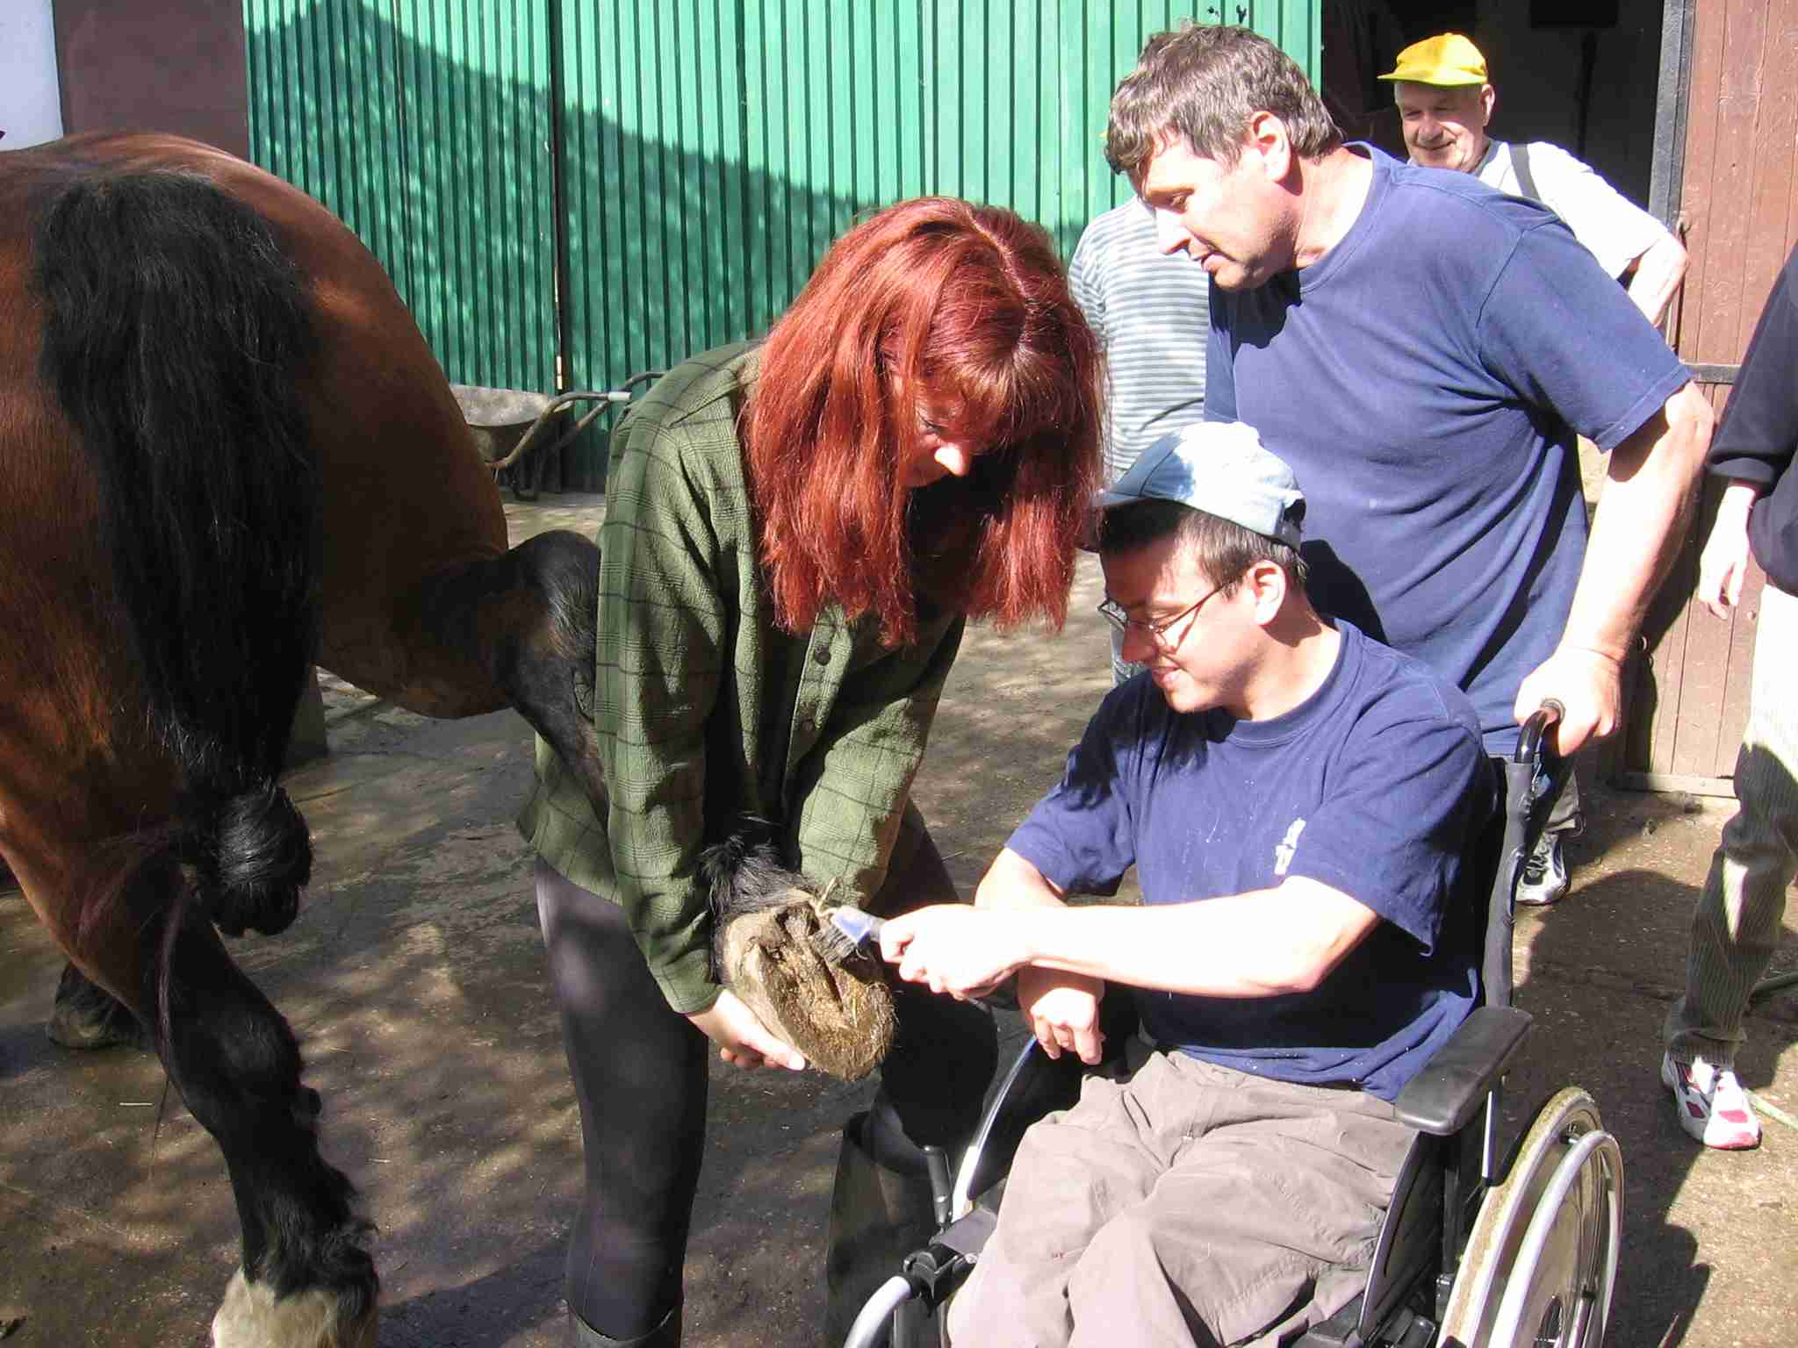
Possible behavioural references and challenges
The offer of social farming
Allows meeting different people and the opportunity to come up with different ideas than just one's own limitations and meagre perspectives
Motivates the exercise of fine and gross motor skills, or at least some natural movement, which generally improves the physical fitness of the individual
For some diseases (asthma, skin diseases), one must be careful where one moves to avoid causing more harm than good
Photo: Farm work on a wheelchair, Bludička (CZ)
Author: Radovan Žitník

Slide 31
The most important goal is to promote the independence of people with physical disability
Promote self-determination by encouraging to set goals and helping achieve those goals
The specific features of social farming activities enable participants to find the time needed to complete their tasks
Not punish a participant to do something they may not be able to manage
Prevent a sense of failure and guilt.
All adult people with physical disabilities should be treated as an adult
Promote the person's dignity by being mindful of privacy, respecting confidentiality, including their decisions, respecting their rights and valuing their differences

Slide 32
Always to see the person and not the disability

Slide 33
Challenges and limitations of social farming with people with physical disabilities
For people with a physical disability, staying on a social farm can be harmful in case of severe disability or other health-related issues, not-allowing stay in a natural environment.
There can be an allergy or a phobia;
The work environment may not be well adapted to the type of disability;
There is a higher risk of an accident at work;
Sometimes it is not appropriate to work together with people with intellectual and physical disabilities because mentally healthy people may not fully respect human rights and the needs of people with mental disabilities;
What is stressful for the farmer is much more challenging for the participant.
Notes:
Although social farming looks like a universal medicine for people with anxieties, depressions, limits in social contacts, education, lower motor skills and other life challenges, there are also some limitations.

Slide 34
List of references
Barker, R. L. (2003). The Social Work Dictionary. 5th Edition. Washington DC: National Association of Social Workers, ISBN 0-87101-355-X.
Hemmingway, A., Ellis-Hill, C., Norton, E. (2016). What does care farming provide for clients?. The views of care farm staff. NJAS – Wageningen Journal of Life Scicences, 79: 23-29.
Elings M. (2012). Effects of care farms: Scientific research on the benefits of care farms for clients. Wageningen UR, The Netherlands: Plant Research International.
International Classification of Functioning, Disability and Health. An Owerview. Available from: PT6 Working paper (cdc.gov)
Slowík, J. (2007). Speciální pedagogika. Praha: Grada.

Slide 35
Read this short story and decide what services you would recommend to the participant regarding social farming. Use the acquired information from the presentation.
Marie (33) was born with moderate disabilities. She has cerebral palsy: gait disorders, poor movement coordination, muscle stiffness and speech disorders. Her mother placed her in institutional, residential care after her divorce because she could not manage the care of herself and her daughter. Marie suffered from symptoms of emotional deprivation, which manifested in her usual form of hospitalism. When her mother settled down the family situation, she began to carry Marie at home during Christmas and summer holidays. These conditions were on the verge of social endurance, but staying in the institute again worsened Marie's mental state. Therefore, her support worker sought a replacement solution in the form of placement in a smaller facility. In the end, they found a way into sheltered housing as an open community in a community house. Marie is used to living in a rural environment; her mental state has stabilised, but she needs physical help to do some daily routine tasks. Marie would like to be more independent, find a paid job and have a life partner, but she cannot without professional help and advice.
Notes:
Work in groups: Reread Marie's life story and imagine she found a safe place to work and relax on a social farm. Draw a farm plan with all the important elements so that Marie feels good there. Describe the individual components.

Slide 36
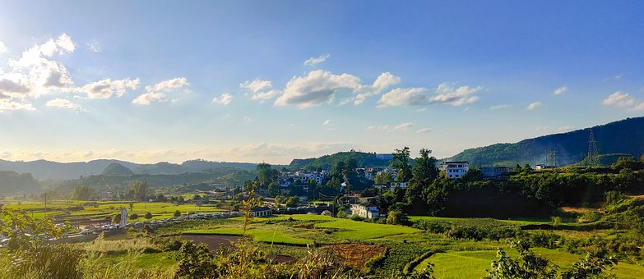
Draw a farm plan with all the important elements so that Marie feels good there. Describe the individual components.
Photo: https://pixabay.com/

Slide 37
thank you for your attention
Name of Lecturer
Institution of Lecturer
name@xyz.com

Slide 38
Farming with Refugees and forced displaced people - Agriculture as a path of inclusion © 2023 by SoFarTEAM is licensed under CC BY-NC 4.0.
To view a copy of this license, visit http://creativecommons.org/licenses/by-nc/4.0/
The slides were created by Eliška Hudcová
Contact:
Jabok - Academy of Social Pedagogy and Theology
Salmovská 8
120 00 Praha 2, Czech Republic
hudcova@jabok.cz

