Slide 1
Youth & Social Farming
Name of Lecturer
Institution of Lecturer
00
00
0000

Slide 2
Overview
Types of social farms their goals
Youth – definition of the group
Goals, benefits & approaches connected to SF
Safe environment
Being fully present
Ideas of R. W. Emerson & Martin Buber

Slide 3
TYPES OF SOCIAL FARMS AND THEIR APPROACHES
PRODUCTION
SOCIAL WORK
AGRICULTURE
CARE, REHABILITATION Spending time meaningfully
Notes:
The type of a farm determines its goals. Social workers together with young people should consider which type of a farm will suit best the goal they pursue.

Slide 4
youth
Do you consider yourself „YOUTH“?
A specific group only from the 1950s onwards – the development of subcultures & free time
Since 1960s the youth = 12 – 24 years
UNICEF & WHO
Adolescent: 10-19
Young People: 10-24
Youth: 15-24
20 – 29 years old = young adults
Notes:
The aim is to make the students understand, that they are „youth“ as well and that this presentation concerns primarily their peers as well as themselves. For the success of this lecture/workshop/session it is important to make the discussed issues personal.
There are many ways how to define the age group „youth“

Slide 5
Youth – G. H. Mead´s theory
Youth is a period when self-concept is constructed
According to George Herbert Mead our self is strongly influenced by significant and generalized others + the influence of peers, lifestyle, gender, culture and other relevant factors
‘I‘ (natural) is the response of an individual to the attitudes of others, while the ‘Me‘ (socially determined) is the organized set of attitudes of others which an individual assumes
The ‘I‘ is self as subejct; the ‘Me‘ is self as object
SELF = I + Me
Notes:
The theory of constructing one´s self by G. H. Mead is described in the book Mind, self and society. The lecturer should focus on the fact that it is „Me“ that is supposed to tame „I“ and to come to understanding of one´s role in the society. On one hand the society (and its rules) binds us with various kinds of regulations, yet at the same time our natural „I“should become the source of doing so in an individual and creative manner.
The students should grasp Mead´s idea of GENERALIZED OTHERS – a farm and its whole environment become a generalized other for young people. It strongly influences their values, attitudes and also behaviour. Young people are influenced by everything (and everyone) they work with, by the way issues are dealt with, by the whole climate of the farm.

Slide 6
What is your true self?
How would you characterize your own generalized other?
Are you aware of any particular influence?
Your SELF determines who you are and how you relate to other people!
Notes:
At this point the students shoud reflect on the environment where they spend time and which shapes them – what are the values in the family they come from, whether they are active members of organisations with strong values eg. religious or scout movement, what hobbies or interests they pursue and whether they are members of eg. sport clubs, interest groups.

Slide 7
YOUTH as a target group at social farms
Young people may be refugees, they may struggle with their mental health condition, learning or intellectual difficulties, they may be recovering from drug addiction, they may be physically challenged, …
Most often they are those who „fall through the cracks“
Youth coming from socially unsupportive background
Youth with underdevelopped social skills
Youth who have had problems with authorities, or may have even tresspassed the law
…
Notes:
This is just and introduction to what kinds of young people may come as clients to social farms.

Slide 8
main issues of sofarteam
How do you encourage pro-social behaviour on the farm when participants may be coming from backgrounds or situations where this is not modelled or even valued?
How does the farmer communicate what has to be done, establish his/her authority and credibility without being seen as another 'teacher' or someone to be defied?
Notes:
The two essential issues that the project SoFarTEAM asks.

Slide 9
Essential conditions of SF success
Engagement of farmer and supervisors
Social Community
Useful and diverse activities
Green environment
Overall safe, yet challenging environment
Notes:
If work with youth is to succeed in social farming environment, certain conditions have to be met.

Slide 10
Goals pursued by social farms
Social & occupational skills
Self-esteem & confidence
Sense of puropose (meaning)
Improvement of physical & mental health
Establishing, learning to keep & enriching social relationships
Improvement in relationships on the community level
Establishing & developing values
Wellbeing & happiness in life … Social pedagogical approach
Notes:
These are some of the typical goals pursued at social farms when working with youth. However, the scope is a lot wider as the last point suggests – it is also connected with the approach to youth and social farming. There might be differences in social work approach in comparison to social pedagogy.

Slide 11
Benefits of Social Farming Environment
Natural environment – connection to nature
Meaningful activities
The wider scope of activities, the better chance of disclosing one´s potential
Progressive & person centred
Removal from (past) negative networks
Meeting new „role models“
Functioning family models (at family run farms)
All the staff & especially the farmer
Notes:
According to various sources these are the main benefits of social farming when working with youth.

Slide 12
What do you need to be able to fulfill the previously mentioned goals and benefits?
???
Notes:
This is a time for the students to reflect on the previous slides … The teacher/lecturer is encouraged to flip through last four slides and remind the students of the essential conditions, goals and benefits & then encourage them to put in their own words what needs to be done, what criteria/conditions have to be met if we want to work with youth successfully.

Slide 13
Holistic approach to people
HOLISTIC EDUCATION
PHYSICAL
SOCIAL
AESTHETIC
SPIRITUAL
EMOTIONAL
INTELLECTUAL
COSMOS
PLANET
SOCIETY
COMMUNITY
PERSON
Notes:
This is an optional slide that can be skipped. The aim of the slide is to point at an individual from the point of view of Holistic education. The environment of social farms may well foster all six aspects of every individual (physical, emotional, intellectual, social, aesthetic, spiritual). Also, all the six aspects can be further worked with on five levels – personal, community, society, planet & cosmos. The unselfish awareness of man´s responsibility towards self as well as to the whole world is essential.

Slide 14
(dis)comfort zone
Danger zone
ME in the comfort zone
Zone of light discomfort – the zone of learning
Notes:
In order to learn new information, skills or gain competencies it is necessary to create challenges that will allow young people grow and develop. The challenges should never be too difficult yet they should not be too easy either. A good challenge is like a mountain that beckons to be conquered. Returning back to the previous slide – the teacher should not forget that a person may welcome extremely difficult intellectual challenges even connected with physical harship, the very same person might be fragile in terms of social or emotional aspects.

Slide 15
What do you need to create environment suitable for personal growth?
Safe, yet challenging environment
Be fully present
Participate on something meaningful
Notes:
How to ensure the success in working with the youth (and almost any other group)? A teacher/social worker/farmer must (1) create safe, yet challenging environment, (2) be fully present – be tuned at the youth when working with them and he or she has to offer work/activities that are meaningful. Especially activities with visible outcomes are powerful.

Slide 16
FEELING SAFE
What conditions do you need to feel safe? At work / on a farm / at school / …
Notes:
Students work - the teacher asks questions such as: What has to happen so that you may feel safe in various environments? What about the people there, the surrounding environment? What about …

Slide 17
(1) Safe environment
Safe environment = the basic condition in order to establish a relationship on which you can build
Environment
People around you (incl. farmer, social worker)
Location (decoration, light, noise, space, layout of space, ergonomics of chairs and tables, tools, aesthetic impression, temperature, …)
Psychohygiene of the group (conditions that lead to satisfaction, happiness, but also fitness and performance)
…
Atmosphere
Climate
Notes:
These are some of the most important aspects that shouldn´t be missed when attempting to create safe environment.

Slide 18
Signs of safe environment
Honesty between group members
Trust between group members (but also towards the farmer/social worker)
Humour (but watch out for sarcasm, sarcasm and irony)
Community cohesion
Community satisfaction
Safe methods of conflict resolution
Concentration on assigned tasks
…

Slide 19
HOW TO FOSTER SAFE ENVIRONMENT
From the farmer‘s perspective
Pay equal attention to all group members (eye contact, asking questions, individual help/cooperation, …)
Do not show if there are "favourites" in the group
Group leadership style – foster relationships (adapt to needs)
Farm community
Promote community cohesion (not only, but mainly trust between group members)
Foster good quality of relationships between group members
Care about the community size
Promote the values of community membership – make it worth
Knowledge, acceptance and understanding of community norms

Slide 20
(2) BE fully present, BE AUTHENTIC
What does it mean to be fully present … here and now?
YOUTH
Notes:
Students work … What does it mean to be fully present? What does it mean to be fully here and now? How do we know we are fully tuned to the present situation, people, environment, etc.?

Slide 21
Being fully present
Being fully aware of oneself
Being „tuned“ on the other(s) … establishing the relationship
Being aware of what is going on in the moment
Being aware of the surrounding environment
Framing the present moment in wider circumstances
Notes:
This might be a list of ways one can be fully present – preferably, the students should come up with these answers.

Slide 22
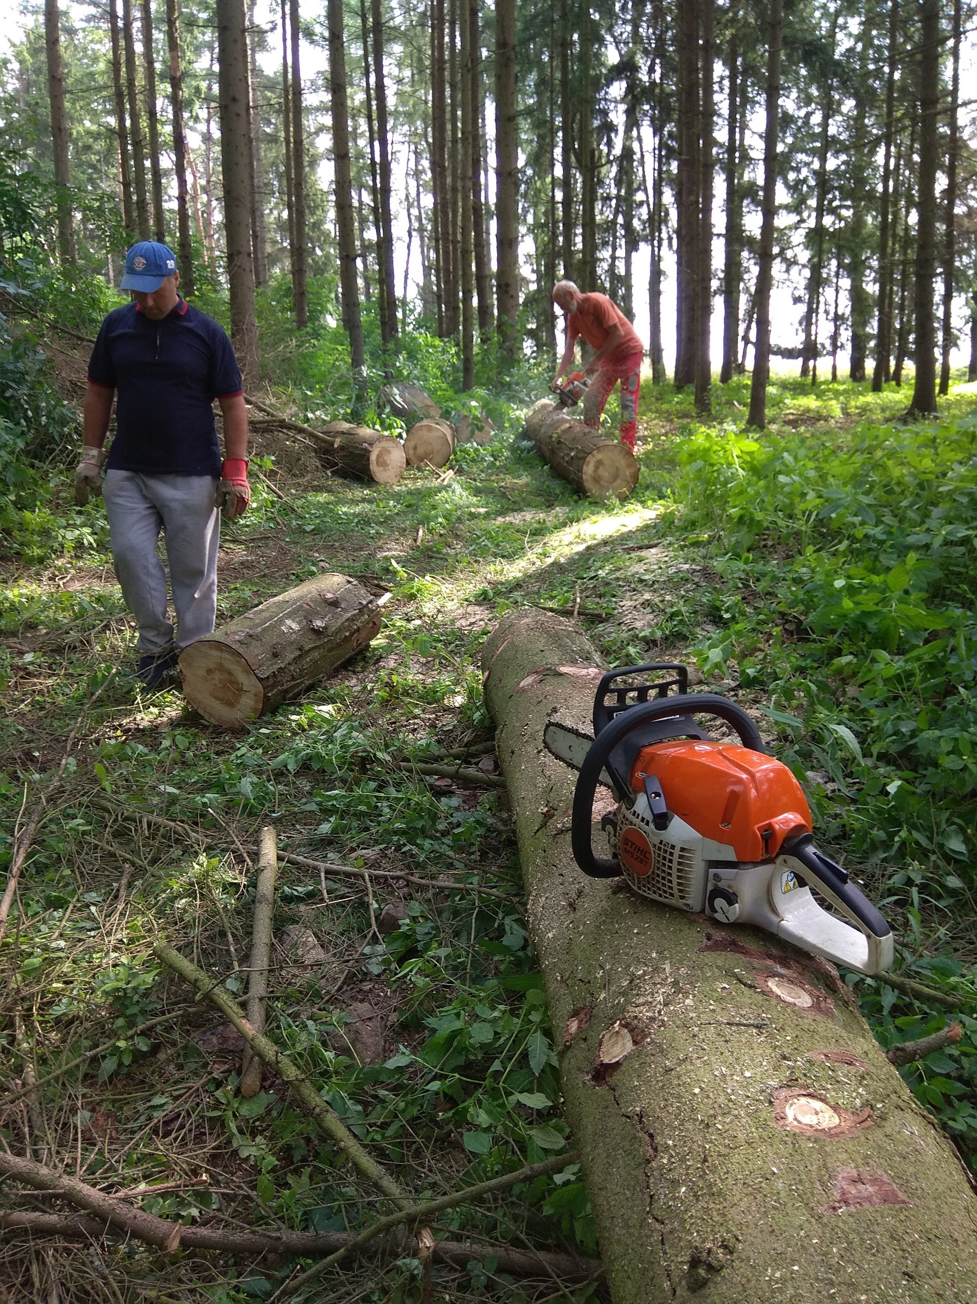
What´s not trembling isn´t solid
No fixed and 100% rigid structures – everything in in constant flux and state of change
Relationships last long and are firm enough only when they change in time … because we change as well
Approaches that worked 10 or even 5 years ago may not work now!

Slide 23
The final question
SO WHY IS A COW A GREAT BOSS?
Notes:
The answer is manifold – it is the fact that caring about animals (eg. cows) is a meaningful activity, there is no excuse in not caring about the animal, the care has to be done regularly which helps to establish working rhythm, the care usually takes place in natural environment (hopefully not only in a cowshed), it is work that can be performed in groups and so it is only natural to socialize, …
Some of the important issues that should be mentioned are on the next slide.

Slide 24
POSSIBLE OUTCOMES
Ensure safe, meaningful and enjoyable experiences for participants
Provide opportunities for participants to shape their own placement experience
Provide a high level of governance and quality assurance for commissioners of social farming placements
Ensure that all stakeholders work together to maximise the benefits from the social farming experience for individual participants
Source:
Social Farming and Youth Work
Relevance, Benefits and Pathways

Slide 25
Social Farming: The IRISH Pathway
Notes:
An example (from Ireland) of a pathway how a youth may get to a social farm.

Slide 26
Social Farming: The IRISH Pathway

Slide 27
thank you for your attention!
Name of Lecturer
Institution of Lecturer
+ call number

Slide 28
Farming with Refugees and forced displaced people - Agriculture as a path of inclusion © 2022 by SoFarTEAM is licensed under CC BY-NC 4.0.
To view a copy of this license, visit http://creativecommons.org/licenses/by-nc/4.0/
The slides were created by Michal Pařízek
Contact:
Jabok - Academy of Social Pedagogy and Theology
Salmovská 8
120 00 Praha 2, Czech Republic

