Slide 1
Introduction Social Farming
Name of Lecturer
  Institution of Lecturer
00
00
0000

Slide 2
Program
Part 1: What is social farming?
Part 2: Development of the social farming sector in Europe?
Part 3: The evidence base under the social farm
Notes:
Before I start, who is familiar with the phenomena of social farms? Does anyone like to explain

Slide 3
Part 1:
Social farming: what is it about?

Slide 4
Part 1:
Social farming: what is it about?
Farms that combine farming with care or green workplaces that are open to vulnerable people
Different terms are used and discusses
Di Iacovo and O’Connor (2009): ”Social agriculture refers to all activities that make use of the agricultural context to provide care and social services”
Notes:
Social farms are farms that combine farming with care or green workplaces that are open to vulnerable people. In Europe there are different terms to describe a social farm or care farm. In the project SoFarTEAM we use the definition of Di Iacovo and O’Connor.

Slide 5
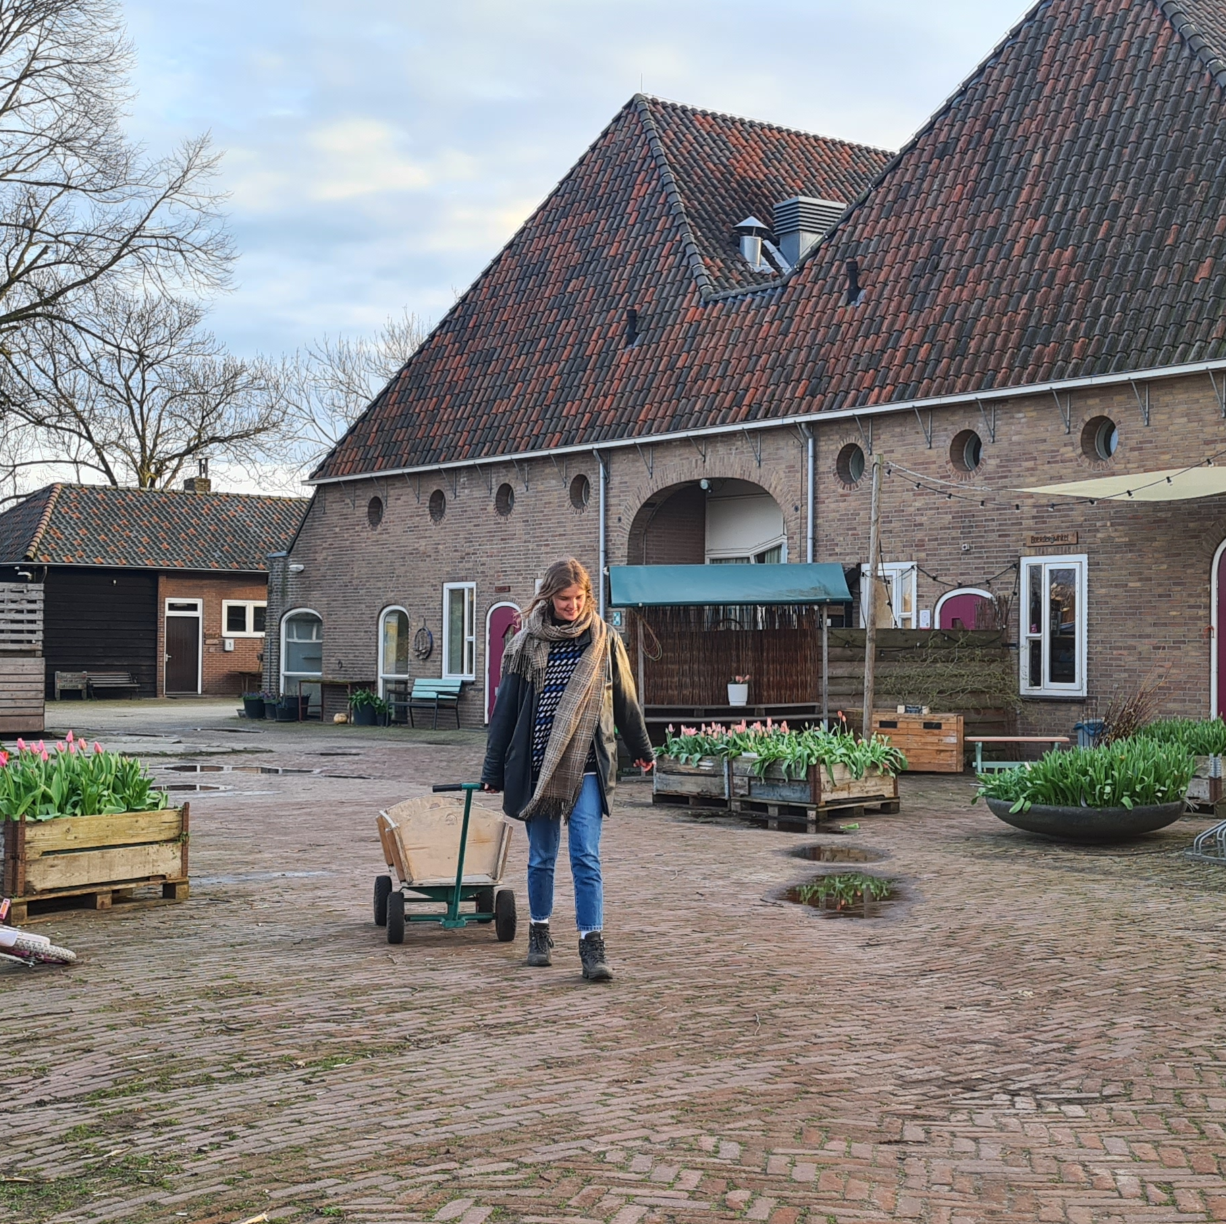
Social farming: a broad definition
Broad variety of social farms
From farm based institutions (e.g. hospitals, care institutions and schools) that offer green or agricultural activities
To family farms that have expanded their business to include care activities
Both in the Netherlands as Europe discussions about definition
The social farm doesn’t exist

Slide 6
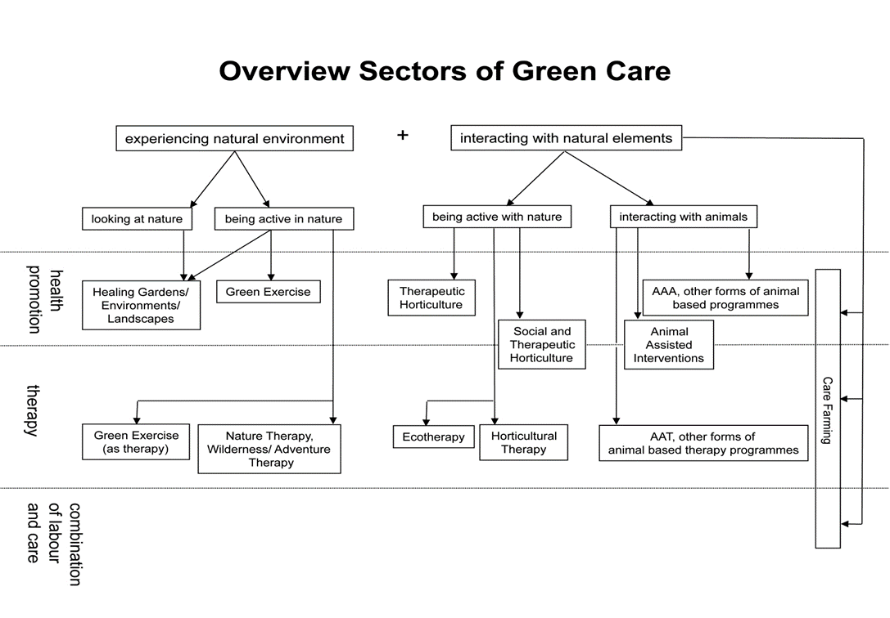
The broader Green Care umbrella
Source: Haubenhofer, Elings & Hine, 2009
Notes:
Not only in the NL but also in other countries like Norway, Belgium, Italy and the UK there has been an increase in the number of care farms or social farms. Care farming can be seen as part of the green care movement. Green care is the umbrella term for all care or health promotion activities conducted with or in nature.
The overview shows that care farms can offer health promotion, therapy and labour reintegration. Over the last few years vocational training and education has become a common feature on care farms as well. In this way care farms in the NL can offer a variety of activities depending on the target group.
For instance vulnerable people with a long distance to the labour market can be part of a labour reintegration program in which they can learn new skills and obtain work experiences. Likewise on a care farm serving elderly people with dementia the focus is on accommodating social farm activities.

Slide 7
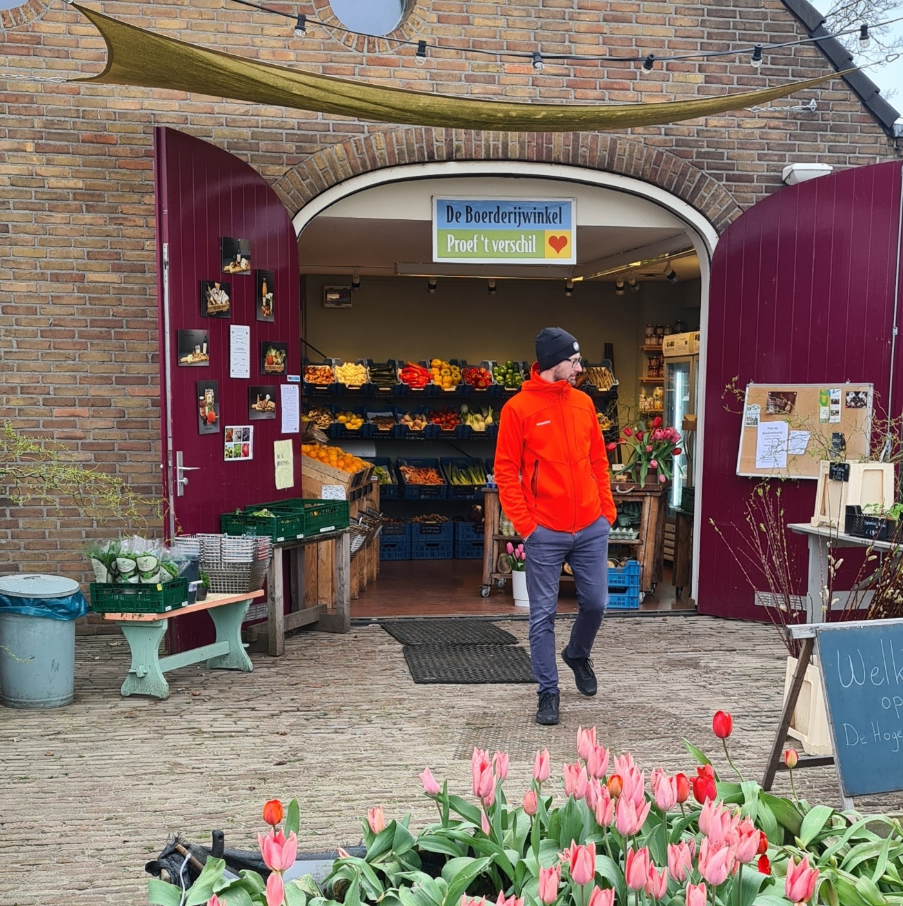
Who is running the farm?
Farmer or the farmer’s wife
Social workers/health care professionals
Educational specialists
Pedagogue, remedial educationalist
Craftsmen/women
In any case they are all social entrepreneurs
Diversification of social farming and with this a change in demand of background of social farmers

Slide 8
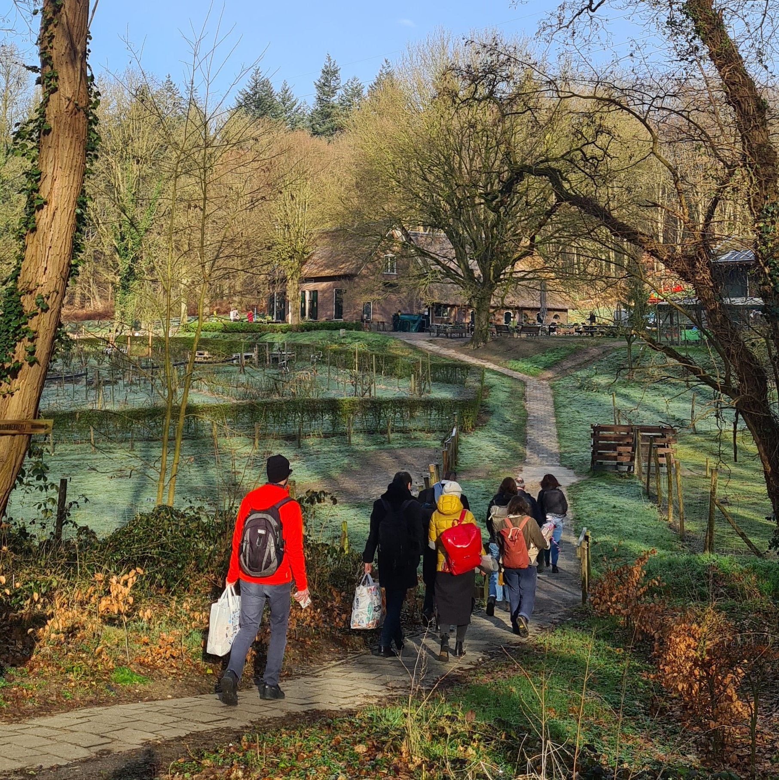
Who are coming to the social farm?
Diversity in target groups
Development of the sector
Difference in different countries
Volunteers

Slide 9
Target groups
People with learning difficulties
People with mental health challenges
Elderly (with dementia)
People with a history in addiction
People with a long distance to the labour market
Children and youth (with behavioral problems)
School drop-outs
Refugees
People recovering from burn-out
Mixed target groups
Brings interesting dynamics
Reflection of society
Target groups can learn from each other

Slide 10
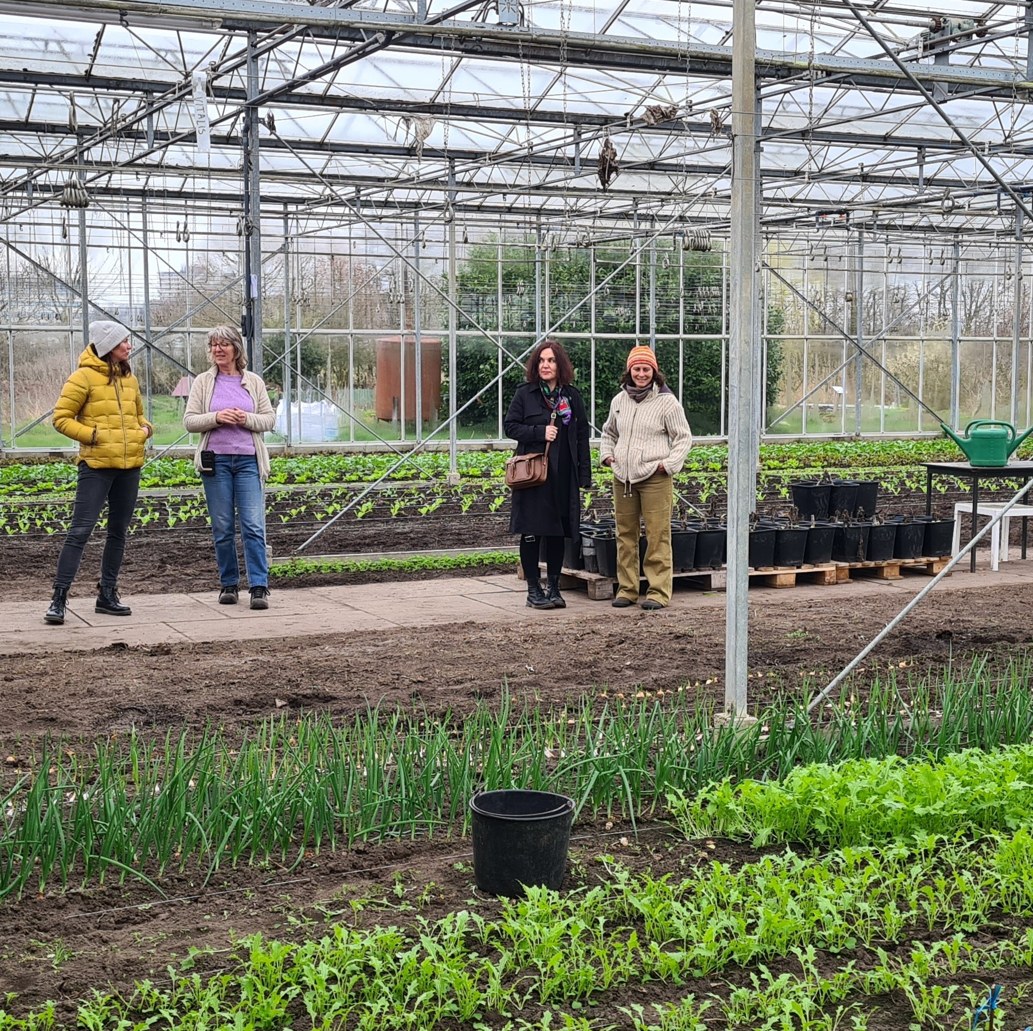
Mixed target groups
“Sometimes when I had a talk with the psychotherapist or really have a bad day and in tears. Maarten comes along as says: come let’s go to work. And with his shear full character he makes me go to work and after a while forget a bit of my problems.” (Elings, Baars & Hassink, 2008)

Slide 11
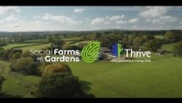

Slide 12
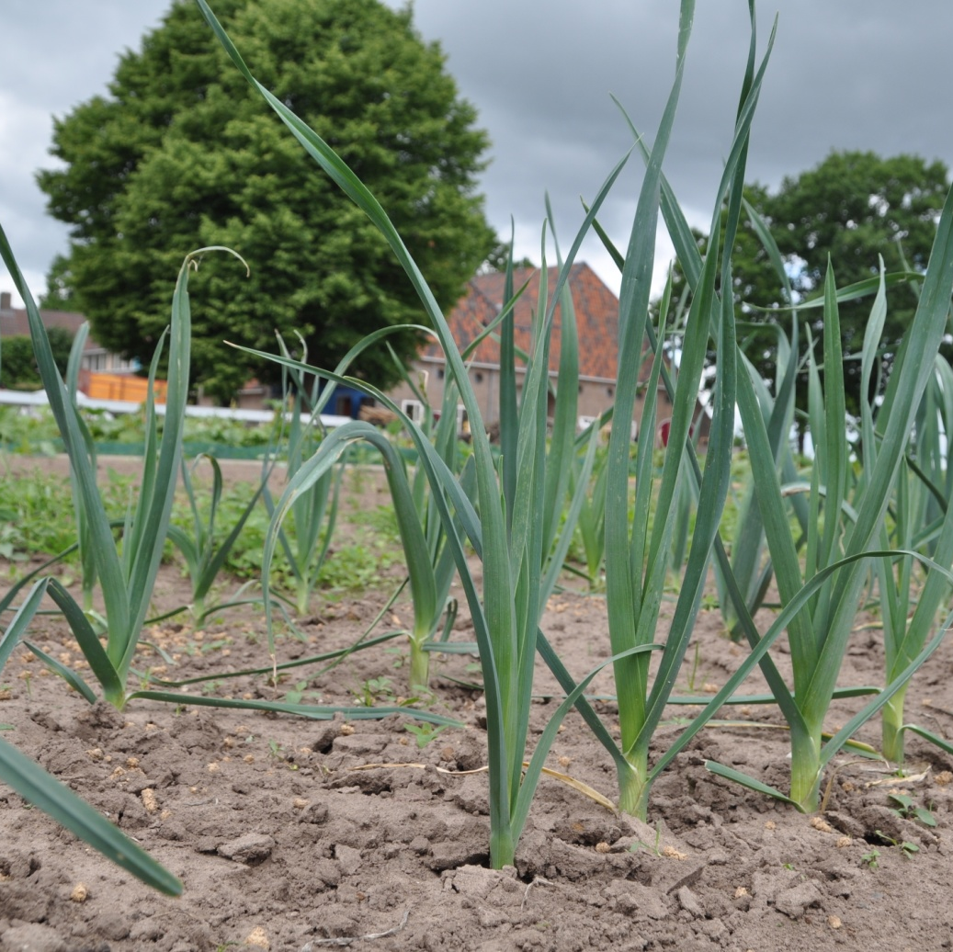
Assignment
What do you think are the key working elements of social farms?

Slide 13
The ‘ground’ beneath the social farm
Engagement of farmer and supervisors
Social community
Informal non-care context
Useful and diverse activities
Green environment

Slide 14
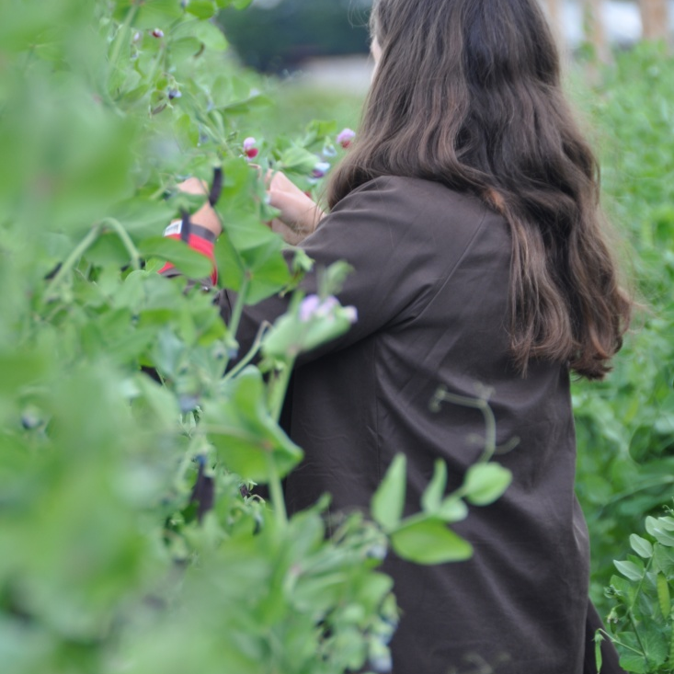
Engagement of the farmer (f/m)
Continuity of care
Role model
Involvement and responsibility
Emphasis on what people can do
Notes:
First the engagement of the farmer:
What came out from a research that studied a program for youngster with behavioural problems youth on care farms is that on care farms the farmer and his or her family are always on the farm. So when a child comes from school he or she can share their story. In regular youth care facilities young people have to deal with frequent changes in the support staff. Staff members have their own norms and rules and this can be difficult for young people who are looking for clarity and stability.
Next to that what we see is that the farmer can set an example for young people who are having trouble with their identity. In general, the farmer is proud of his business and what he has achieved. The farm life is his identity. We also see that especially boys respects the farmer’s authority more easily than they would with youth care workers.
On the farm the participant works together with the farmer, he or she is part of the farmers family. This creates an atmosphere of equality. Farmers indicate that they have the freedom to conduct matters their own way and dare to take more risk. They can explore the limits of people if they need more challenge which can stimulate their responsibility. Next to that the farmer focusses on what particpants can do on the farm in stead of their dissabilities.

Slide 15
Engagement of the farmer (f/m)
“I can imagine that working together and forming a community makes you create less of that client-helper, that falls away a bit. And therefore, you're also much more likely to just be human rather than a client.” (Elings et al., 2011)

Slide 16
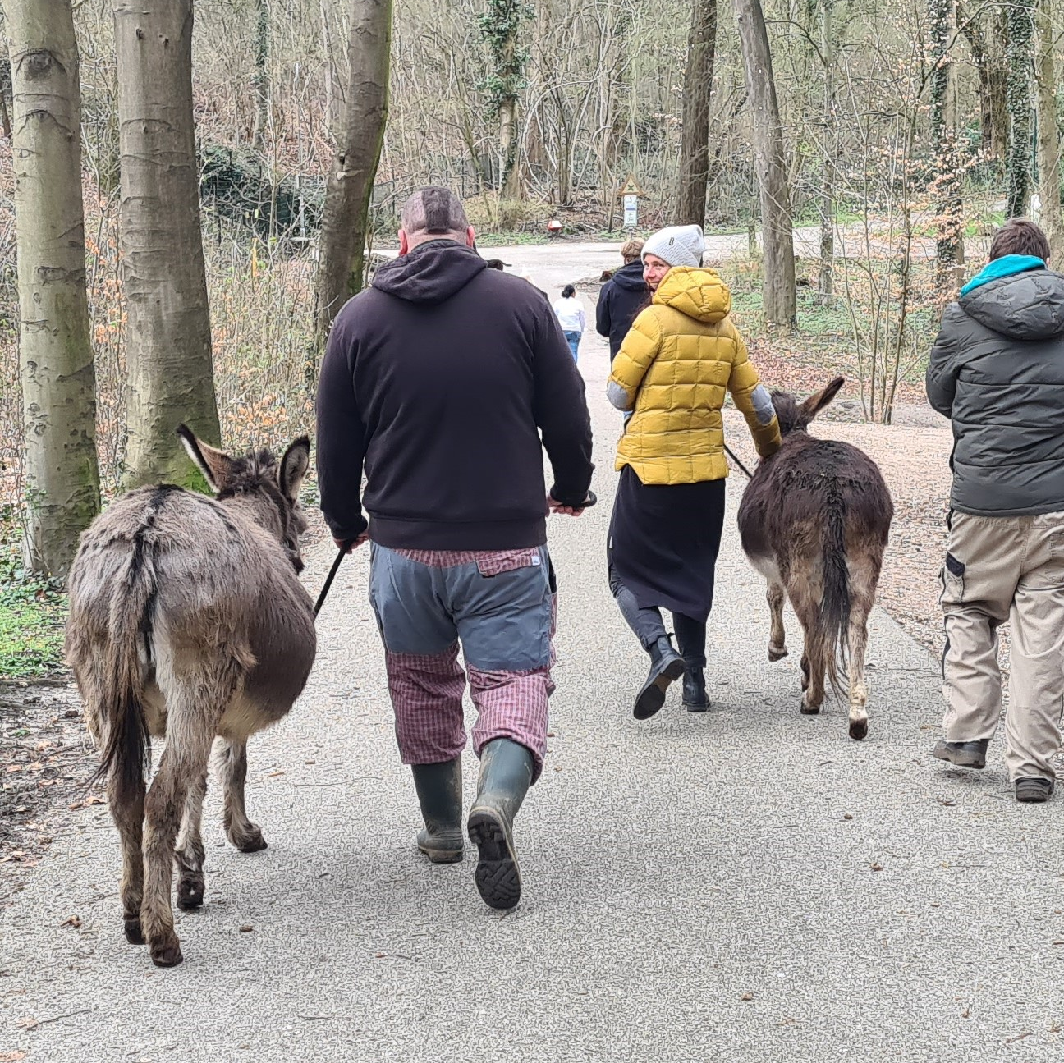
Social community
More social contacts
Demonstrating more social behaviour
Increase of perseverance

Slide 17
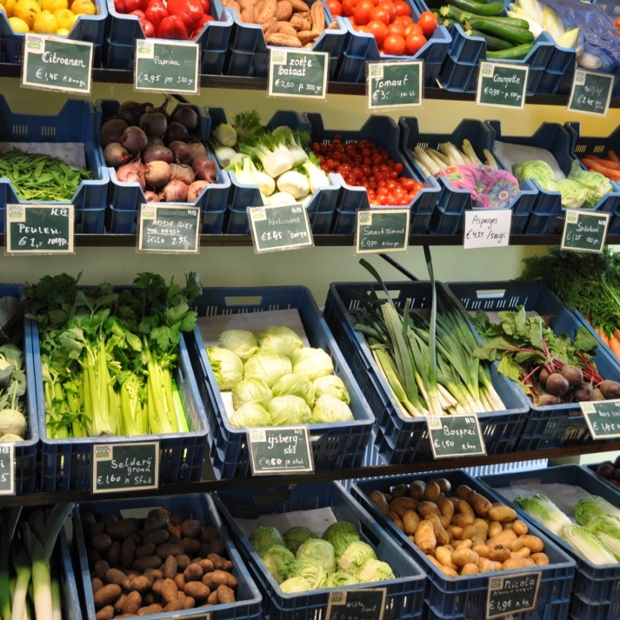
Useful and diverse activities
Distraction
Structure and routine
Different environment
Learning new competences

Slide 18
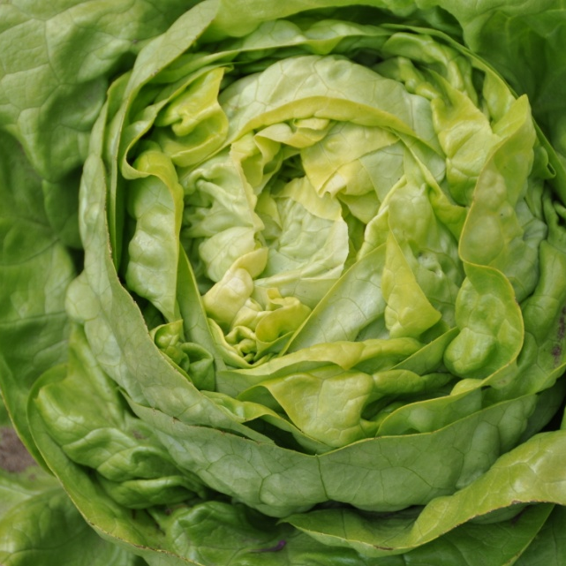
Green environment
A better mood
Improved concentration
Recovery from stress
Stimulates physical activity
Different environment than used to

Slide 19
Green environment
“Because it is not complicated, you are not distracted by emotions. It's lettuce, no more and no less, and the bad leaves you just pick off.” (Elings et al., 2011)
“[...] that everything that happens in your head that meanwhile all those little animals, if you look on the ground, all those little insects that all that goes on. That the birds continue to sing, it continues to be autumn and winter." (Elings et al., 2011)

Slide 20

Part 2: Development of the social farming sector in Europe

Slide 21
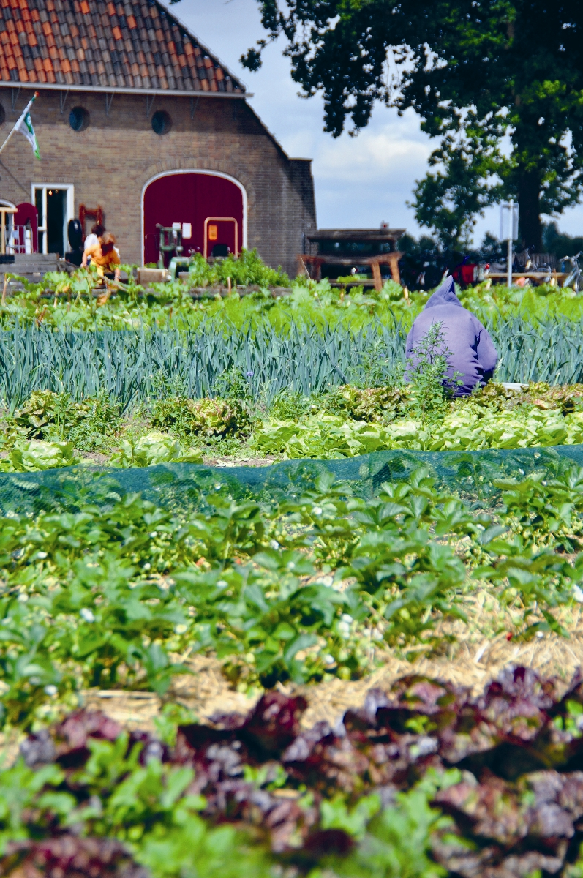
European perspective of social farming
Social agriculture is a fast growing sector in Europe
Different developments and systems in different countries
Innovate sector: combines health care, education and social services with agricultural production.

Slide 22
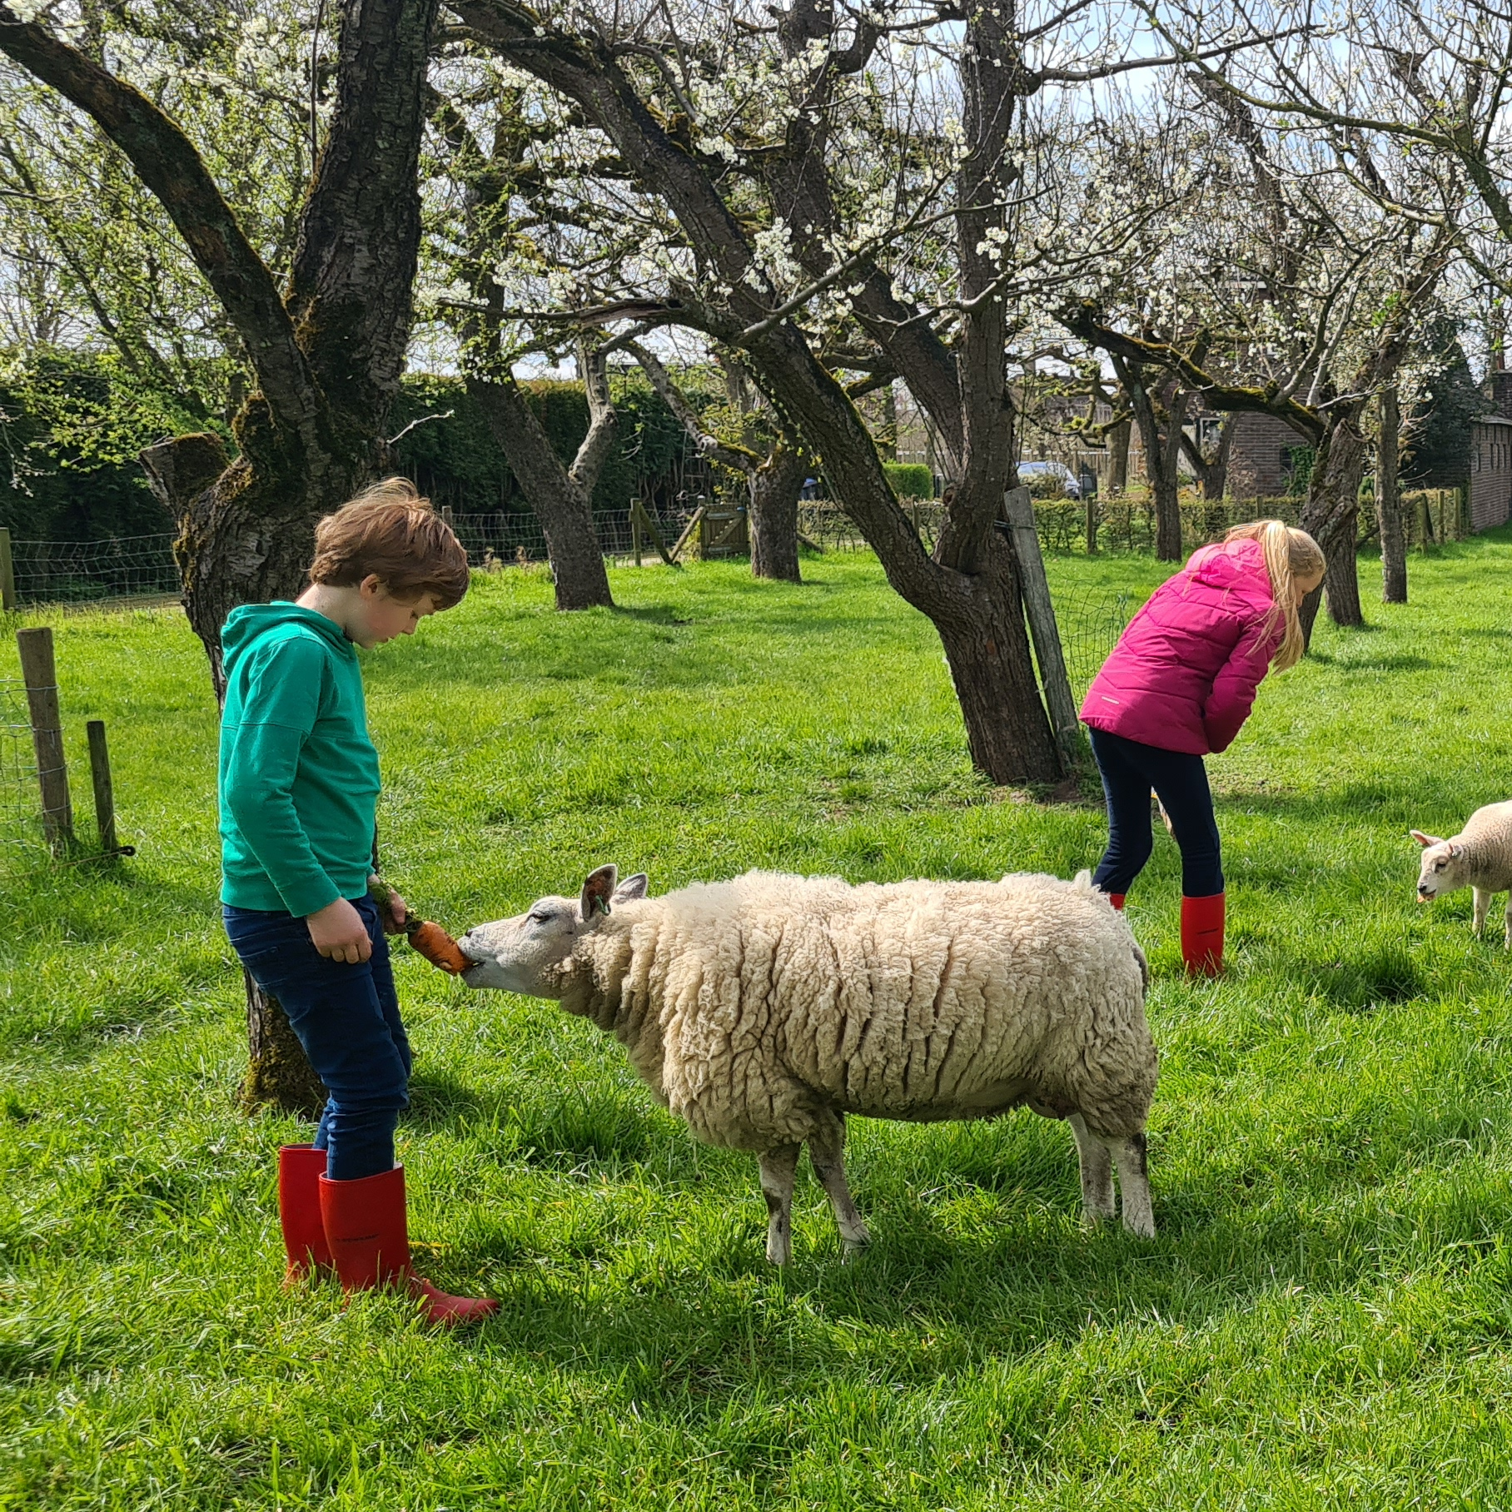
European perspective of social farming
Social farming builds on the concept of:
A more inclusive agricultural sector
In some countries to more sustainable production systems such as organic farming
In some countries ties in with developments in health care

Slide 23
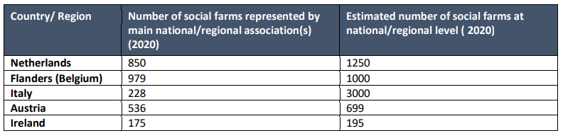
Some numbers

Slide 24
Some numbers
Of the countries where it is available, we see that:
In most countries, we see that the number of participants coming to social farms is growing (NL: 35.000, Italy: 15.000, Fanders: 2050)
Growth in revenues (f.i. NL revenues of the joint regional social agriculture organisations have increased from 11.3 million euros in 2011 to 88.6 million euros in 2018. At the moment the total revenues of the sector is estimated at 250 million euros, 200k on average per social farm)
But conclusion: in many countries, data from the social farming sector are still unavailable

Slide 25
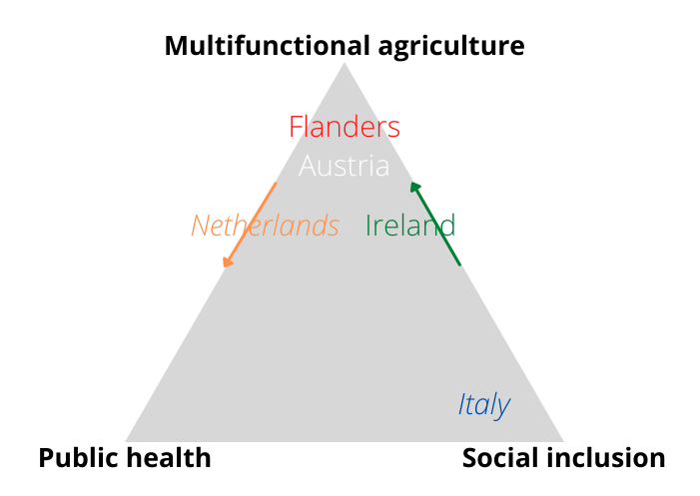
European perspective: different frameworks/discourses in social farming
Source: Green4C social agriculture market-outlook report (2021, Briers, O’Connor, Elings et al.)

Slide 26
Multifunctional agriculture framework
Social farming (SF) is one of the multifunctional activities of a farm
SF takes place on a private or family farm
Combination of commercial farming activities and care activities
SF is an economic activity
Farmer or farmer’s wife are the supervisor
Farmers are paid for care activities
Farmers are mostly no health care professionals
Ireland, Flanders and The Netherlands
Notes:
The social farms in Ireland, Flanders and most of the social farms in the NL fall under this framework

Slide 27
Public health framework
Social farming refers to activities that fall under health promotion, rehabilitation and therapy
Focus is on care services
Private or institutional farms (e.g hospital gardens)
Farmer provides the green environment
Green environment is seen as therapeutic for people with special needs
Farmer has no role in supervision
Professionals interacting with participants are health professionals or work supervisors
Professionals are formally employed and receive wages. Farmers might receive payment for providing farm setting
Germany, Austria and the UK

Slide 28
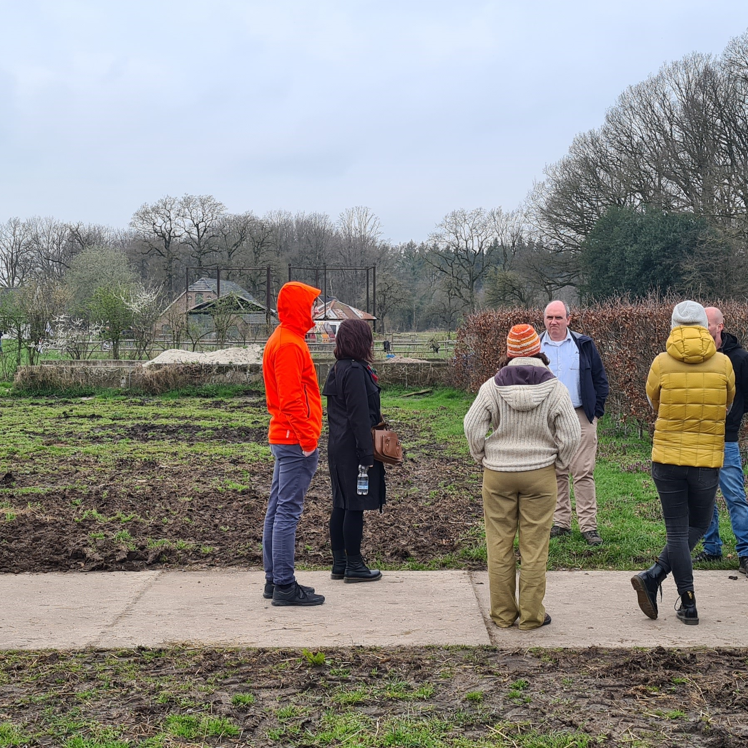
Social inclusion framework
Social farming contributes to the reintegration of vulnerable people in society by offering activities on the farm
Focus is social inclusion
Private farms, co-operatives or institutional farms
Supervision by farmer or social services
Participants are paid and sometimes the farmer
Italy
Notes:
Italy is the best example of a country with social farms that are often social co-operatives working together with regional social services.

Slide 29
Assignment
How, in your opinion would the social farming sector ideally be organised? And why?
How would you organize the social farming sector in Germany taking into account the German perspective and system?
Source: Briers et al., 2021

Slide 30
Funding
Influenced by different welfare models
The Netherlands:
Number of social farms increased because of innovations in financial structure of the healthcare sector
Personal budgets
Neo-liberal reforms of health care sector gave social farmers opportunity to have an accreditation and have direct contracts with municipalities
1998: 75 2022: 1300
Annual revenues of the SF sector increased from 11.3 million euros in 2011 till 88.6 million in 2018
Notes:
Although all EU countries are embedded in European policy and funding opportunities, we see that social farming financing shows that different welfare models influence the way in which social agriculture is financed across Europe.

Slide 31
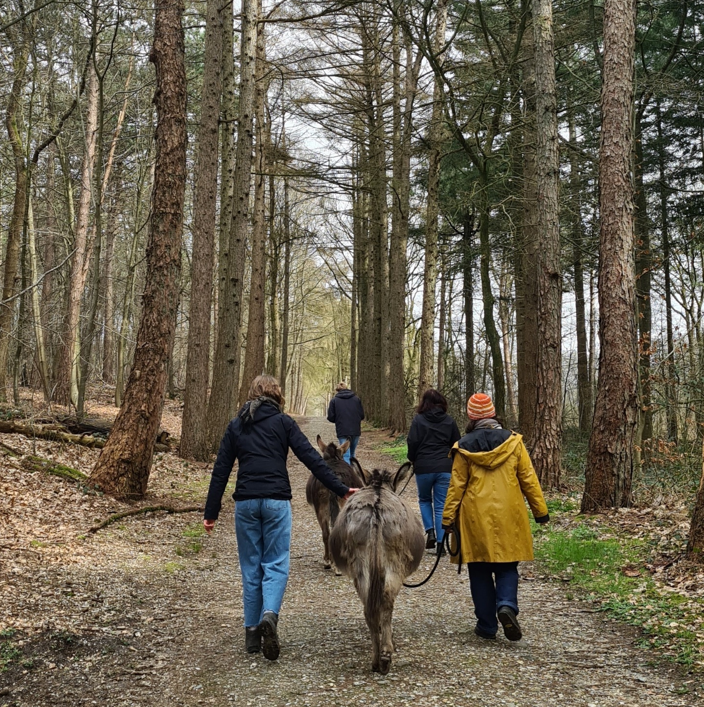
Funding
Italy:
Funding for social farming (SF) comes mainly from the European Agricultural Fund for Rural Development but no data available on the specific amount
SF activities are not reimbursed by public health care systems
Often the participants are paid rather than the farmers

Slide 32
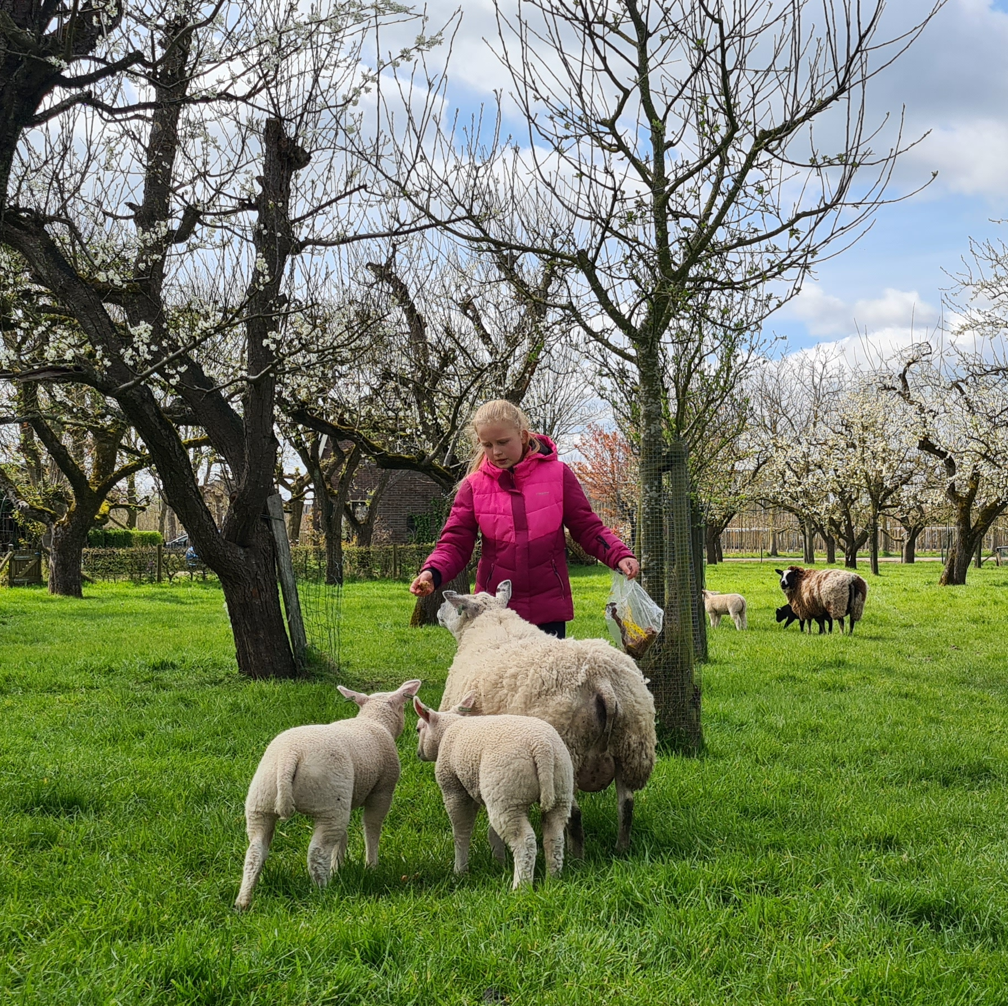
Funding
Flanders (Belgium):
But mostly farmers receive a Compensation of the Flemish Department of Agriculture and Fisheries for offering SF activities
40 euros per day irrespective of the number of participants taken onto their farms

Slide 33




Quality assurance and certification
Differences between countries
The Netherlands, Norway, Flanders (Belgium), Austria and Ireland have a kind of National Support Centers or franchise formula
The Netherlands have the Dutch Federation of Care Farms
Flanders (Belgium) Green Care support centre
Austria has green care Austria ‘Wo Menschen aufbluhen’
Norway has ‘In the courtyard’

Slide 34

Quality assurance and certification
The Netherlands:
Federation of Care Farms, quality systems since 2000
Quality mark, farmers need to comply with laws and regulations, every 3 years an audit
Flanders (Belgium)
Quality is guaranteed by co-operation between social farmer and a care or welfare organisation

Slide 35
Key success factors in the development of the Dutch social farming sector
1990’s: Isolated initiatives, lack of legitimacy and no financing
In line with objectives Ministries of Agriculture and Health Care
  Support ministries
  National support centre (networks, database, quality system)
Changes in regulations (personal budgets and liberalization of health care sector (new entrants)
Regional collaboration and entrepreneurship
  Professional regional organisations
  New services initiated by care farmers
Notes:
I would like to come back to the start of my presentation: the development of the social farming sector in the Netherlands. Because today we are in Prague to talk about building a social farming sector and network in Czech Republic. I can imagine if you hear the stories of the other countries like the NL there is a lot not known for the future but if we look 20 years back from now there was no social farming sector in the NL so the development of such a sector can be rapid.
What were the key success factors in the swift development of the Dutch social farming sector?

Slide 36
Clever strategies
Pioneers
    Looking for support from influential persons; parents of clients, media, alternative financing
Support Centre/ Federation of care farmers
    database, PR, quality system, connecting to policies, promoting research
Regional organisations:
    Framing to be innovative (focus on clients, innovative services, meeting demands of municipalities and ministries) and professional
Care farmers at this moment
    Good relation municipality, focus on participation, collaboration and being part of chain
Notes:
Next to that we see that the social farming sector is successful because of some clever strategies.

Slide 37
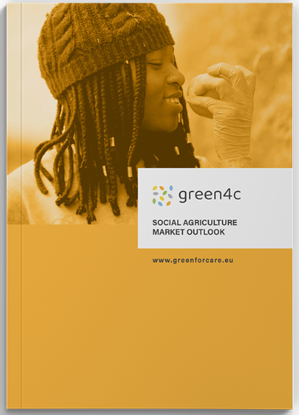
Market outlook report
Developments of the social farming sector in Europe
Future prospects of the social farming sector in Europe
www.green4c.eu
Notes:
On of the results of this project is a study done on the future perspectives of social farming in Europe. If you are interested you can download this report from our website.
The next couple of minutes I will tell something about the SF sector in Europe using the results and data from this report.

Slide 38
Future of social farming in Europe: broadening of target groups and activities
Historically focused on activities for people with disabilities or mental health issues
Recently increase of demand from other groups: elderly, school drop-outs, refugees, school children
Changing demand also different types of social entrepreneurs and business models are needed
Discussants stressed the unique role of and contact with ordinary farmers and their families
Diversification in terms of participants profiles will allow for other sources of funding

Slide 39
Future of social farming in Europe: visibility
Importance of communication
Social farming not only beneficial for participants but also (economically) beneficial for farmers and rural areas
Positive image of agriculture
Play a role in communicating the role of farming in food production
Important role of national federations of care farmers to disseminate best practices and develop evidence base on the social farming sector

Slide 40
Future of social farming in Europe: open up to a wider audience
Social agriculture can play an important role in making green spaces more accessible not only for people with disabilities but to the wider public

Slide 41
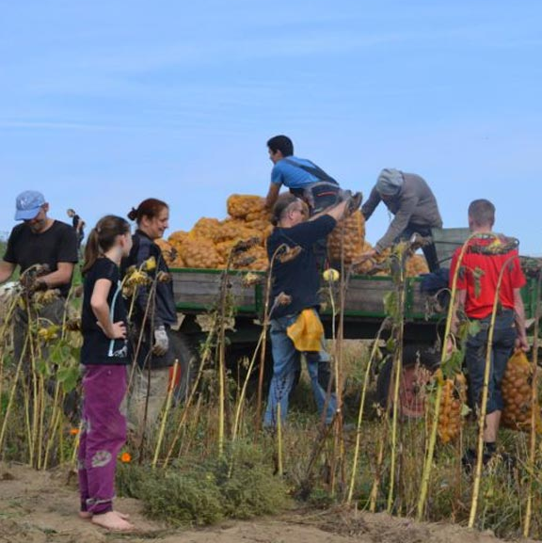
Part 3: Evidence base: research on social farming

Slide 42
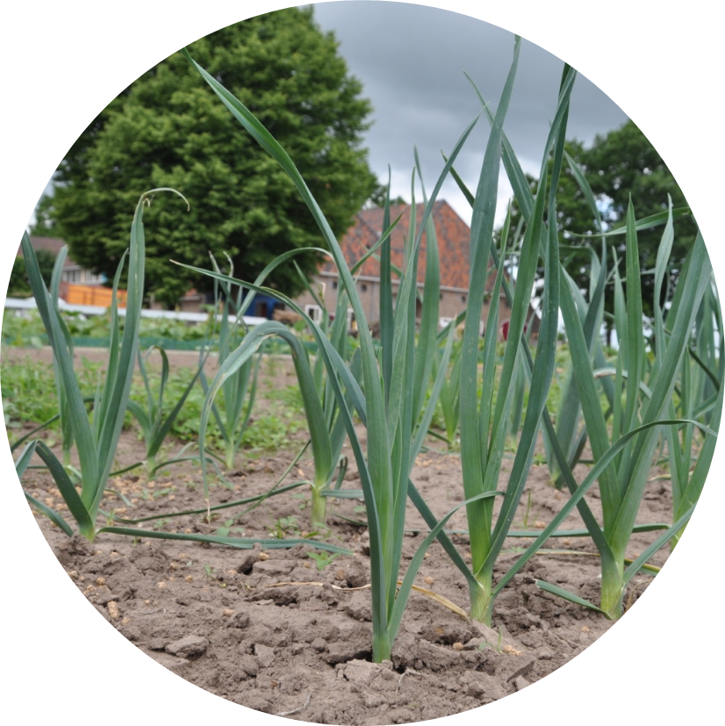
Research on the effects of working on social farming for participants
Evidence base is necessary in healthcare to receive reimbursements for interventions or to convince consumers that you are providing good health care
In addition, it is important for the development of your care practice: am I doing the right thing, and does it have a positive effect on the clients? Also, for the development of your practice
But how can we best study the effects of care farms?

Slide 43
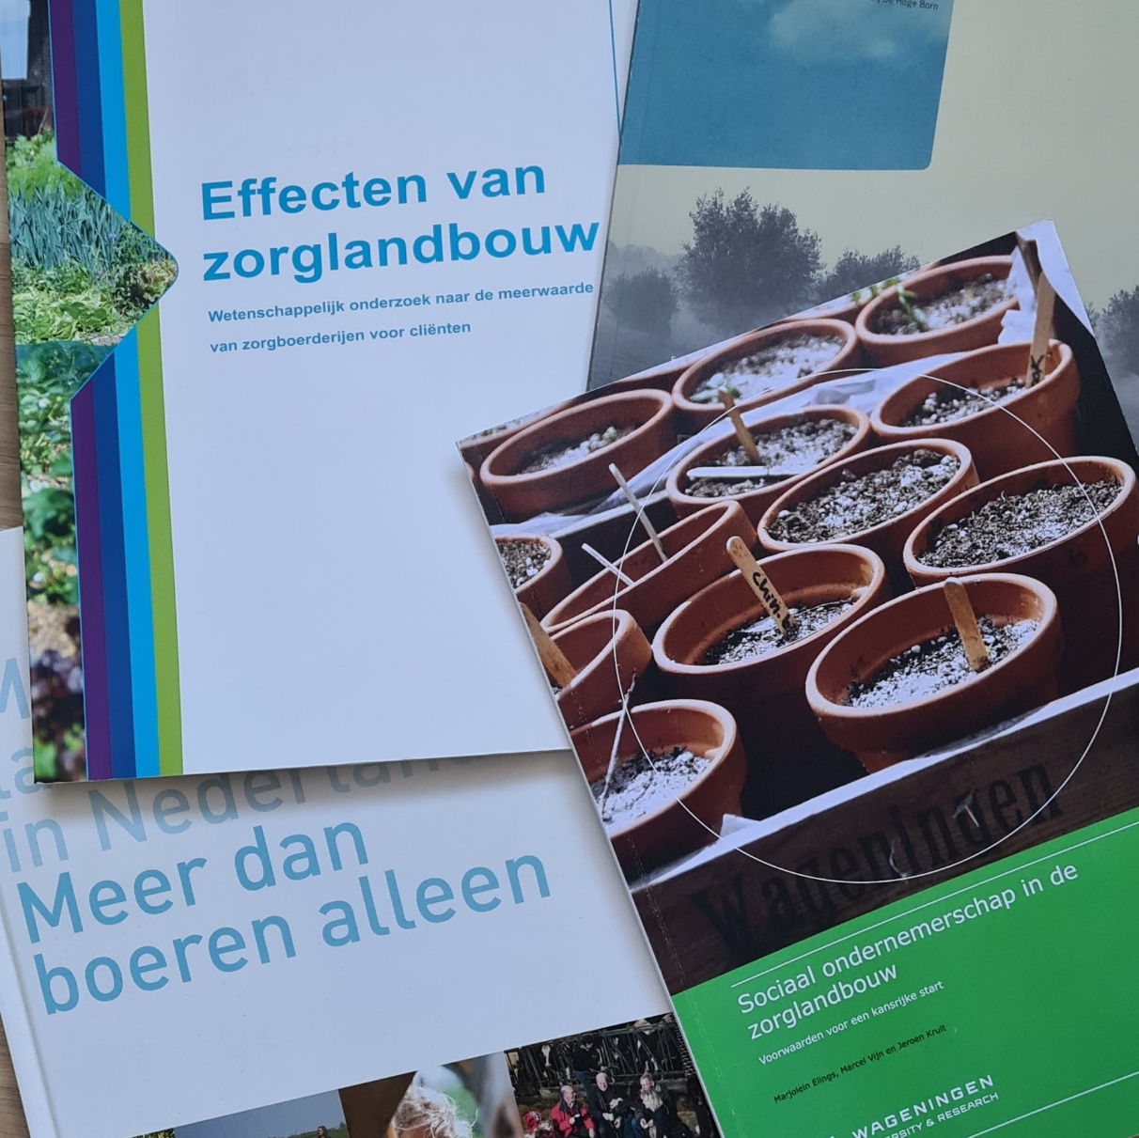
Doing research
Evidence base practice
Quantitative research by RCT (randomized control trials) or experimental design using standardized surveys
Surveys did not capture the holistic approach of social farms
Qualitative research
Insights in how the farm environment is beneficial for participants

Slide 44
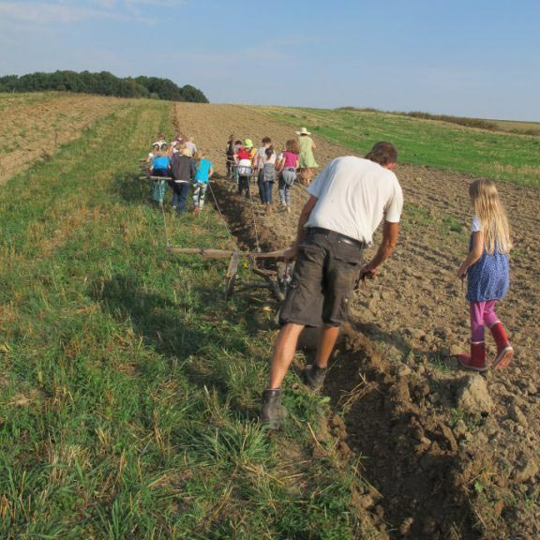
People with learning difficulties see the farmer as:
A: role model
B: friend
C: employer
D: boss
Notes:
Answer A. From research of Elings on the importance of being a commercial farm for people with learning difficulties it becomes clear that this target group finds it important to have a real farmer on the farm. For these participants, the farmer is an authority, an authentic figure. As often said, "I want to be like farmer Pete" or participants tell that they come to the farm to help the farmer

Slide 45
What aspect on the social farm do people with mental health challenges find most important?
A: working with animals
B: caring for plants
C: being part of a community
D: having meaningful work
Notes:
Right answer D:
In focus group meetings with more than 40 people with mental health challenges, it becomes clear that they particularly enjoy being part of a community on a farm. As someone puts it: "You work with colleagues, the farmer and the farm family. All this happens in a safe environment where they are aware of your problems (Elings, et al., 2011)."

Slide 46
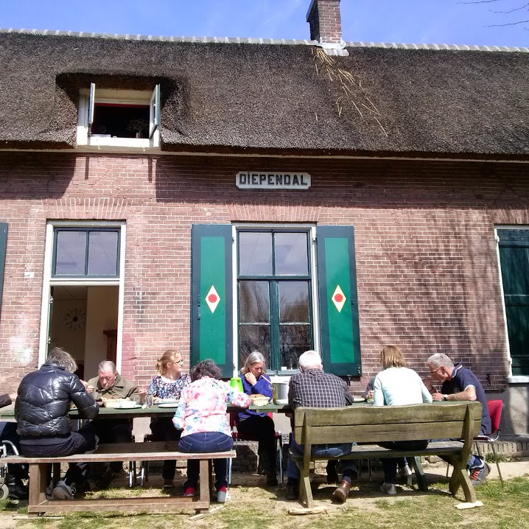
What aspect on a social farm do people with an addiction history value the most?
A: the animals
B: the farmer's respect
C: the social contacts
D: being outdoors
Notes:
Right answer is: C
In a study of Elings et al., 2011 people recovering from addiction indicate in interviews that they are actually surprised by the farmer's openness. People with a drug or alcohol addiction who walk the streets, for example, are used to being looked at with the neck, nobody respects them and they are a burden to society. They thought farmers would have the same attitude but social farmers open their farms and yards to these people and show respect for the work they do and this feels good.

Slide 47
Effect study: Youngsters with behavioural problems
Notes:
In a quantitative research on the effects of staying on a farm for youngsters with behavioural problems Hassink et al., (2011) saw a significant positive change after the program for the use of drugs, contact with the police and behavioural problems.

Slide 48
Effect study: People with mental ill health/addiction
Quasi-experimental setting
Follow-up T=0, T= 1 (half year) T=2 (one year)
N=149
No significant change on quantitative data
No negative change in QoL, mental health or social functioning
Decrease of use in medicine
Highly satisfied with care on farm (8.2 and 8.3)
Notes:
Together with the Dutch Mental Health Institute Elings et al., 2011 did a study were they followed 149 respondents that had day activity on either a farm or another day activity centre. Unfortunately the results show no significant positive change on QoL, mental health or social functioning. But there was also no negative change on these outcome measures. What we find is a decrease in medicine during the year we followed the partctipants. Next to that we also measured the satisfaction. On a scale from 1-10 the farms scored a 8.2 on how satisfied they were about the work on the farm. The coaching from farmer and/or farmer’s wife got a 8.3.

Slide 49
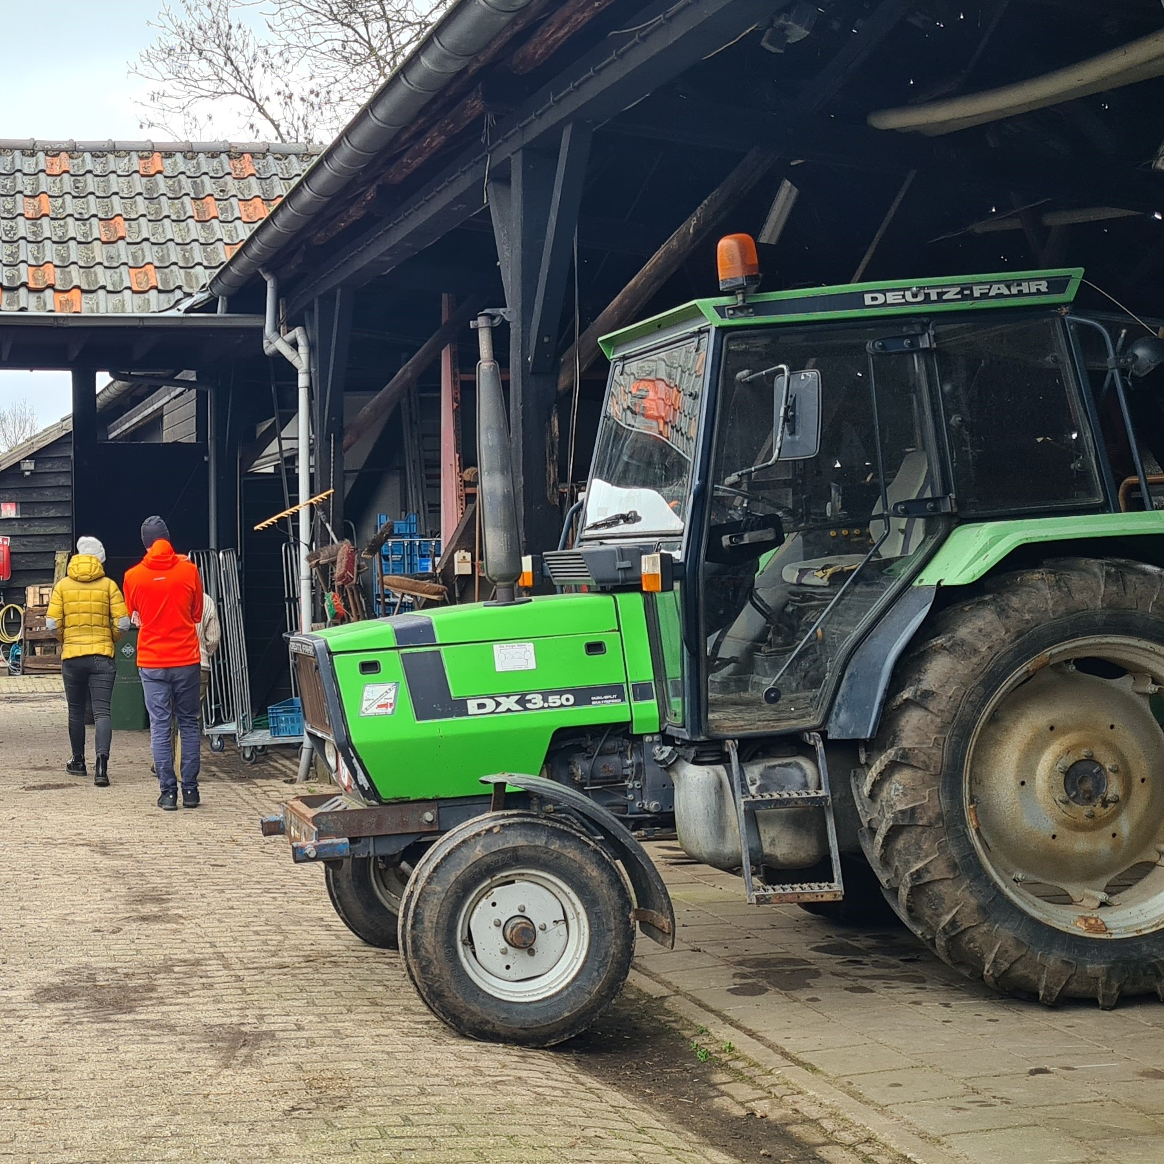
Elderly with dementia
Quasi-experimental
Care farms – regular day care
Positive significant change in dietary intake
Relief of informal care takers
Notes:
In a quasi-experimental research of Simone de Bruin (2009) she compared day care on farm and regular day care for elderly with dementia. From this study she found a significant positive effect on the dietary intake, more intake of carbohydrates and fluid on the elderly that had day care at the farm in comparison with the elderly on regular day care. Next to that the results also show that care farms can give informal care takers some relief. We see for instance that care farms in the NL especially popular with male elderly because they have often not that much alternatives besides handknitting or something like that in the regular day care.

Slide 50
Effects of working on a social farm for participants
Physical well-being
Mental well-being
Social well-being
Spiritual well-being
Notes:
The different elements and qualities of the care farm also have an effect on participants' well-being. In the following slides, I would like to talk about the effect that working on the farm has on the physical, mental, social and spiritual well-being of participants.
In the impact research I did on people with mental health problems and/or recovering from addiction, I looked at what working on the farm means for their physical, mental and social well-being. In addition, we recently added a fourth in the SoFarTEAM project, namely spiritual well-being.

Slide 51
Physical: getting in motion
Getting in motion
Structure and rhythm
Getting physically stronger
Better appetite
Use of senses
Balancing energy
Getting tired
Feeling your body

Slide 52
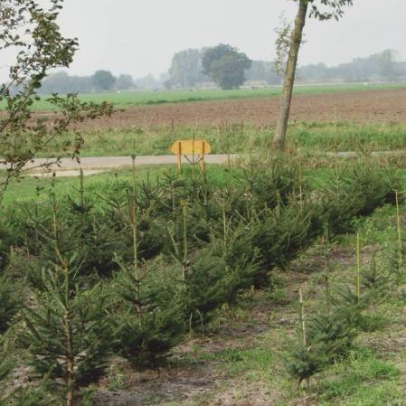
Physical well-being
"This is where I learnt my first lesson of 'smart hoeing' so not going at it like crazy, putting all your feelings into it and being broken quickly. Becoming aware of how I work and finding your own rhythm." (Elings, Baars & Hassink, 2008)

Slide 53
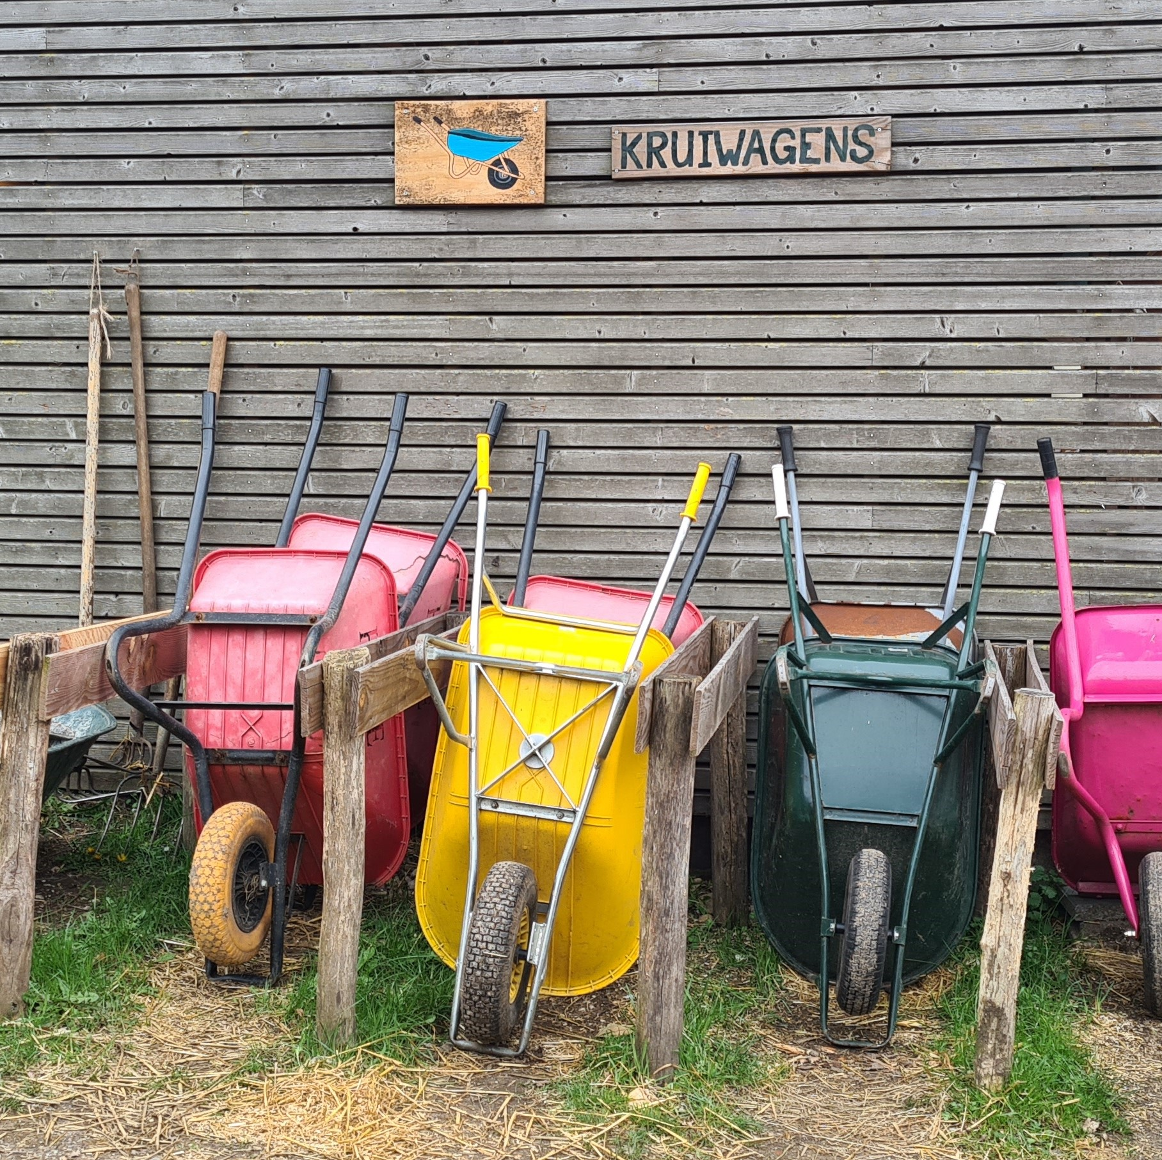
Physical well-being
"We used to live much more with the seasons now summers are as long as winters because you can turn on the lights and the stove at home. With that, you miss the rhythm of the seasons as you retreat in winter. Working on the farm gets people back into their rhythm." (Elings et al., 2011)

Slide 54
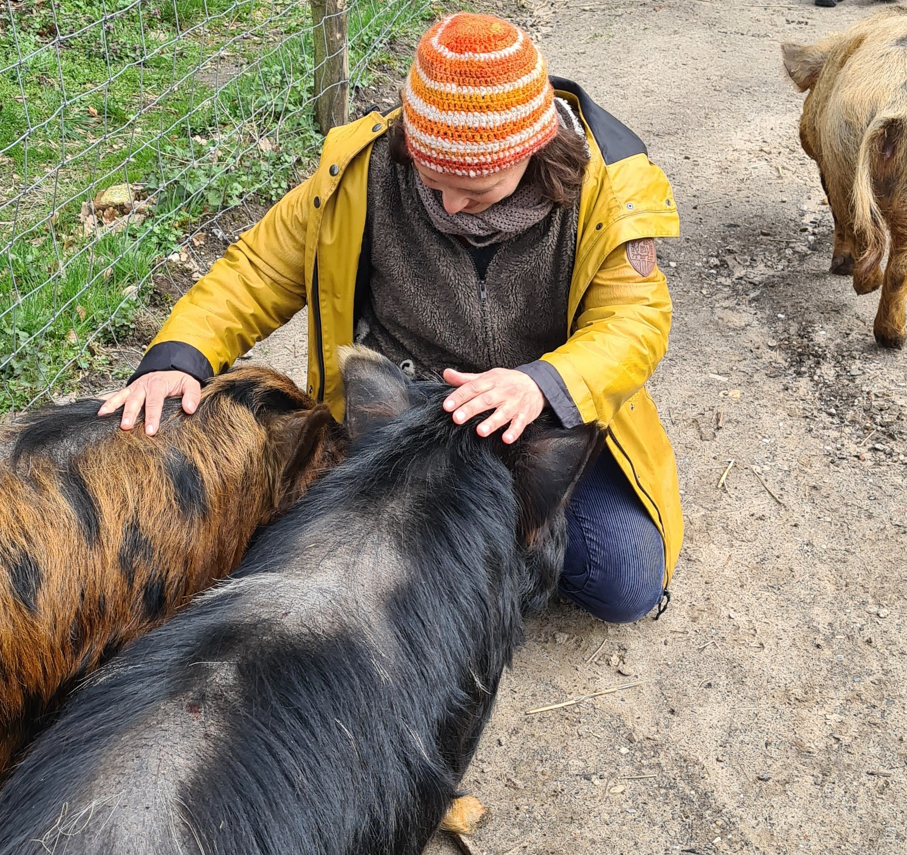
Mental well-being
Aim for the day
Increase in self confidence and self-respect

Slide 55
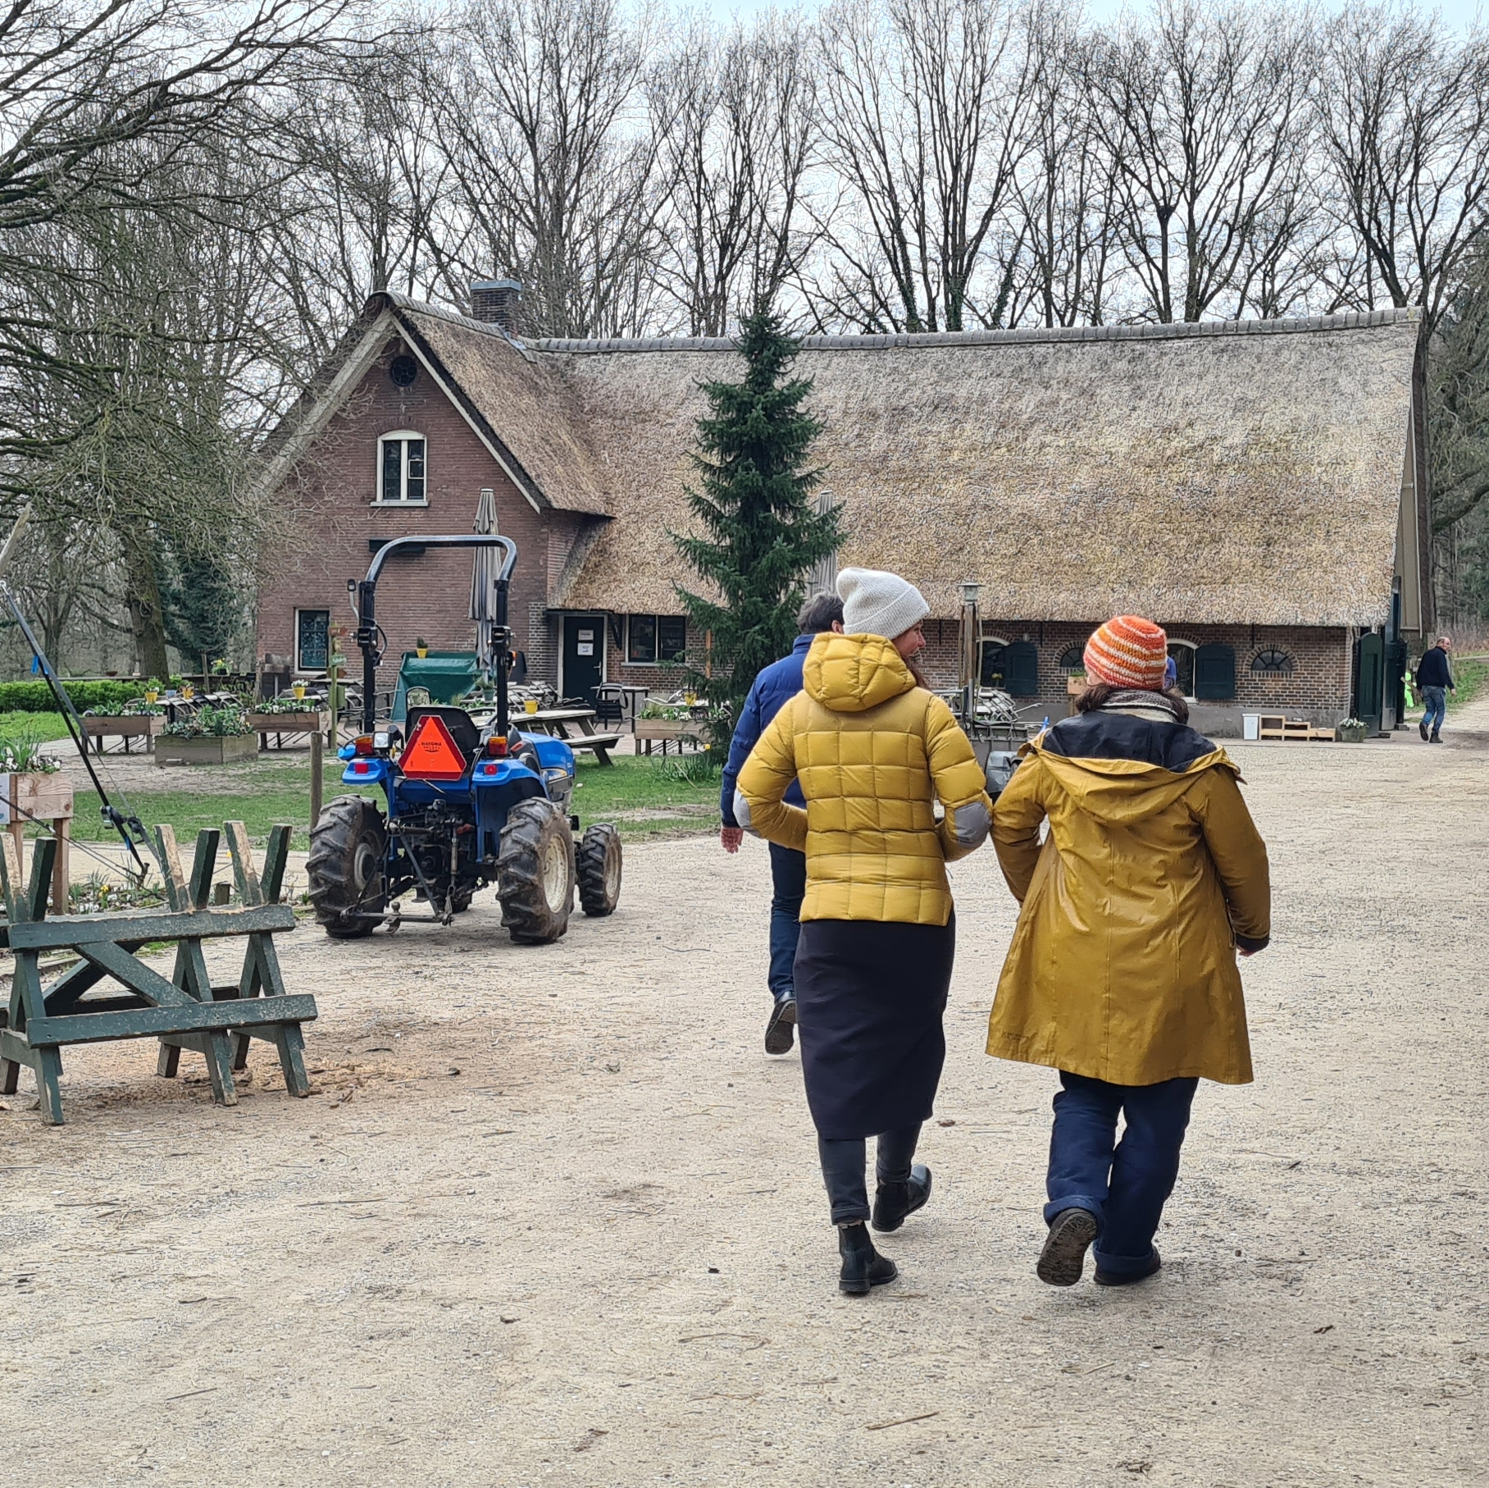
Mental well-being
"You are working on something and you see results. I always say when plants come into my room they kill themselves immediately, I thought that will never work here at the farm. And then I had planted or sown something and I liked it so much and then you just see it grow and come to life [...] then I hadn't been to the place for a month and then the green beans were up to 1.5 meters high, then I was completely amazed. I think I told everyone. Then the confidence comes back anyway. I've had three years where I could hardly do anything. And then here I have a gigantic result with that little bit of energy." (Elings et al., 2011)

Slide 56
Mental well-being
"Self-esteem and self-confidence that has increased tremendously for me. You have the opportunity to make a success of things here, you grow from that. And I also notice something like that in my environment, which reacts very differently to me than when I came out of the clinic. That's because of more self-confidence, before I felt like I was walking with a sign around my neck saying 'junk.”(Elings et al., 2011)

Slide 57
Mental well-being
Increase perseverance
Calm down
Increased commitment and responsibility
Thinking more about yourself
Notes:
The rhythm on the farm, having to get up and arrive on time increases participants' perseverance. They learn to stick to certain agreements and if they are assigned certain tasks, such as feeding the cows, that is their responsibility. Taking care of the plants and animals also gets participants involved. They are curious to see how the animals and plants are doing and feel responsible to come to the farm and take care.
Social farmers and supervisors see participants unwind on the farm. First of all, this is because there is little or no work pressure on the farm. Secondly, the farm offers space to work alone if you want to and the environment offers less stimuli. It therefore also offers space to think about yourself. (Source: Elings et al., 2011)

Slide 58
Mental well-being
“When people are too much in their heads, I say: go and weed with your hands instead of with the hoe because then you are closer to the soil.”

Slide 59
Mental well-being
"To learn to enjoy small things. People are used to thinking big, if I have a lot of money then...they don't dwell on the fact that small things can also bring joy like birds nesting here at the farm."

Slide 60
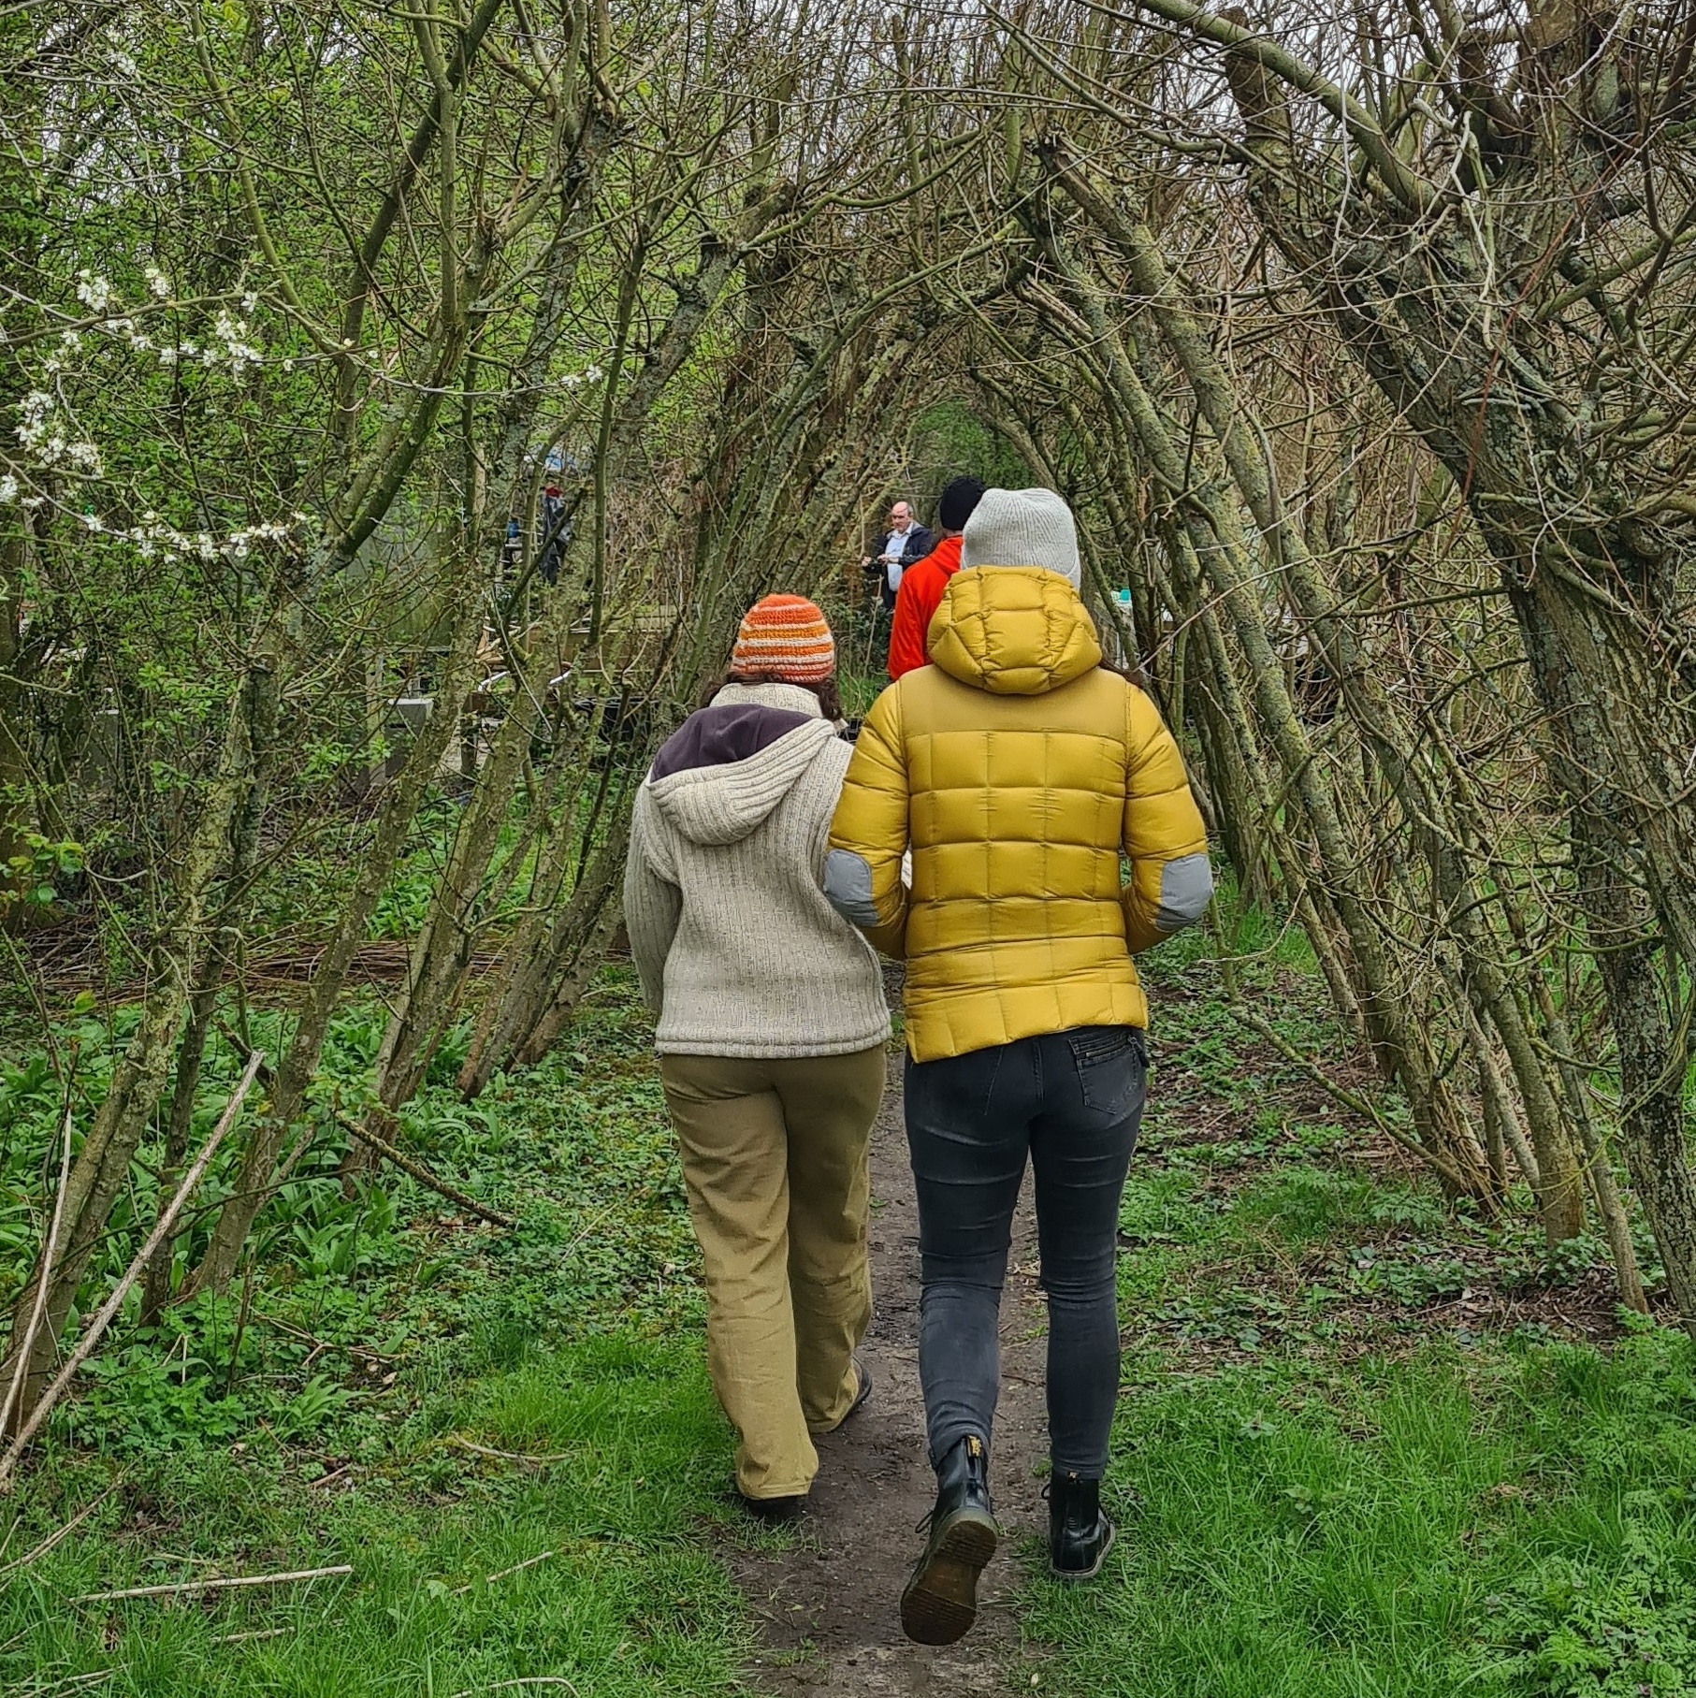
Social well-being
Increased social contacts
Opportunities to practice social interaction
Keeping appointments
Respect from others
Notes:
On the farm, you work together in a group that in that way you get to know new and different people. Some participants also learn how to make social contacts and how to work together. And not unimportantly: you experience something on such a day on the farm and that in turn provides food for thought for contact with others. Birthday example. You don't have to answer: I'm sitting at home drawing benefits from the government. For participants recovering from addiction, it is a way to leave their old world and scene behind.
Once participants feel at home at the farm, it also ensures that they keep appointments more easily because they enjoy coming or encourage each other to do so (this is especially true for people from addiction care). Source: Elings et al., 2011.

Slide 61
Social well-being
"They can rearrange their lives a little bit, they can say: I have to go to work tomorrow so can't meet up [...] they don't get clean from that but it does give them structure and a certain status, that they go to work and that this is what the boss requires.“ (Elings et al., 2011)

Slide 62
Social well-being
"The children who come here have always struggled at school, struggled to make relationships, if you then have a place where you can do things together that is very important."

Slide 63
Social well-being
"Man, group portrait of diversity, I love that, from highly educated to less educated, from religious to non-religious and each person brings a story and together you could write books of what you experience. You experience a lot together. That's because both nature and people have a certain dynamic."

Slide 64
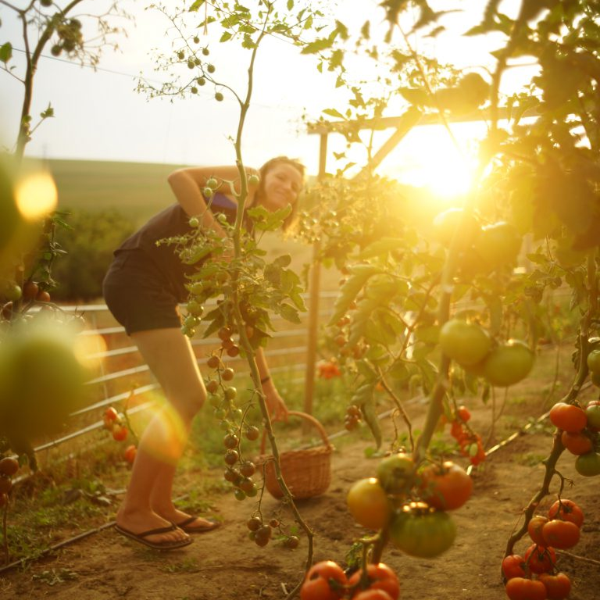
Spiritual well-being
Wonder/fascination
Experiencing seasons
Feeling part of a bigger picture
Notes:
And finally, working on the farm also has an effect on participants' so-called spiritual well-being. This involves participants being amazed by nature, by how plants grow or how beautiful the behaviour of animals can be. That they feel more connected to nature and also experience the seasons more and that they therefore also feel part of a greater whole. And on the one hand, this is about the fact that as a person they are important in this greater whole and that they matter, and that they can make a difference, for example, but on the other hand, it is also about putting things into perspective, that despite everything, for example worries, quarrels and problems, nature will take its own course and it will be summer, autumn and winter, and that this can also be a metaphor for people not to worry too much because things will eventually turn out all right.

Slide 65
Spiritual well-being
"To see the small beauties in nature for instance a beautiful bird and to name that too. Even though the world is very dark at the moment that people can still wonder."

Slide 66
Spiritual well-being
"The contact with nature and what effect that has on your worldview. That you have to take care of nature and that it is nice there. You lay a foundation for that. We also do nature and environmental education here and you do create ownership with that."

Slide 67
Assignment 1
What do you think are the key working elements of social farms?

Slide 68
Assignment 2
How, in your opinion would the social farming sector ideally be organised? And why?
Source: Briers et al., 2021

Slide 69
THANK YOU FOR YOUR ATTENTION
Name of Lecturer
  Institution of Lecturer
name@xyz.com

Slide 70

Farming with Refugees and forced displaced people - Agriculture as a path of inclusion © 2023 by SoFarTEAM is licensed under CC BY-NC 4.0.
To view a copy of this license, visit http://creativecommons.org/licenses/by-nc/4.0/
The slides were created by Marjolein Elings
Contact:
Wageningen University & Research
Droevendaalsesteeg 1
6708 PB Wageningen, Netherlands
marjolein.elings@wur.nl

